Slide 1
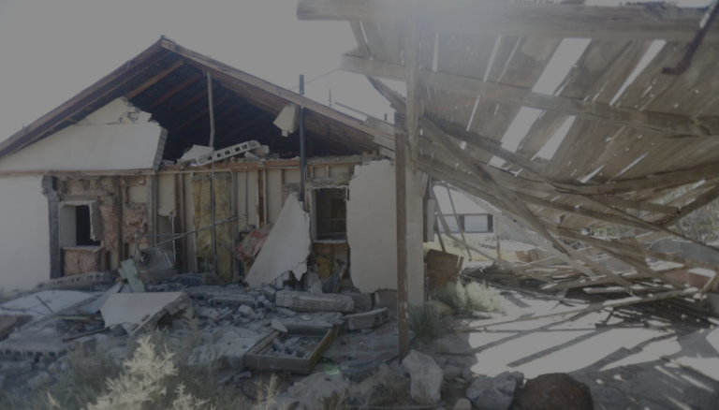
Aftershocks From the 2019 Ridgecrest Earthquake Sequence
Robert Ni
Image Source: PBS News

Slide 2
Ridgecrest and the ETAS Model
ETAS: epidemic-type aftershock sequence
Steps:
  Fit ETAS model parameters to Ridgecrest earthquakes
    July 4, 2019 to July 4, 2020; M>2.5
  Produce simulated ETAS catalogs from model parameters
Challenges + Takeaways:
  Way too simple to characterize complex fault interactions

Slide 3
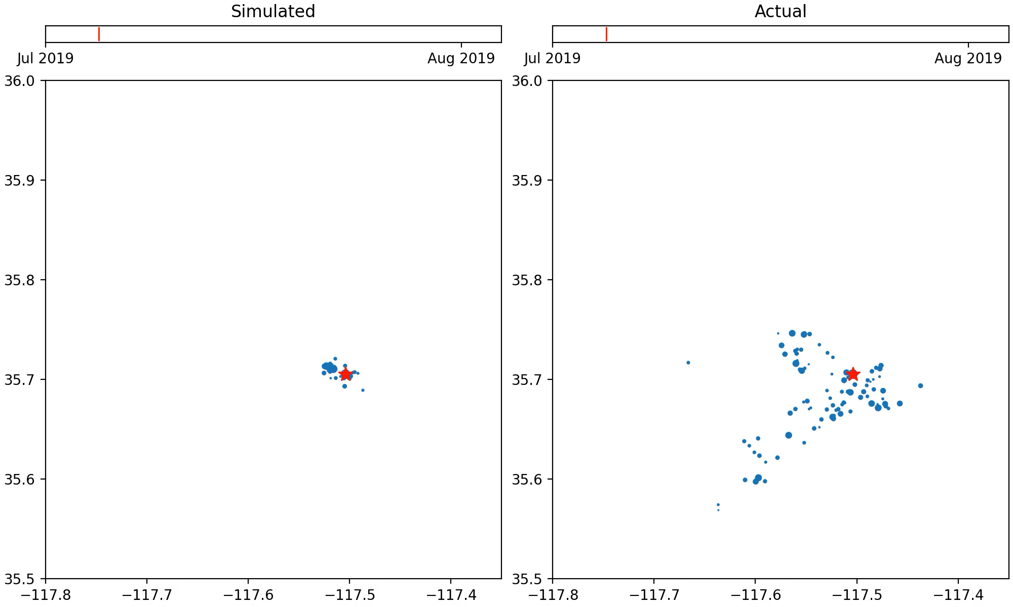
Simulated Catalog vs. Actual Sequence

