Slide 1
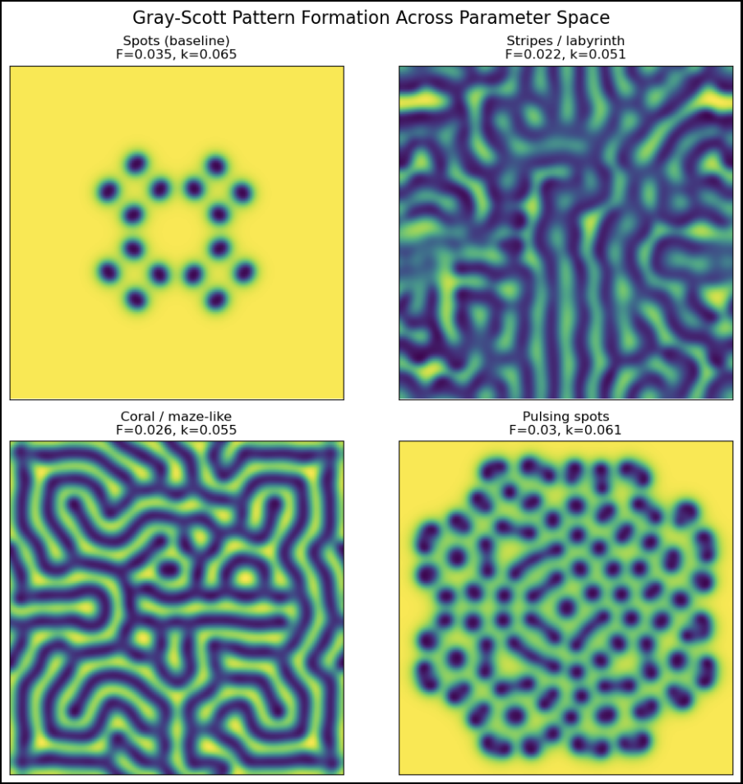
Pattern Formation in
the Gray-Scott
Reaction–Diffusion
System:
How Nature Paints Life
Using Chemistry and Math
Rheanna G. Mahboobani

Slide 2
Pattern Formation in the Gray-Scott Reaction-Diffusion System
What Does This Mean?
Reaction
Two chemicals interact and change each other
(such as pigments forming or dissolving)
Diffusion
Chemicals spread out over space
like dye in water
Pattern Formation
Small random differences grow into structured patterns: spots, stripes, and waves
Gray-Scott Model
A mathematical model combining reaction and diffusion to produce biological patterns
Goals
Simulate the Gray-Scott reaction-diffusion model
Understand how reaction and diffusion create biological patterns
Reproduce spots (like leopards), stripes (like zebras), and coral-like waves
Study how changing parameters alters the final pattern
Method
Two coupled PDEs describing chemical species U (activator chemical) and V (inhibitor chemical)
Finite difference spatial derivatives
Explicit Euler time stepping for simulation
Useful for understanding how cells self-organize during development, leading to patterns in nature like animal coats, seashell markings, and tissue organization in embryos.

Slide 3
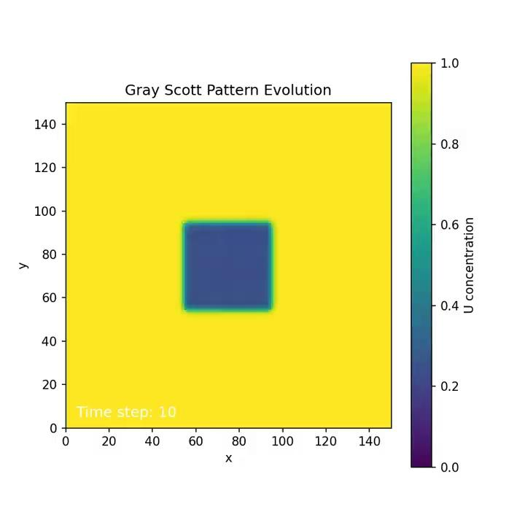
Animation
Chemical V - Activator
→ V appears only in seeded regions, converts nearby U into more V, and forms spots/stripes.
Chemical U - Inhibitor
→ U starts everywhere, is consumed by V, and diffuses quickly to smooth out the pattern.
What’s Happening?
→ Yellow chemical U spreads fast and tries to smooth everything out.
→ Blue chemical V grows in clusters by consuming U.
→ Their competition creates these natural patterns.

Slide 4
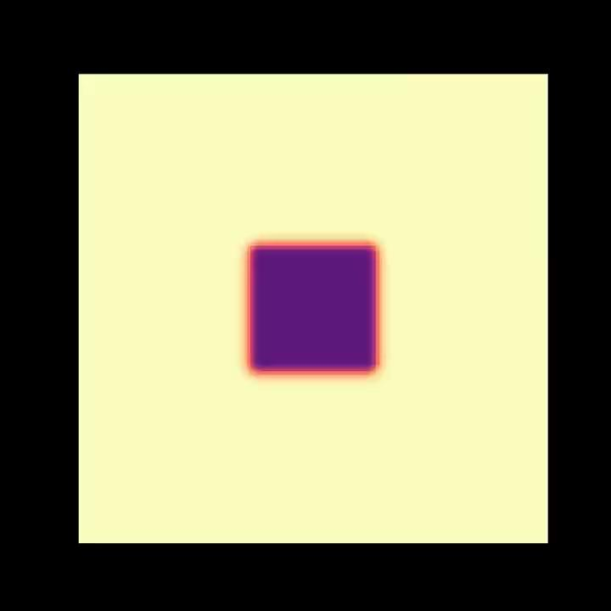

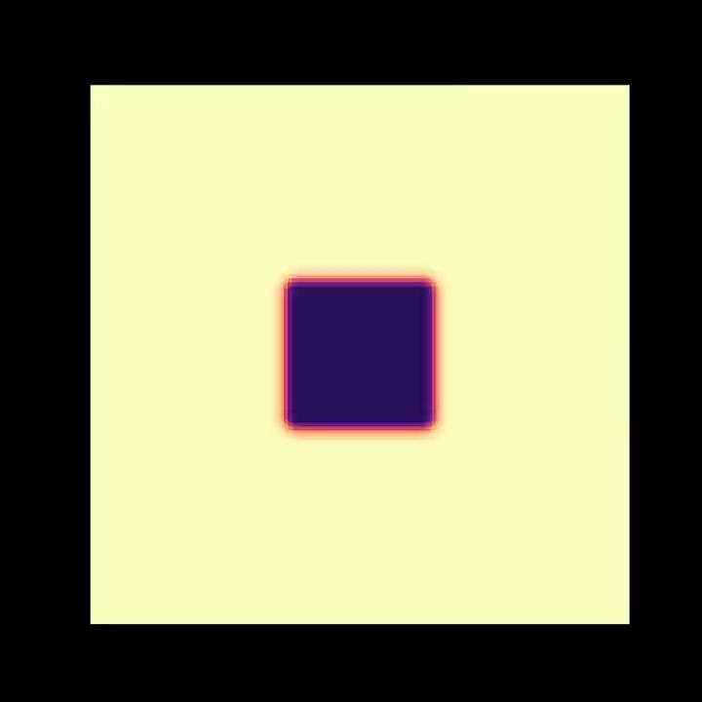
What Happens if We Change the Parameters?
Spots
Scales
Corals
F=0.035, k=0.065
F=0.022, k=0.051
F=0.026, k=0.055

Slide 5
Thank you

