Slide 1
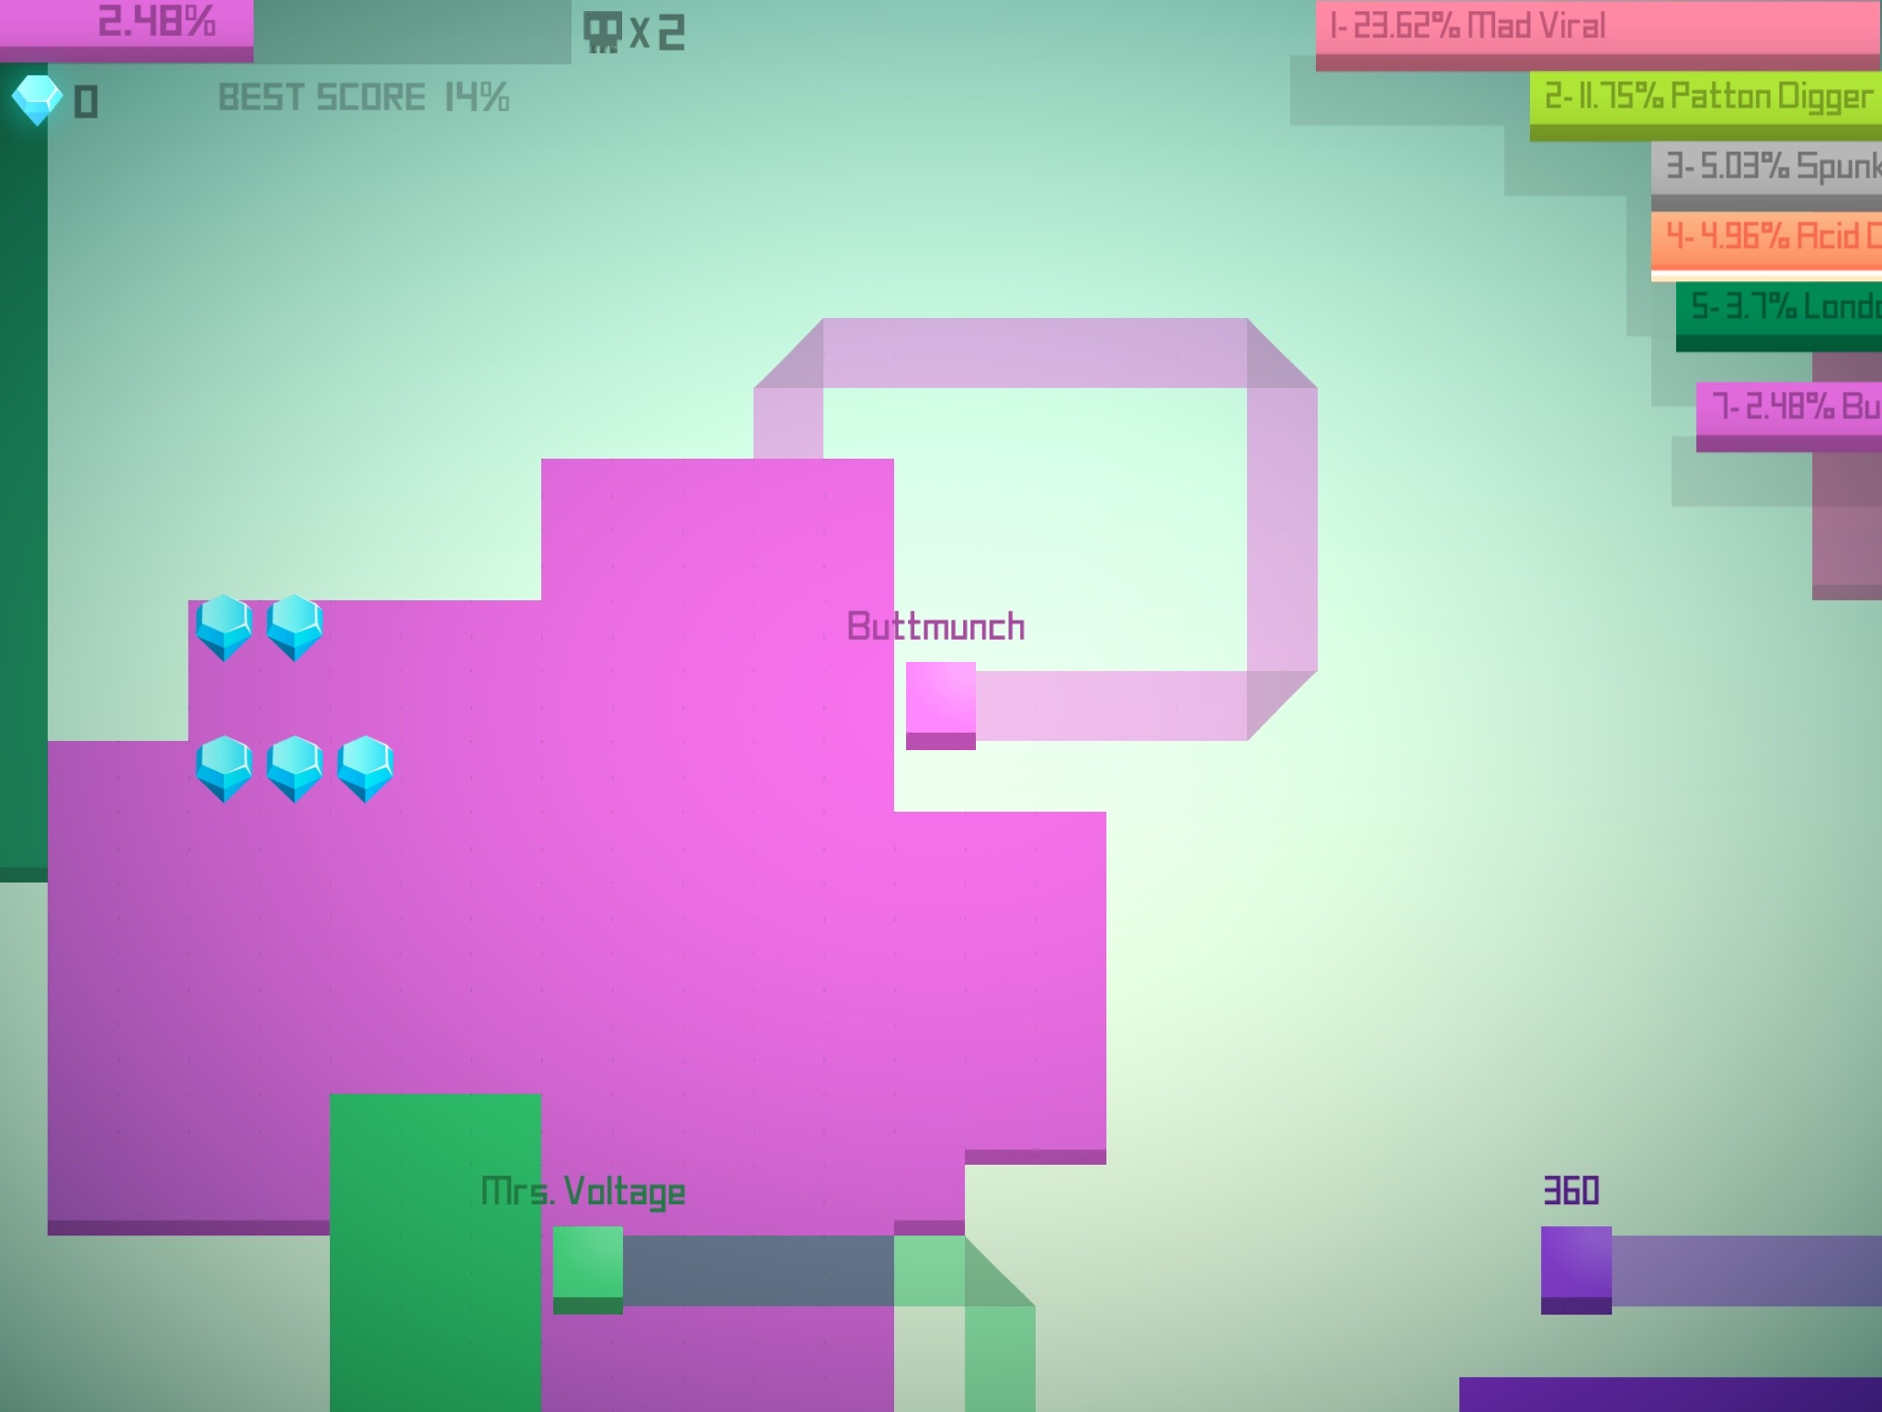
Simulating Agent Territorial Battle
Professor Burkhard Militzer
EPS 109
By Joshua Lu

Slide 2
Heuristic Driven Random Walk
Strategy 0: low-risk agent
Stays close to home territory
Goal: simulate agents competing for territory
Mirror real-world competition for resources
Agent:
Move randomly and trace a path
Floodfill enclosed area when path connects to territory
Eliminate other agents when hitting their path
Movement heuristics
momentum: bias to continue current directions
explore: bias to move out of territory
max_tail: how long agent stays outside territory
home: bias that directs agents to return back to its territory
Strategy 1: regular agent
Default agent with default params
Strategy 2: high-risk agent
Tend to move further from home

Slide 3
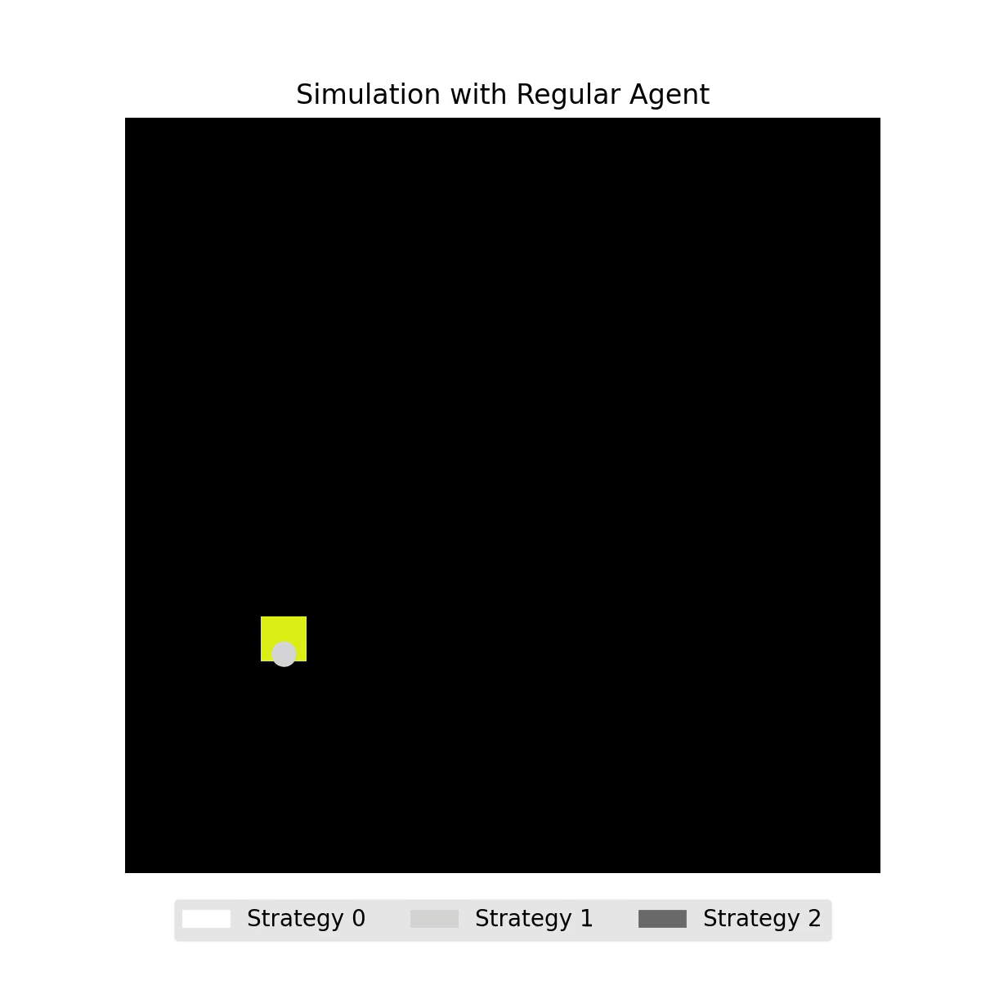

Slide 4
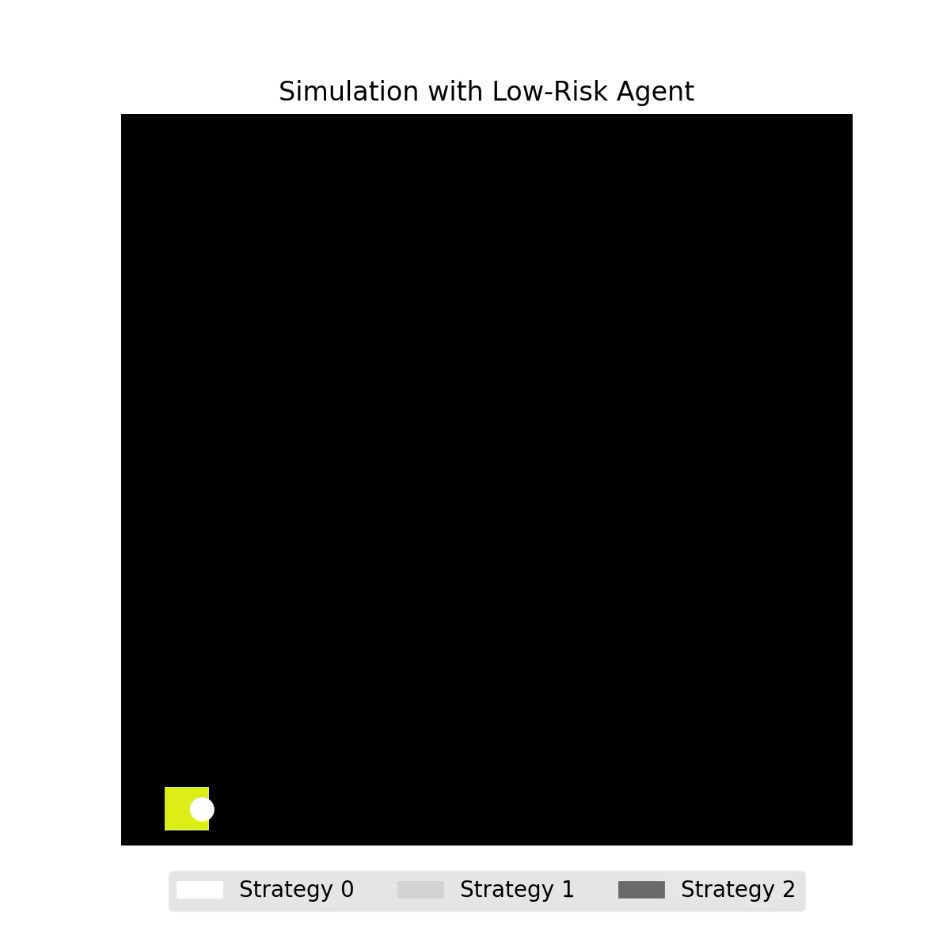
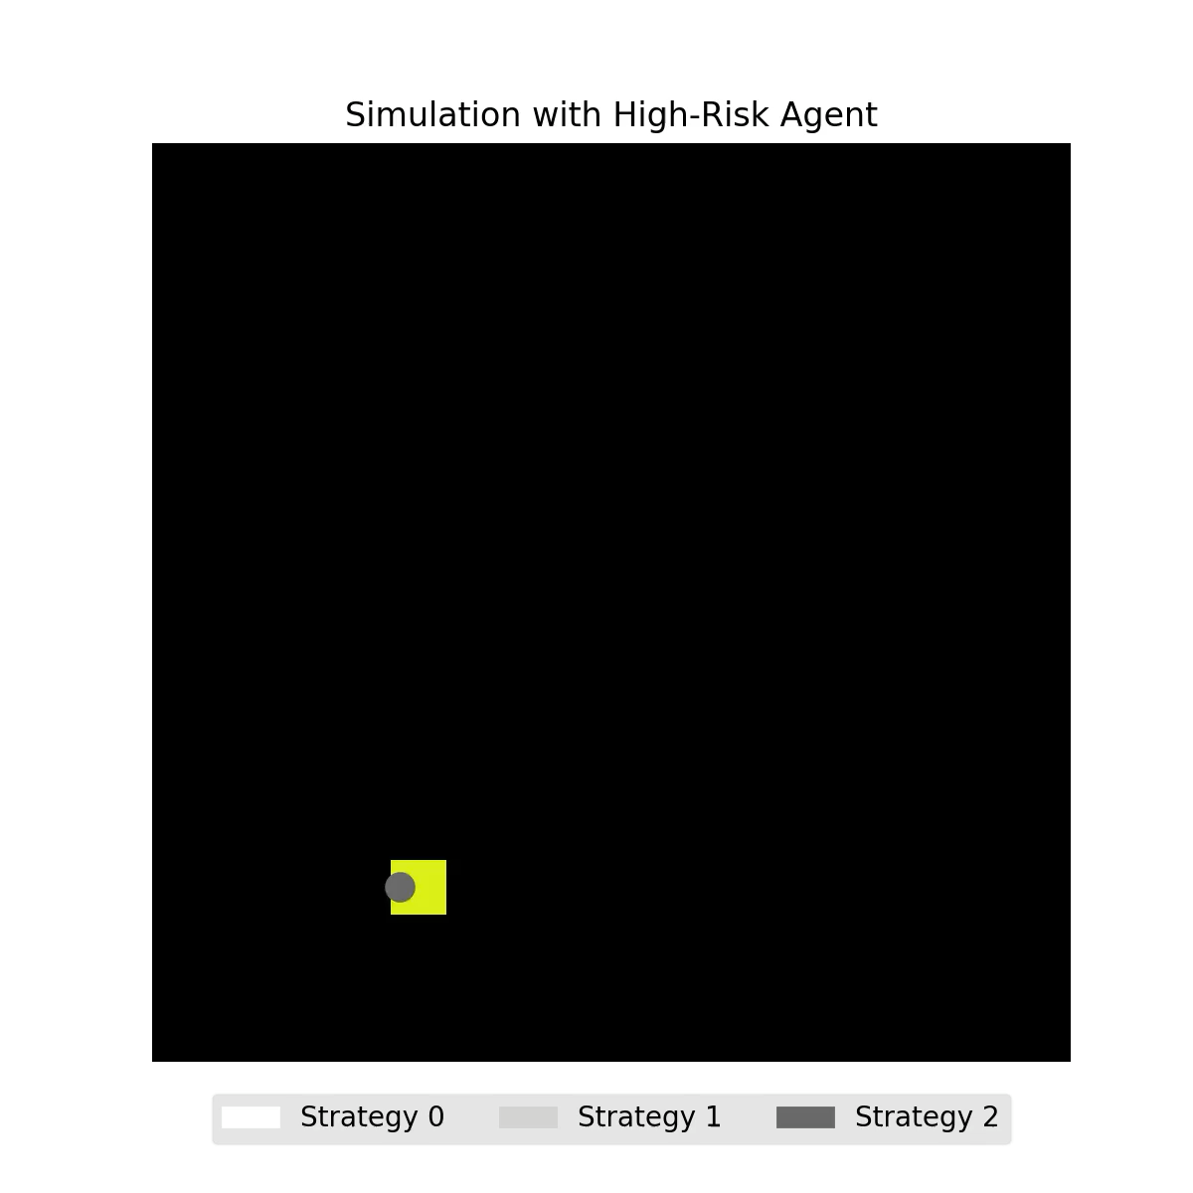

Slide 5
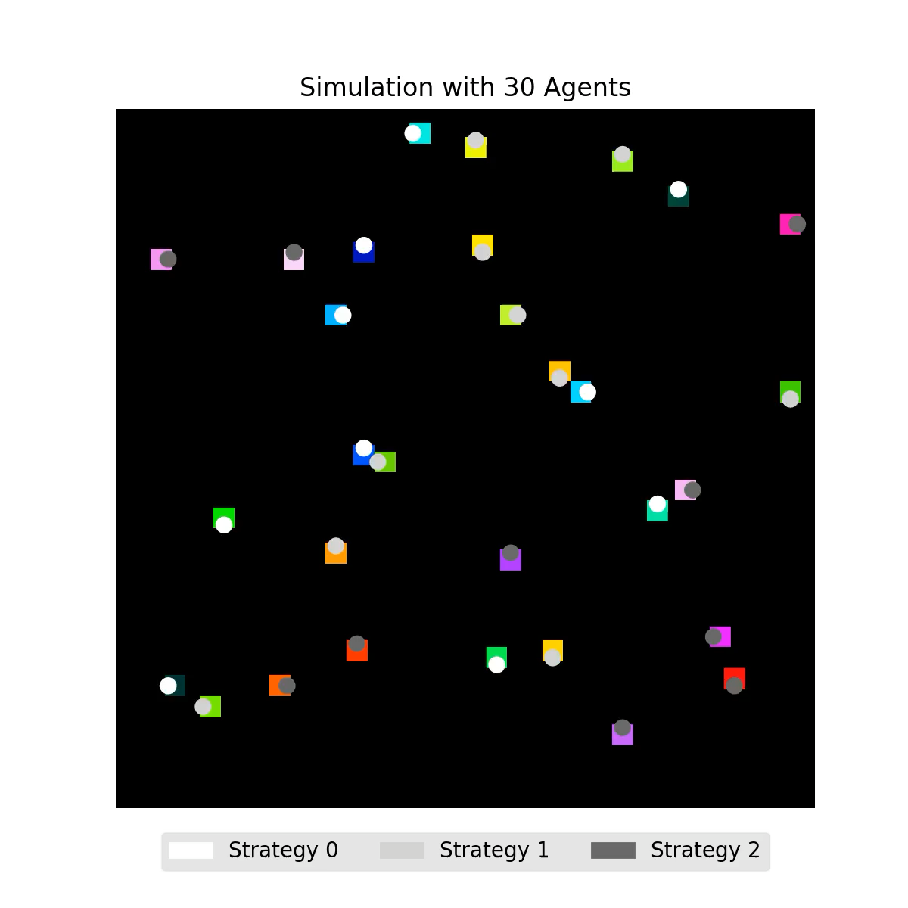

Slide 6
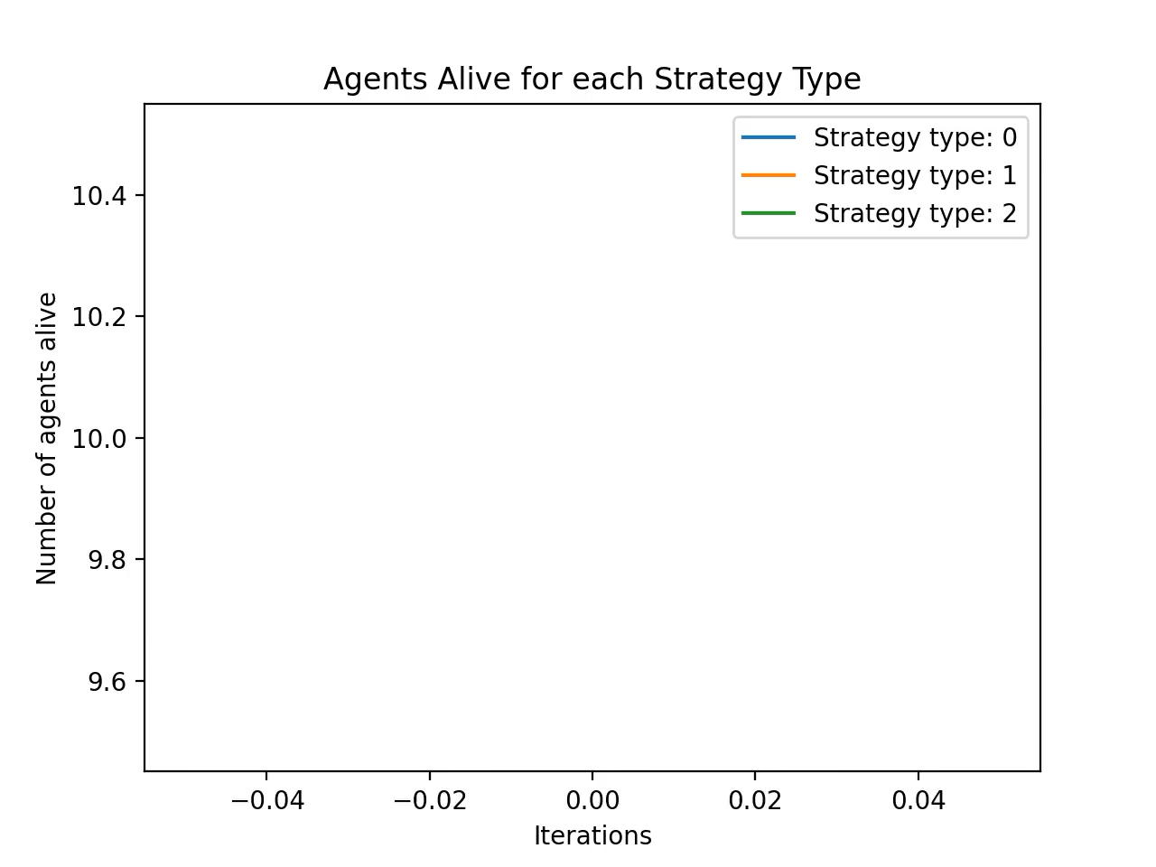
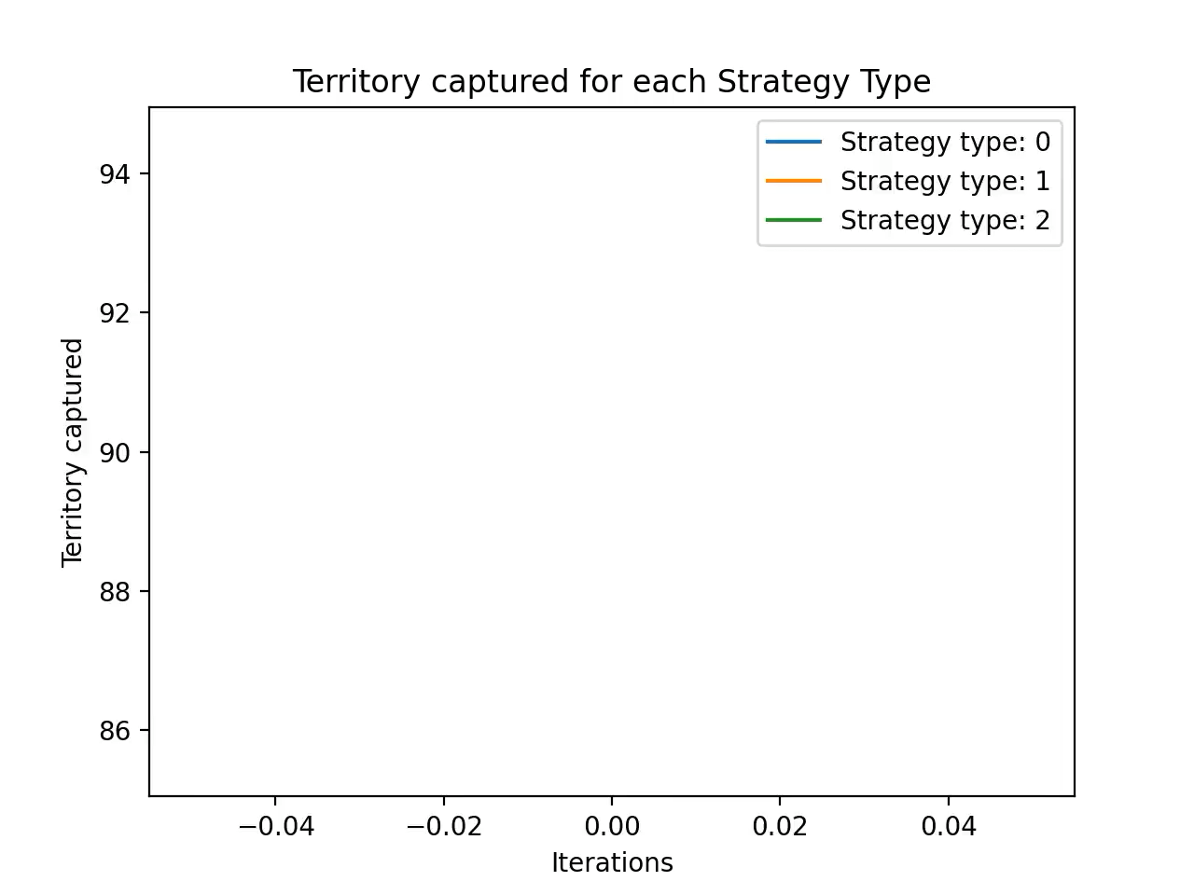

Slide 7
Thank you!
Any questions?

