Slide 1
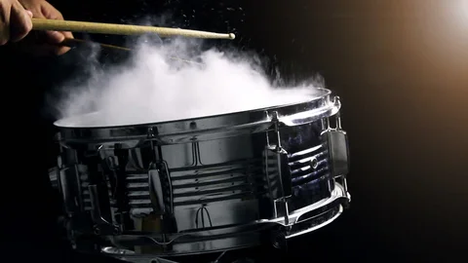
Drum Set Simulation Determined By Audio
By Makaio Jimenez

Slide 2
Goal
Recreate the physics of my drum set playthrough as accurately as possible by using physical relationships and recorded sound wave data in Python

Slide 3
Timeline
Librosa and Scypi.io scan .wav files for amplitude, frame, and sample rate data
Take the plot animations from the drumheads and sync real time audio of the original recording
Apply physics
Record Drums
01
02
03
04
Animate
Utilize microphones and a D.A.W. to capture Raw audio
Process Sounds
The 2D Wave Equation dictated how the drum surface would move upon impact

Slide 4
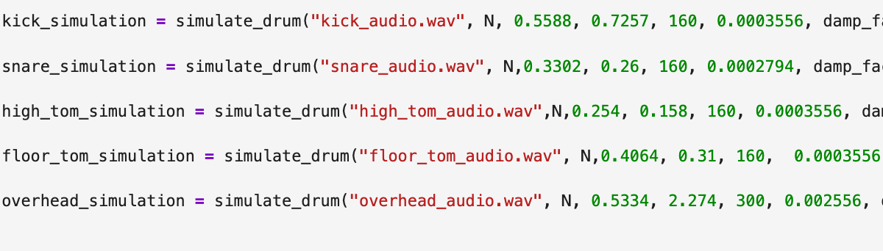



Methods and Logistics
$\frac{δ\text{2}}{δ\text{t}\text{2}}u=c2$($\frac{δ\text{2}}{δ\text{x}\text{2}}$u + $\frac{δ\text{2}}{δ\text{y}\text{2}}$u )
u(x,y,t) = Deflection with a location at a time frame
C = $\frac{Tension}{Mass Density}$
Librosa used built in rms function to harvest the amplitude envelope of the audio.
Librosa.onset() then looks for transient moments within time*

Slide 5
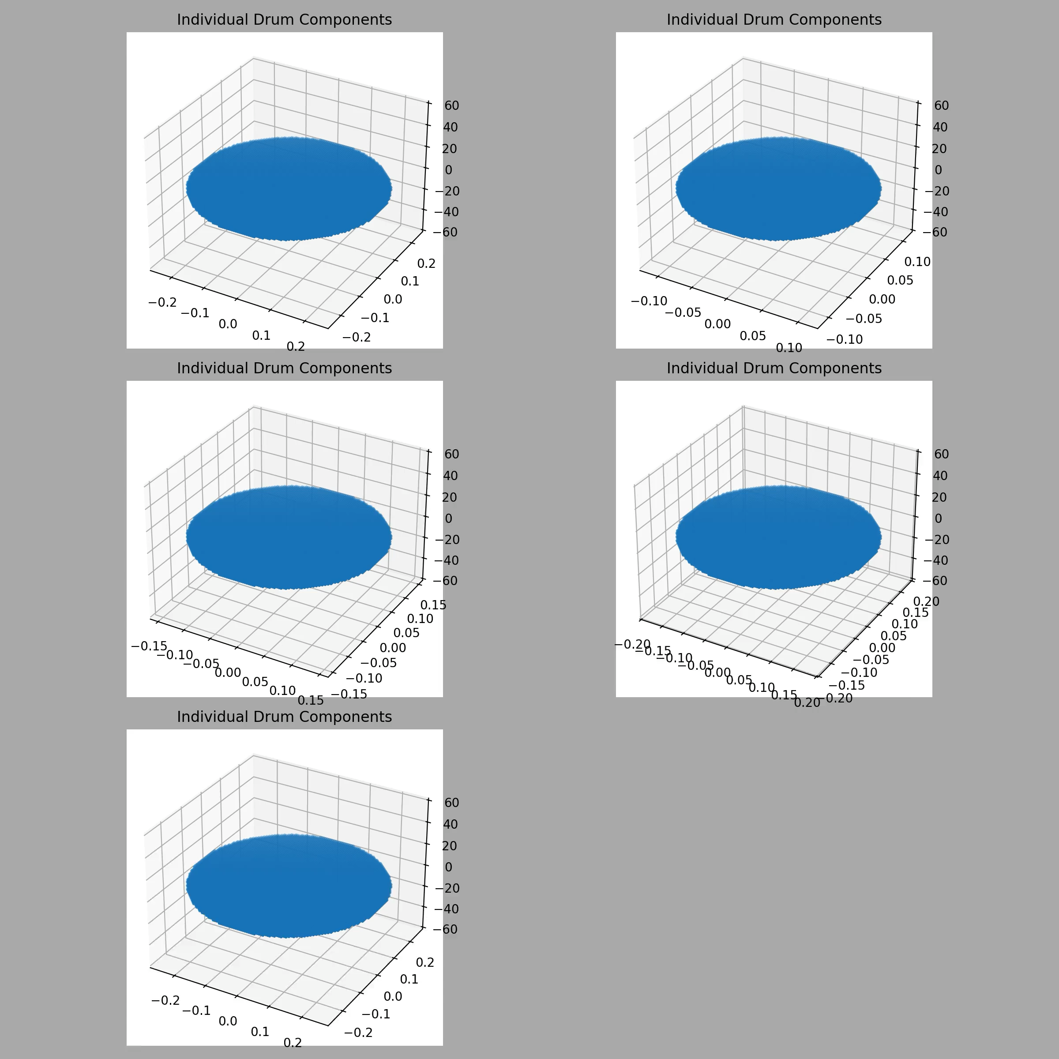

Slide 6
Sources
Authors, L. (n.d.). Librosa. librosa.org. https://librosa.org/doc/latest/index.html
Matplotlib Contributors. Matplotlib. “Matplotlib 3.10.7 Documentation”
https://www.shutterstock.com/video/clip-27594961-video-drum-sticks-hit-on-snare-black?dd_referrer=https%3A%2F%2Fwww.google.com%2F

