Slide 1
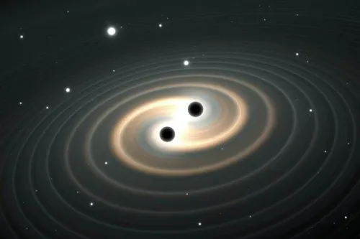
Visualizing Gravitational Waves with Python
Joshua Curiel
EPS 109 Final Project
December 2nd 2025

Slide 2

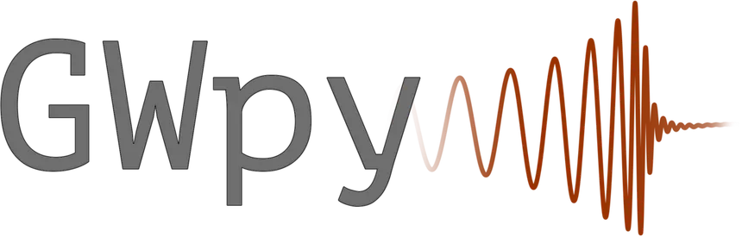
Methods and Motivation
Are there any libraries like obspy for Astrophysics? Yes there are!
PyCBC
GWpy
PyCBC allows us to create waveforms of gravitational waves
GWpy allows us to pull real data from the Laser Interferometer Gravitational-wave Observatory (LIGO)

Slide 3
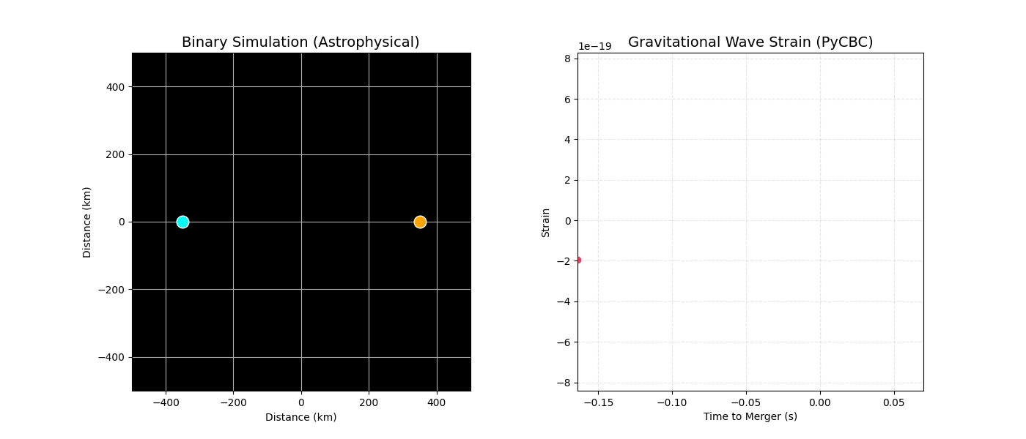
Demonstration

Slide 4
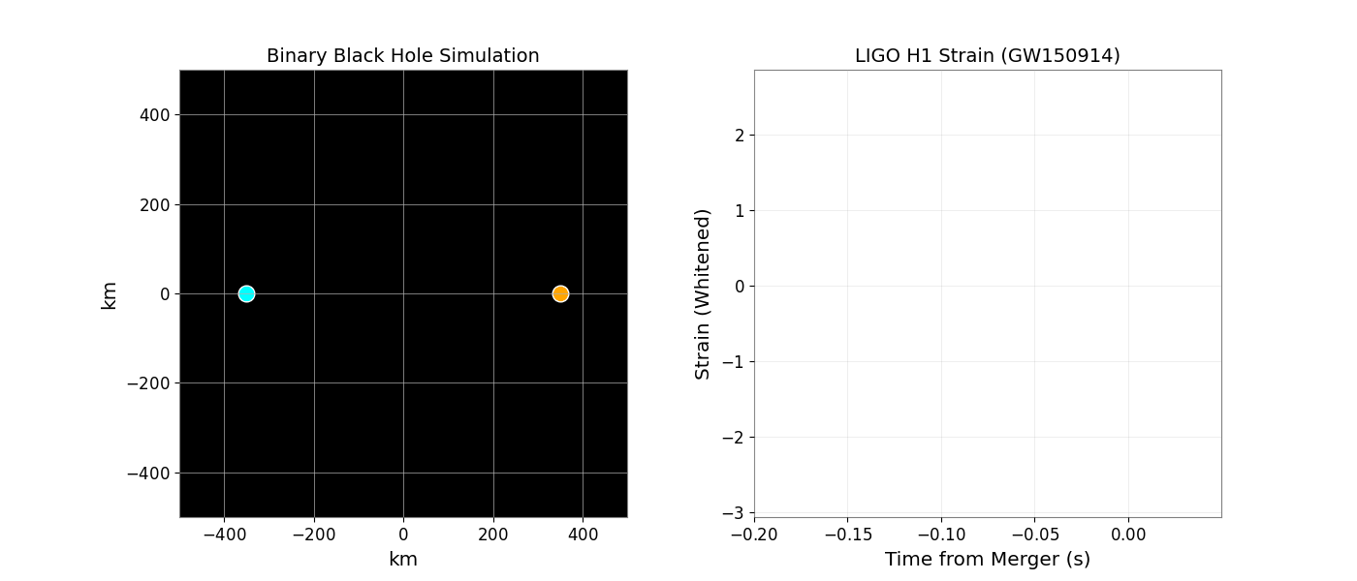
Using Real Data to Create a Simulation!

