Slide 1
Shockwave Response of Mine Support Scenarios
EPS 109 Fall 2025
Ethan Brouwer

Slide 2
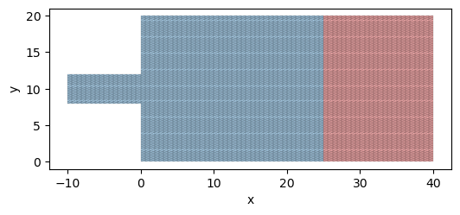
Material Properties & Loading Conditions
Strong Rock (Blue) – Granite:
Young’s Modulus: E = 40 x 10⁹ Pa
𝜌 = 2700 Kg/m³
Weak Rock (Red) – Fractured Rock:
Young’s Modulus: E = 15 x 10⁹ Pa
𝜌 = 2600 Kg/m³
Applied Loads:
Far-Field Compressive Stress: 100 MPa
Gravitational Burden (40m depth): 1.06 MPa
Dynamic Blast Loading (Shockwave):
Amplitude: 60 MPa
Duration: 0.004 seconds
Birds-Eye View of Simulated Mine Void

Slide 3

GetFEM Library
In This Project
Used to build meshes, assign materials, and define excavation geometry
Solve static and dynamic elasticity to track stress redistribution and blast-wave response
Computes stress fields and failure indicators
Generates stage-by-stage visualizations of excavation growth and stress evolution
Used Python Interface - Version 5.4.4 - Available at: https://getfem.org

Slide 4
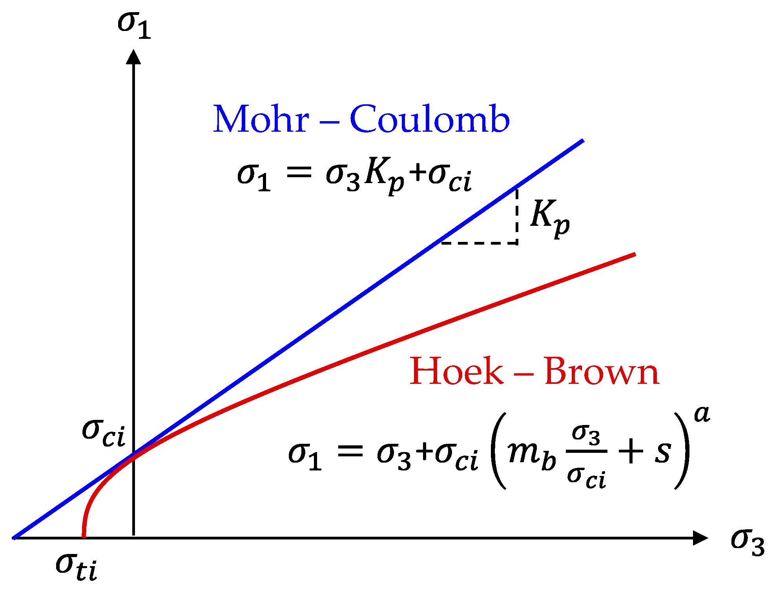
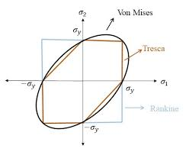
Outputs
Von-Mises Stress
Condensed 3D stress tensor to indicate tendency for yielding
High values (red) under a lot of stress
Hoek-Brown Failure Criterion
Predicts when rock transitions from elastic behavior to brittle fracture
Computed threshold for weak and strong regions

Slide 5
Points of Interest

Slide 6
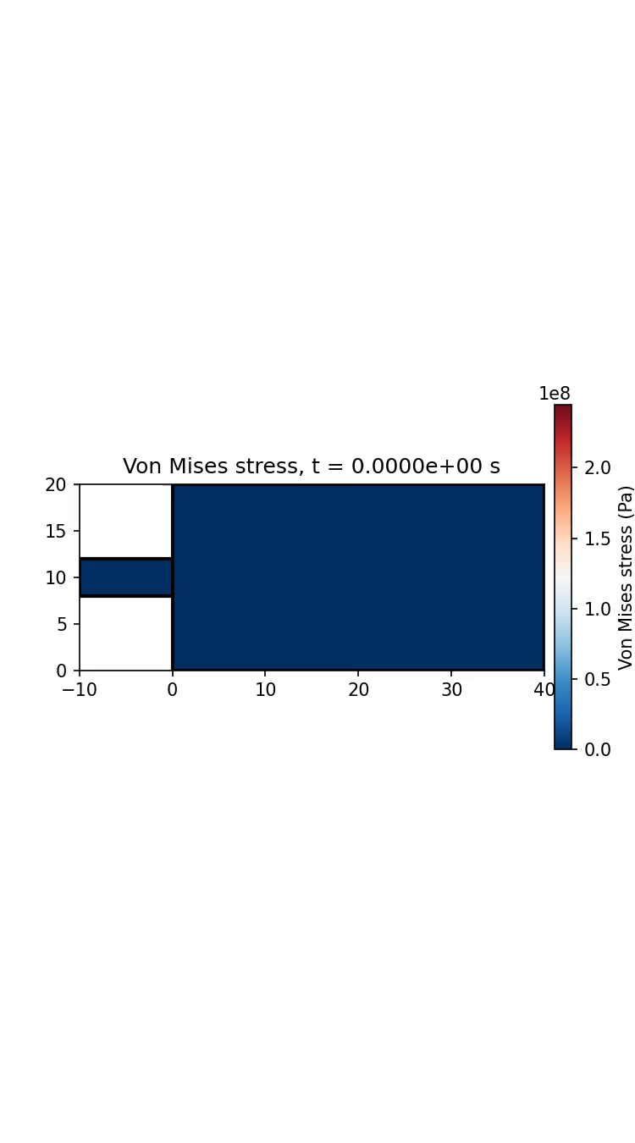
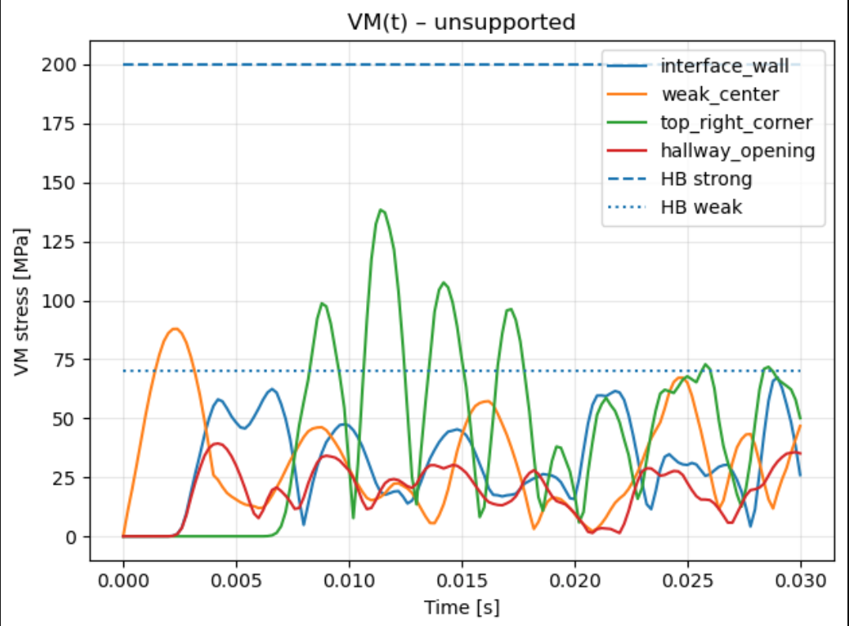
Unsupported Results

Slide 7

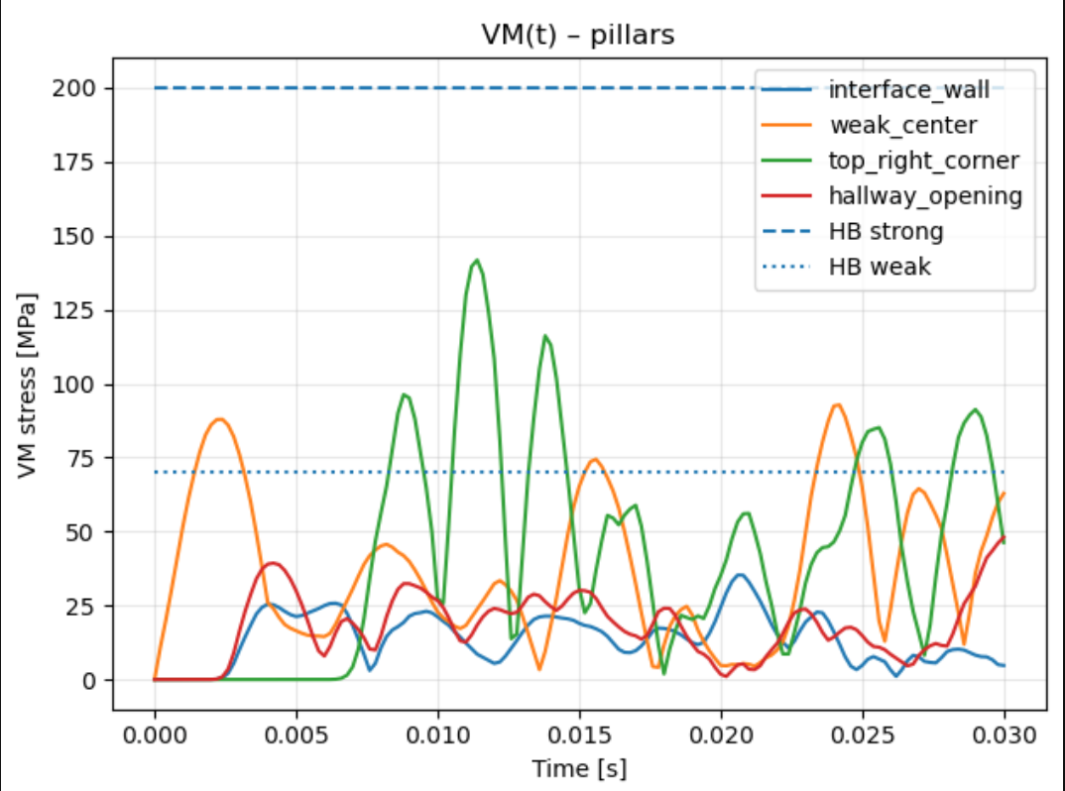
Pillar Results

Slide 8
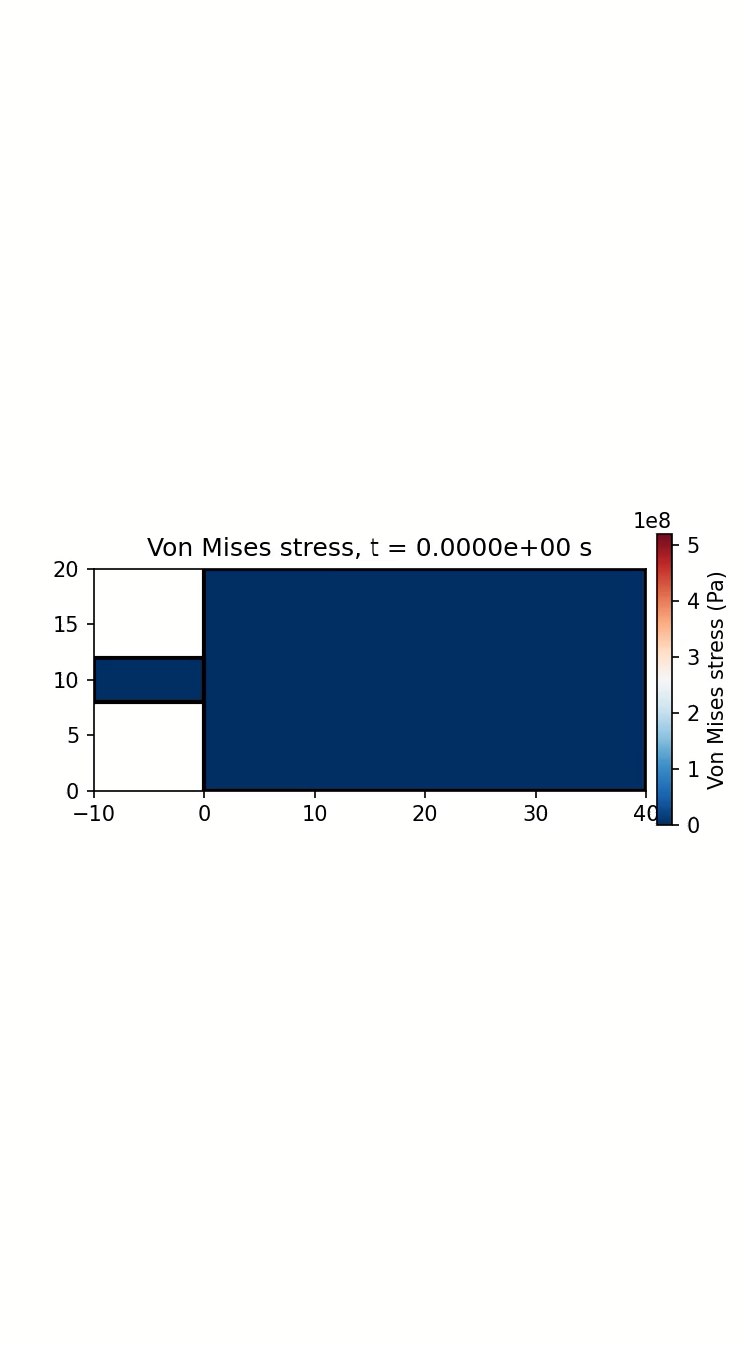
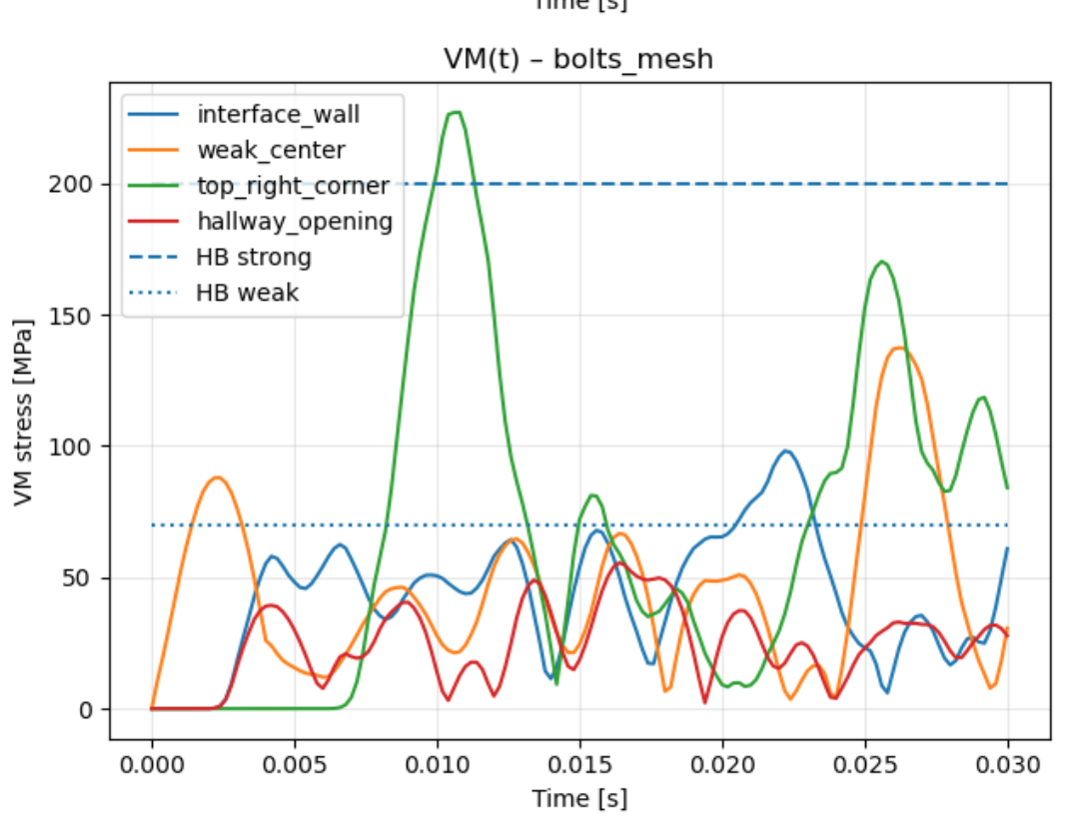
Bolts & Net Results

Slide 9
Implications
Stress ‘Pinching’ at the Top-Right Corner
Corner geometry concentrates load paths and reflects incoming waves, consistently amplifying stress in that region.
Pillars Provide the Largest Stress Reduction
Load-bearing continuity → Distributing vertical and lateral loads more evenly
Lower peak stresses throughout duration
Bolt & Net Support Smooths Stress Gradients
Bolts tie layers together, preventing localized shear bands
General Observation
Geometry dominates wave focusing, while support systems mainly influence how stress redistributes through the excavated zone.

