Slide 1
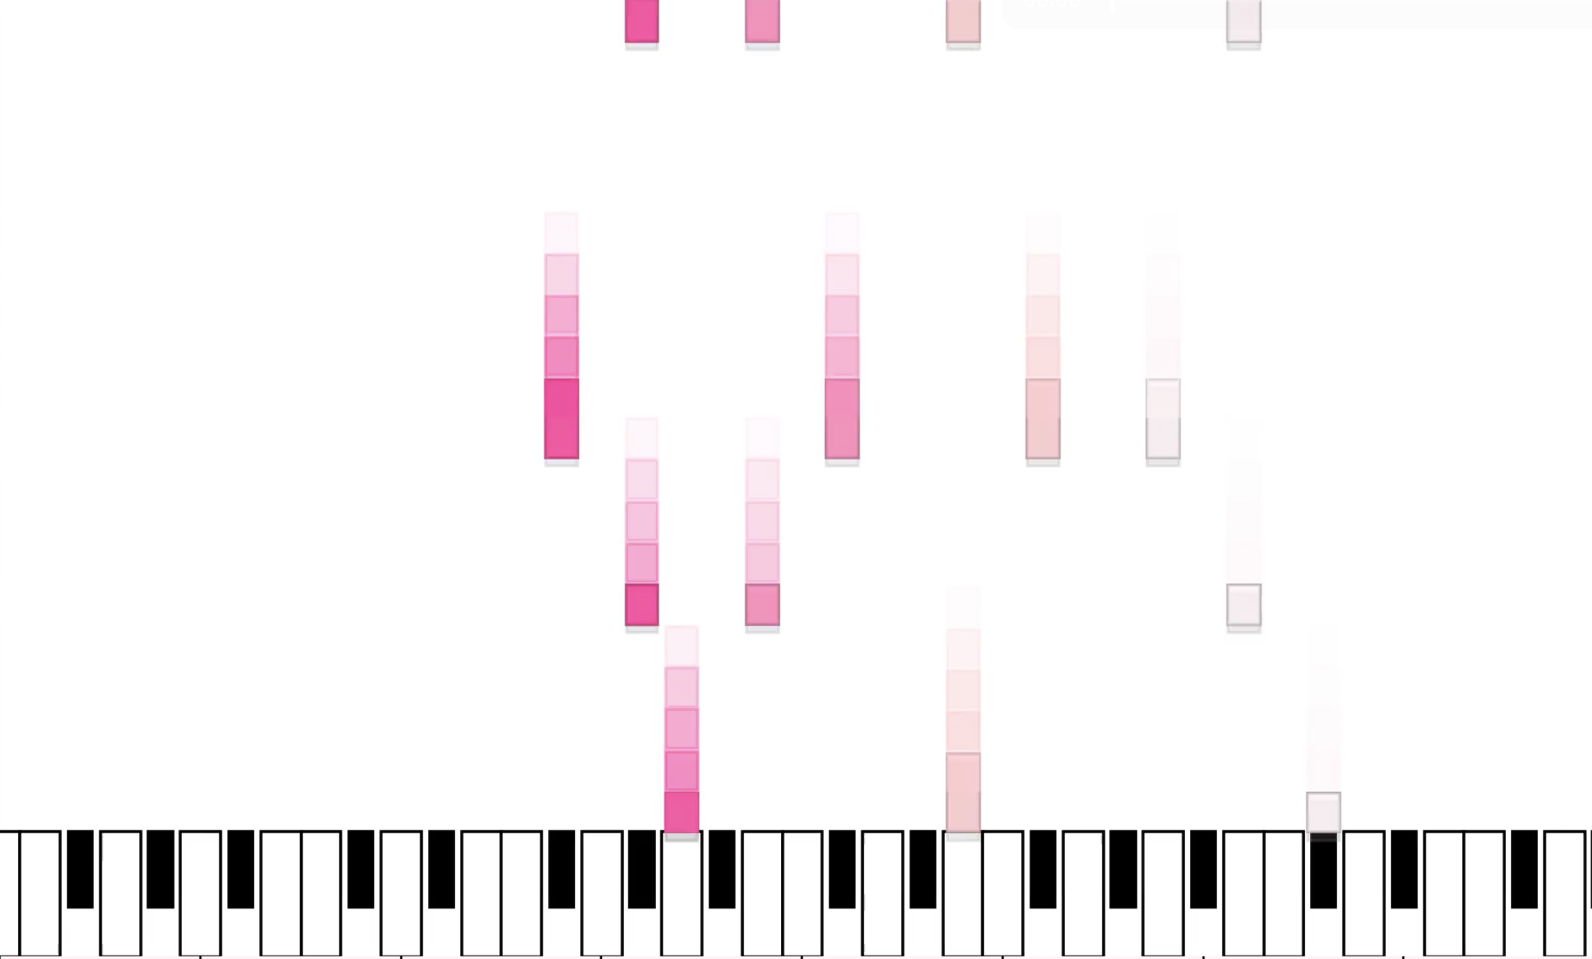





Visualizing Bach Chorales
Safia Barmada

Slide 2
Methods
Bach chorales– common music to analyze
Patterns in voice leading and harmonies
Soprano, Alto, Tenor, Bass
Using music21 Python toolkit to load and analyze piece
From mxl file
Store the notes in each voice in arrays, along with their times, pitches (MIDI pitch), and durations.
Use matplotlib to plot a keyboard, and plot notes in each frame
Use FFMpeg to save the animation
For audio, write midi file using music21, convert to wav, and use FFMpeg to combine audio with animation mp4

Slide 3
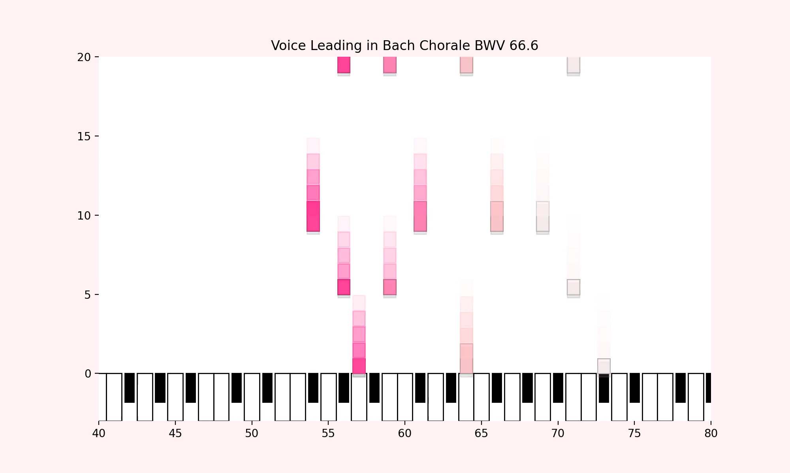
Chorale BWV 66.6

Slide 4
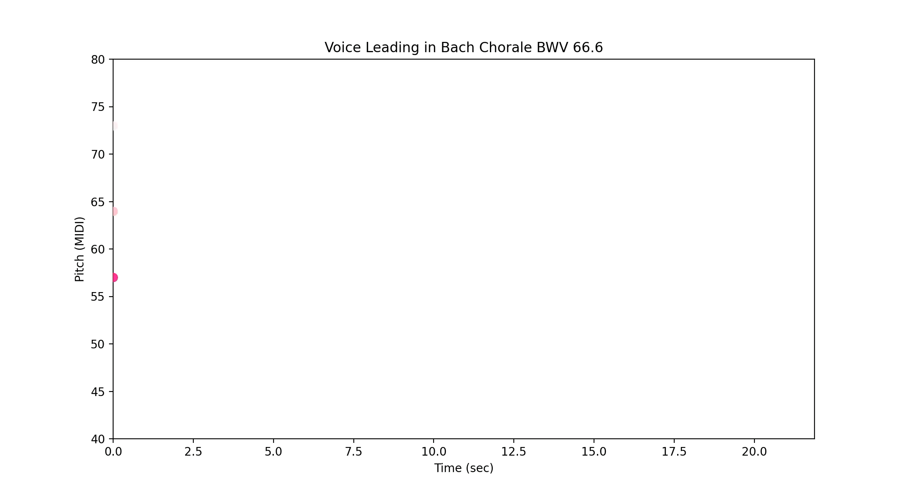
Visualizing harmonies

Slide 5
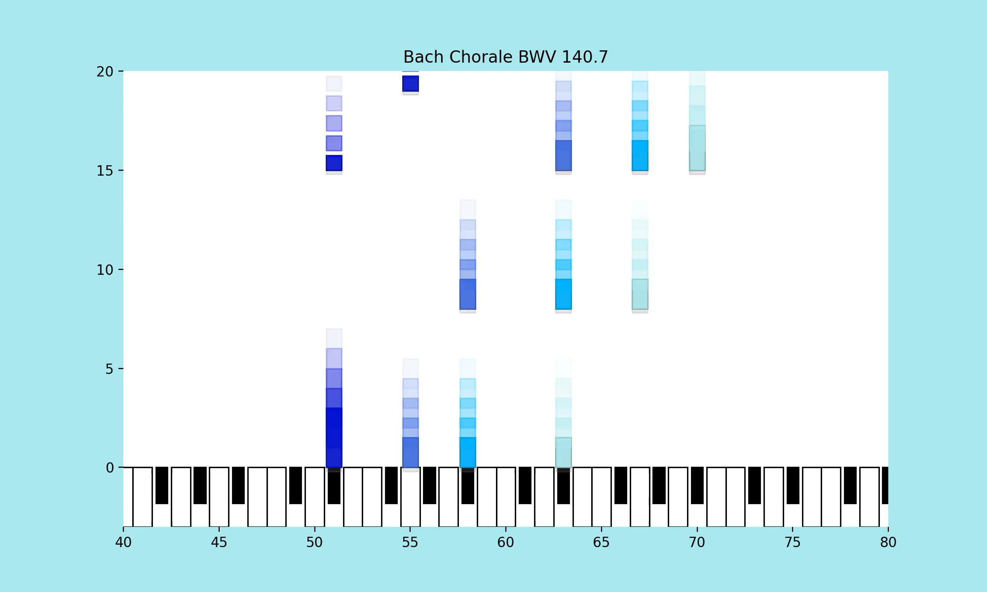
Another Chorale (BWV 140.7)

