Slide 1
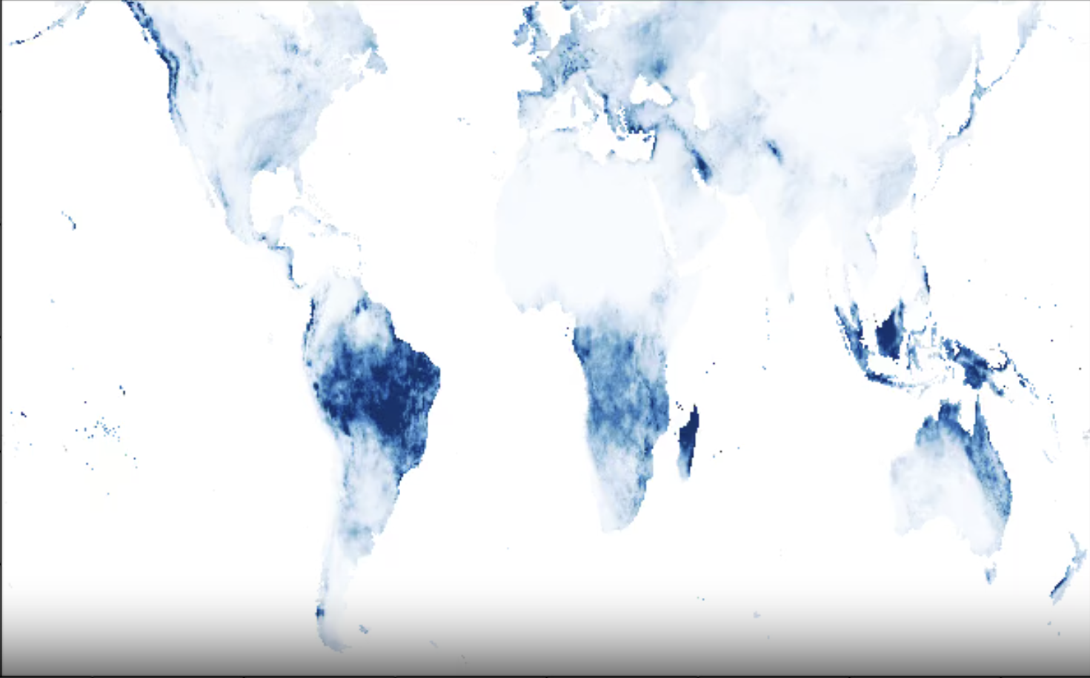
Geospatial Raster Map of 44 years of Percipitation Data
Isaac Romero
11/30/2025
Caption

Slide 2
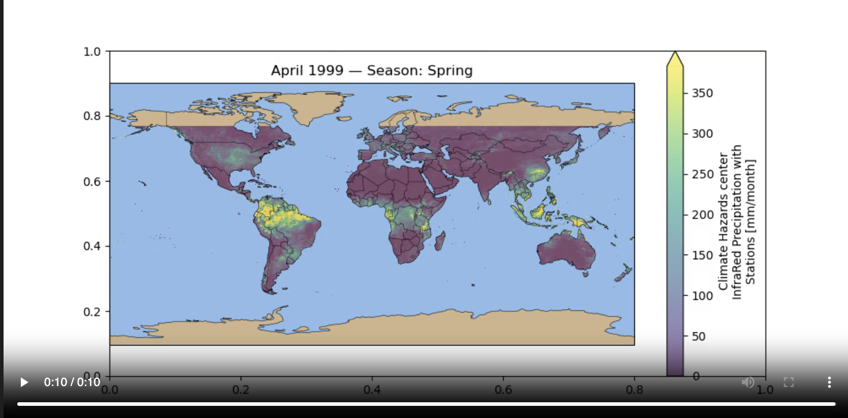
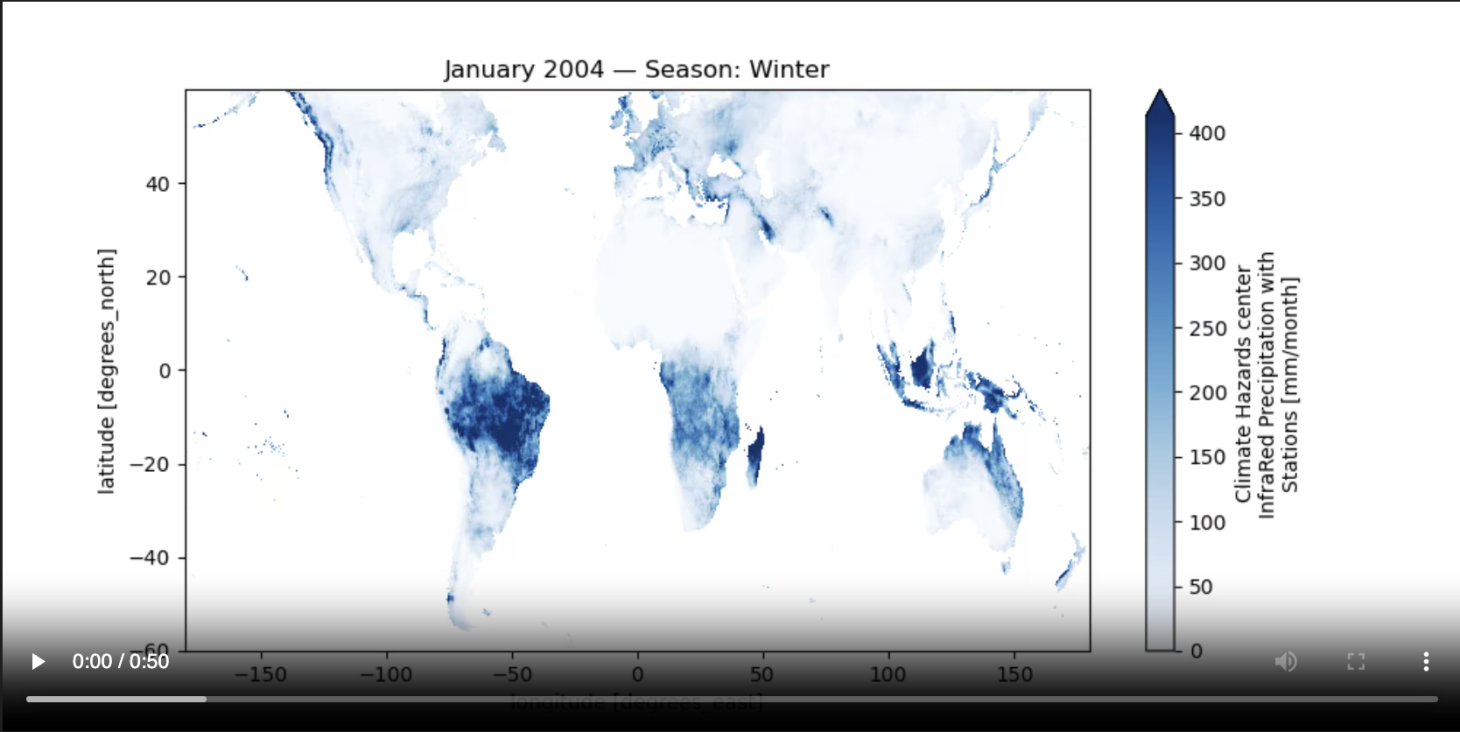
Geospatial Raster
NetCDF (Network Common Data Form)
Xarray (Efficient Data Download + Data manipulation)
Most of the work was done here. Xarray cleverly parses precipitation data frames by year, but it also requires some Xarray conversions for the animation to work. As a result, we can then get frame-by-frame Geospatial Rasters.
FuncAnimation (Handles for loop + Update logic)
Cartopy (Creates a Realistic Map Appearance)

Slide 3
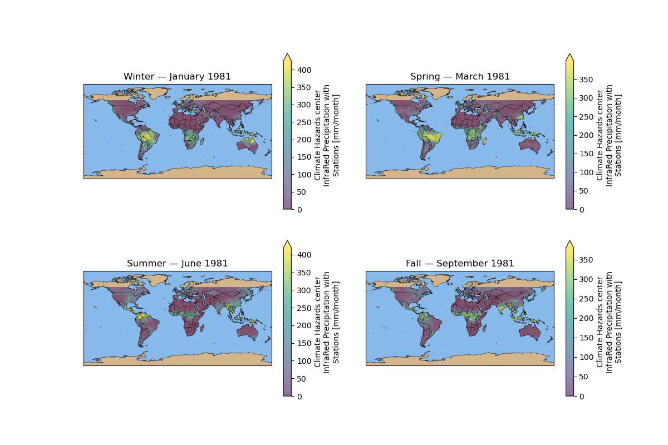
Seasonal Precipitation (1981-2025)

Slide 4
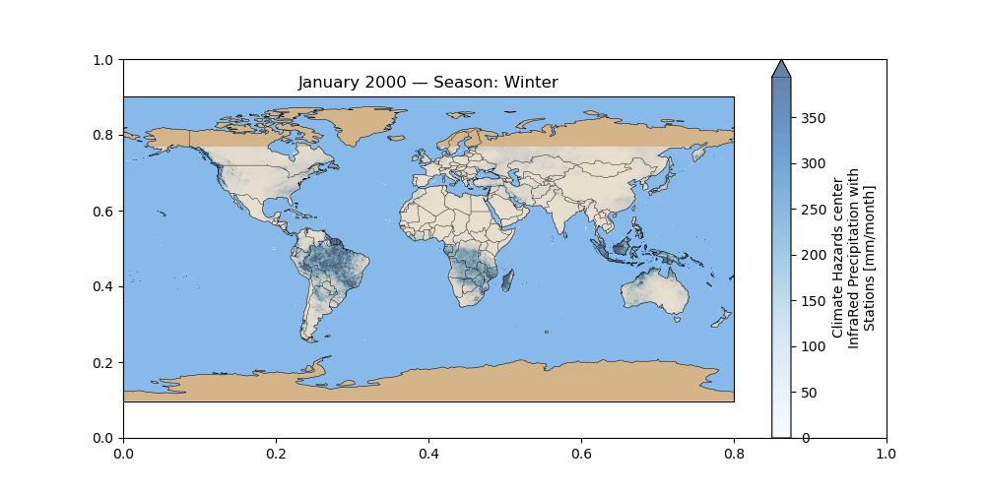
Precipitation across 25 years

