Slide 1


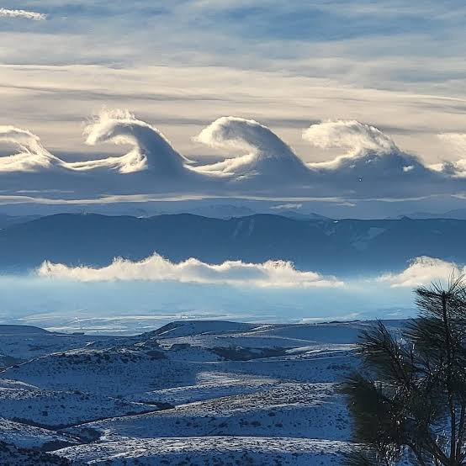


EPS 109 Capstone Project
Fluid Dynamics in the Atmosphere
Exploring how atmospheric phenomena arise as a result of differing physical mechanisms
  Courtesy of Rachel Gordon from Facebook
Simulating
fluid dynamic
phenomena
Author: Jeslyn Liu

Slide 2

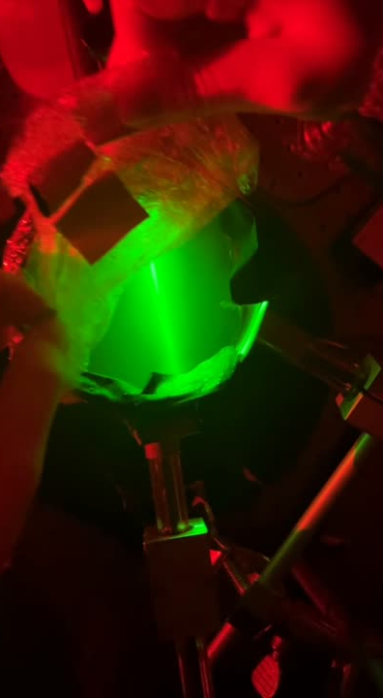
Introduction
Theory & Methods
Animations
Introduction
Inspiration for This project
  Physics 5CL Capstone: How do different types of cloud condensation nuclei affect the optical properties of clouds?
    Swirling patterns in clouds made during the experiment
      Occur because of turbulence and mixing air at a temperature boundary
What physical conditions and mechanisms lead to the formation of real-life patterns that appear in clouds in the atmosphere?
  A cloud from my 5CL experiment!

Slide 3
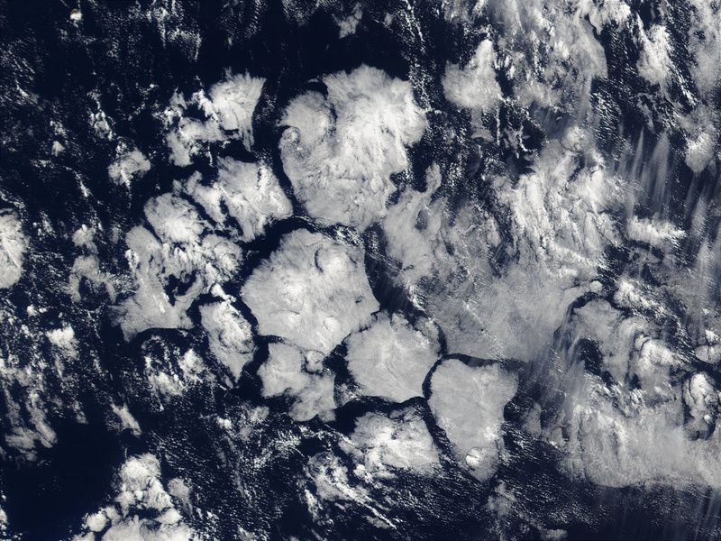
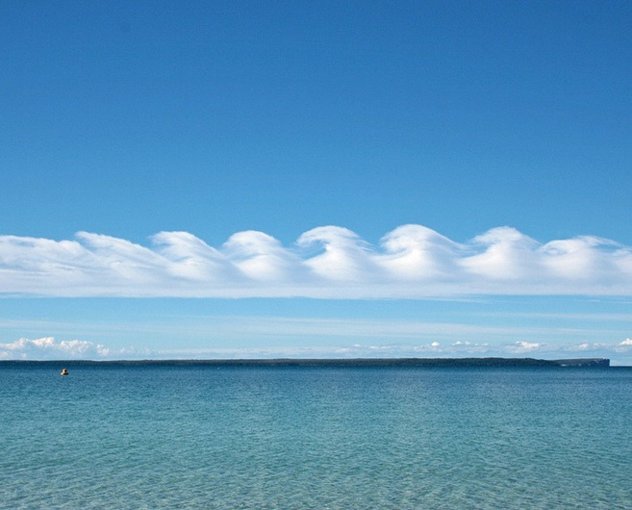
Introduction
Theory & Methods
Animations
Theory & Methods
Rayleigh-Bénard Convection
A temperature gradient—with cooler, denser air sitting atop warmer, less dense air—causes buoyancy-driven convection
Kelvin-Helmholtz Instabilities
A sharp velocity difference between strata creates a shear force that causes small perturbations to grow into waves
hexagonal cloud cells
rolling billow clouds
Navier-stokes PDE solver:
  Relies on the Boussinesq approximation to simplify the coupled PDE system
  Discretizes the equations using the Finite Difference Method
  Uses the 4th order Runge-Kutta method to solve the coupled system

Slide 4
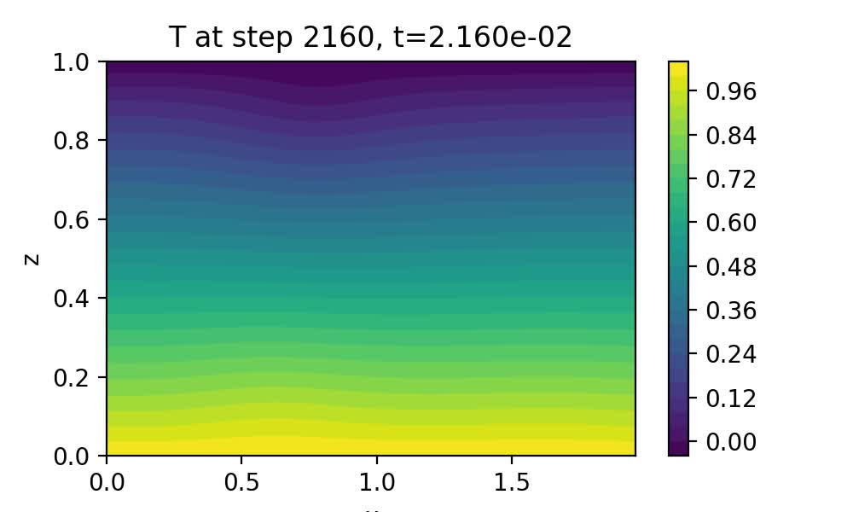
Introduction
Theory & Methods
Animations
Rayleigh-Bénard Convection
Animations
  0.75x speed

Slide 5
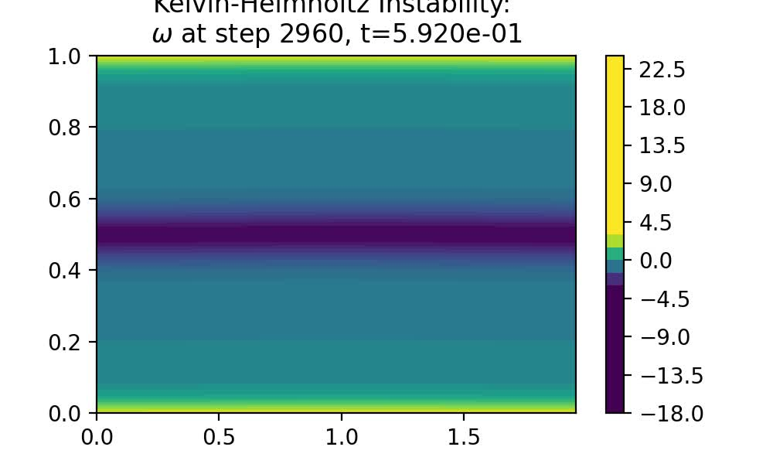
Introduction
Theory & Methods
Animations
Kelvin-Helmholtz Instability
Animations
  Evolution of vorticity field over time

