Slide 1
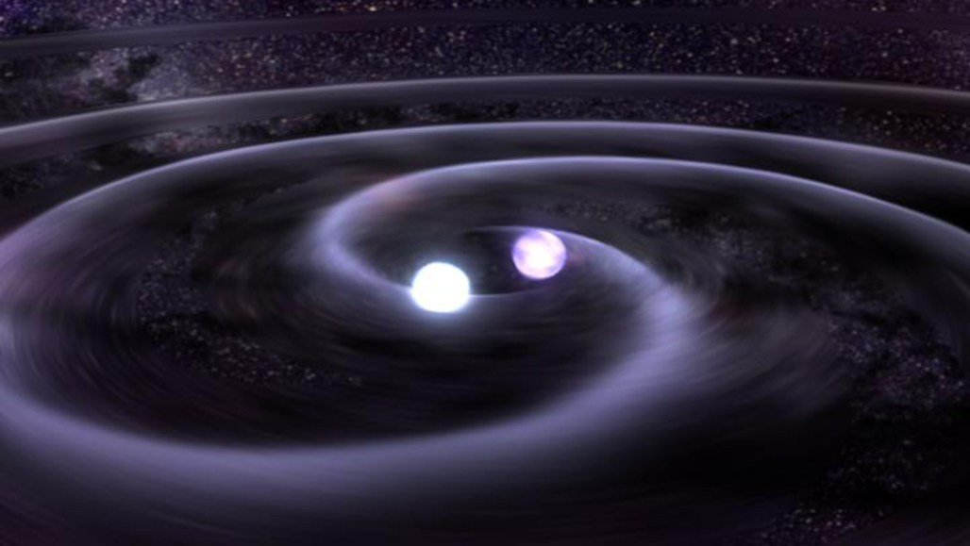
Star (Particle) Collision Simulator
By: Jaehyun (Jay) Lim

Slide 2
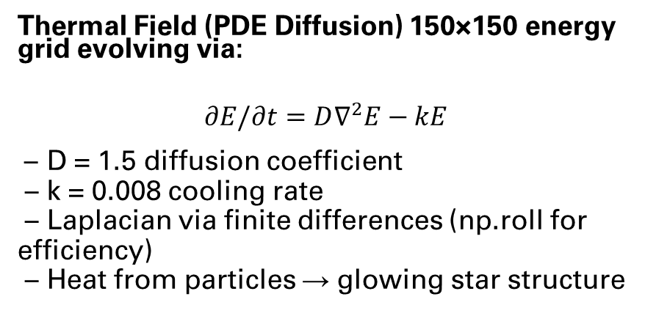
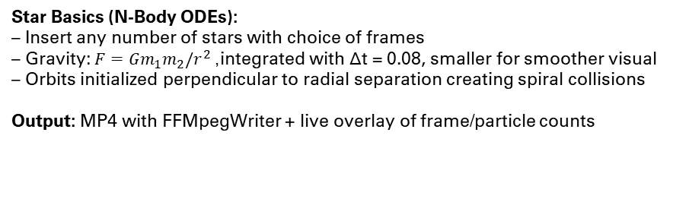
Description
Goal: Simulate multi-star particle gravitational collisions using a combination of ODE & PDE to create a physics engine modeling core dynamics.
Star Basics (N-Body ODEs): – Insert any number of stars with choice of frames – Gravity: $F=Gm_{1}m_{2}/r^{2}$, integrated with Δt = 0.08, smaller for smoother visual – Orbits initialized perpendicular to radial separation creating spiral collisions Output: MP4 with FFMpegWriter + live overlay of frame/particle counts
Collision & Explosion Mechanics:
• Core distance < 20 units: turbulence increase and heating
• Distance < 10 units: explosive force constant multiplied to each particle’s v_x and v_y through for loop and multiplication:
When a particle gets very close to a star core (distance < 10 units on the grid) AND a collision is happening, it experiences an outward "explosion force" (shown visually)
Gas Particles (150 per core): – Gaussian radial distribution → dense core + diffusive outer layer (np.random.randn() then taking abs() so most particles get close to core -> mimicking real stars)
– Forces: gravitational pull from cores + turbulence (experimented with small random jitter added to each particle's velocity aka way to simulate thermal motion from 0.03 to 0.15)
– Temperature model: From heat lab, followed using unitless T ≈ 30 (dim) to 100 (bright), particles showing smaller T removed
Thermal Field (PDE Diffusion) 150×150 energy grid evolving via:
$$∂E/∂t=D∇^{2}E−kE$$ – D = 1.5 diffusion coefficient – k = 0.008 cooling rate – Laplacian via finite differences (np.roll for efficiency) – Heat from particles → glowing star structure
Note: That Laplacian formula is built directly from the standard finite-difference definition of a derivative, just applied twice . Hence, I estimated by computing average of four neighbors (since the Laplacian just tells you how different a point is from the average of its neighbors.)

Slide 3
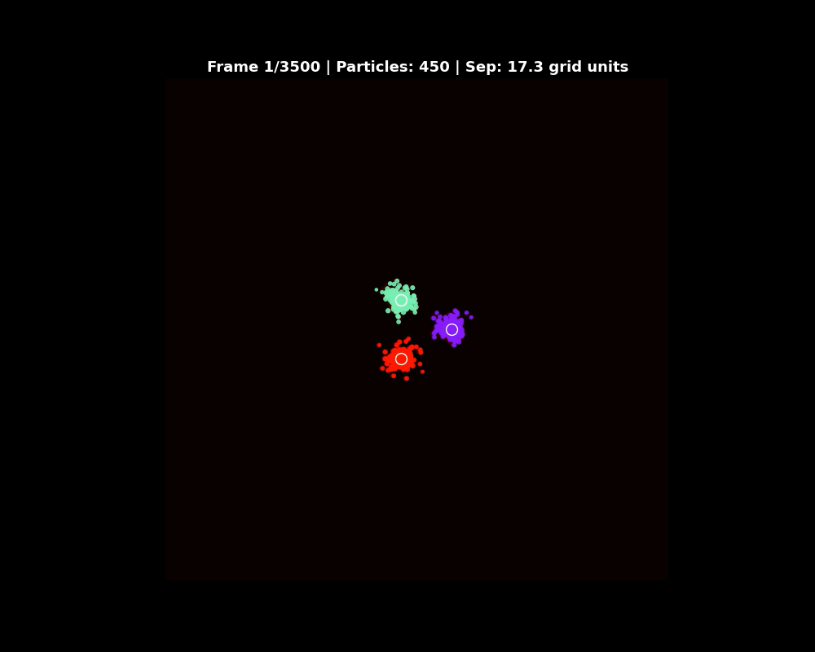
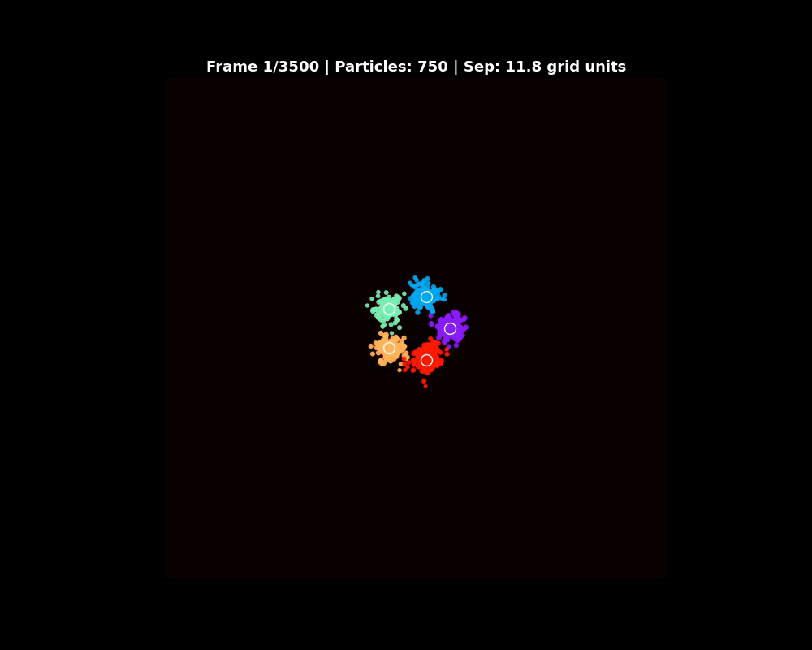
Visual

