Slide 1
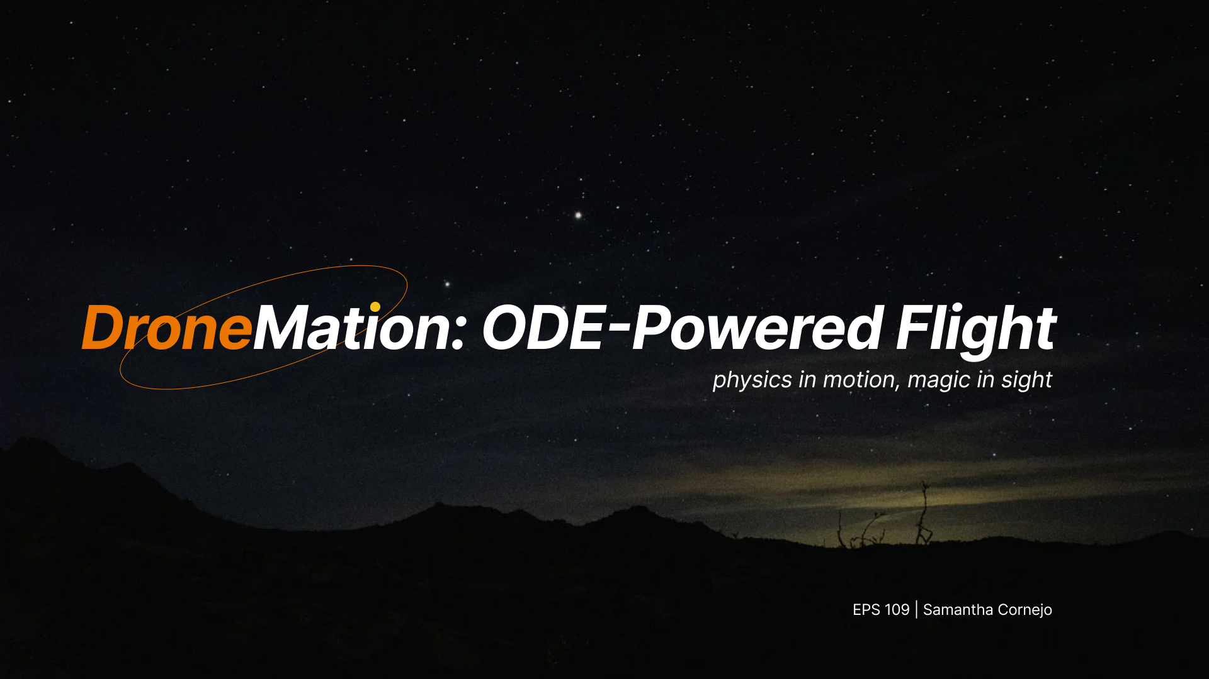

Slide 2
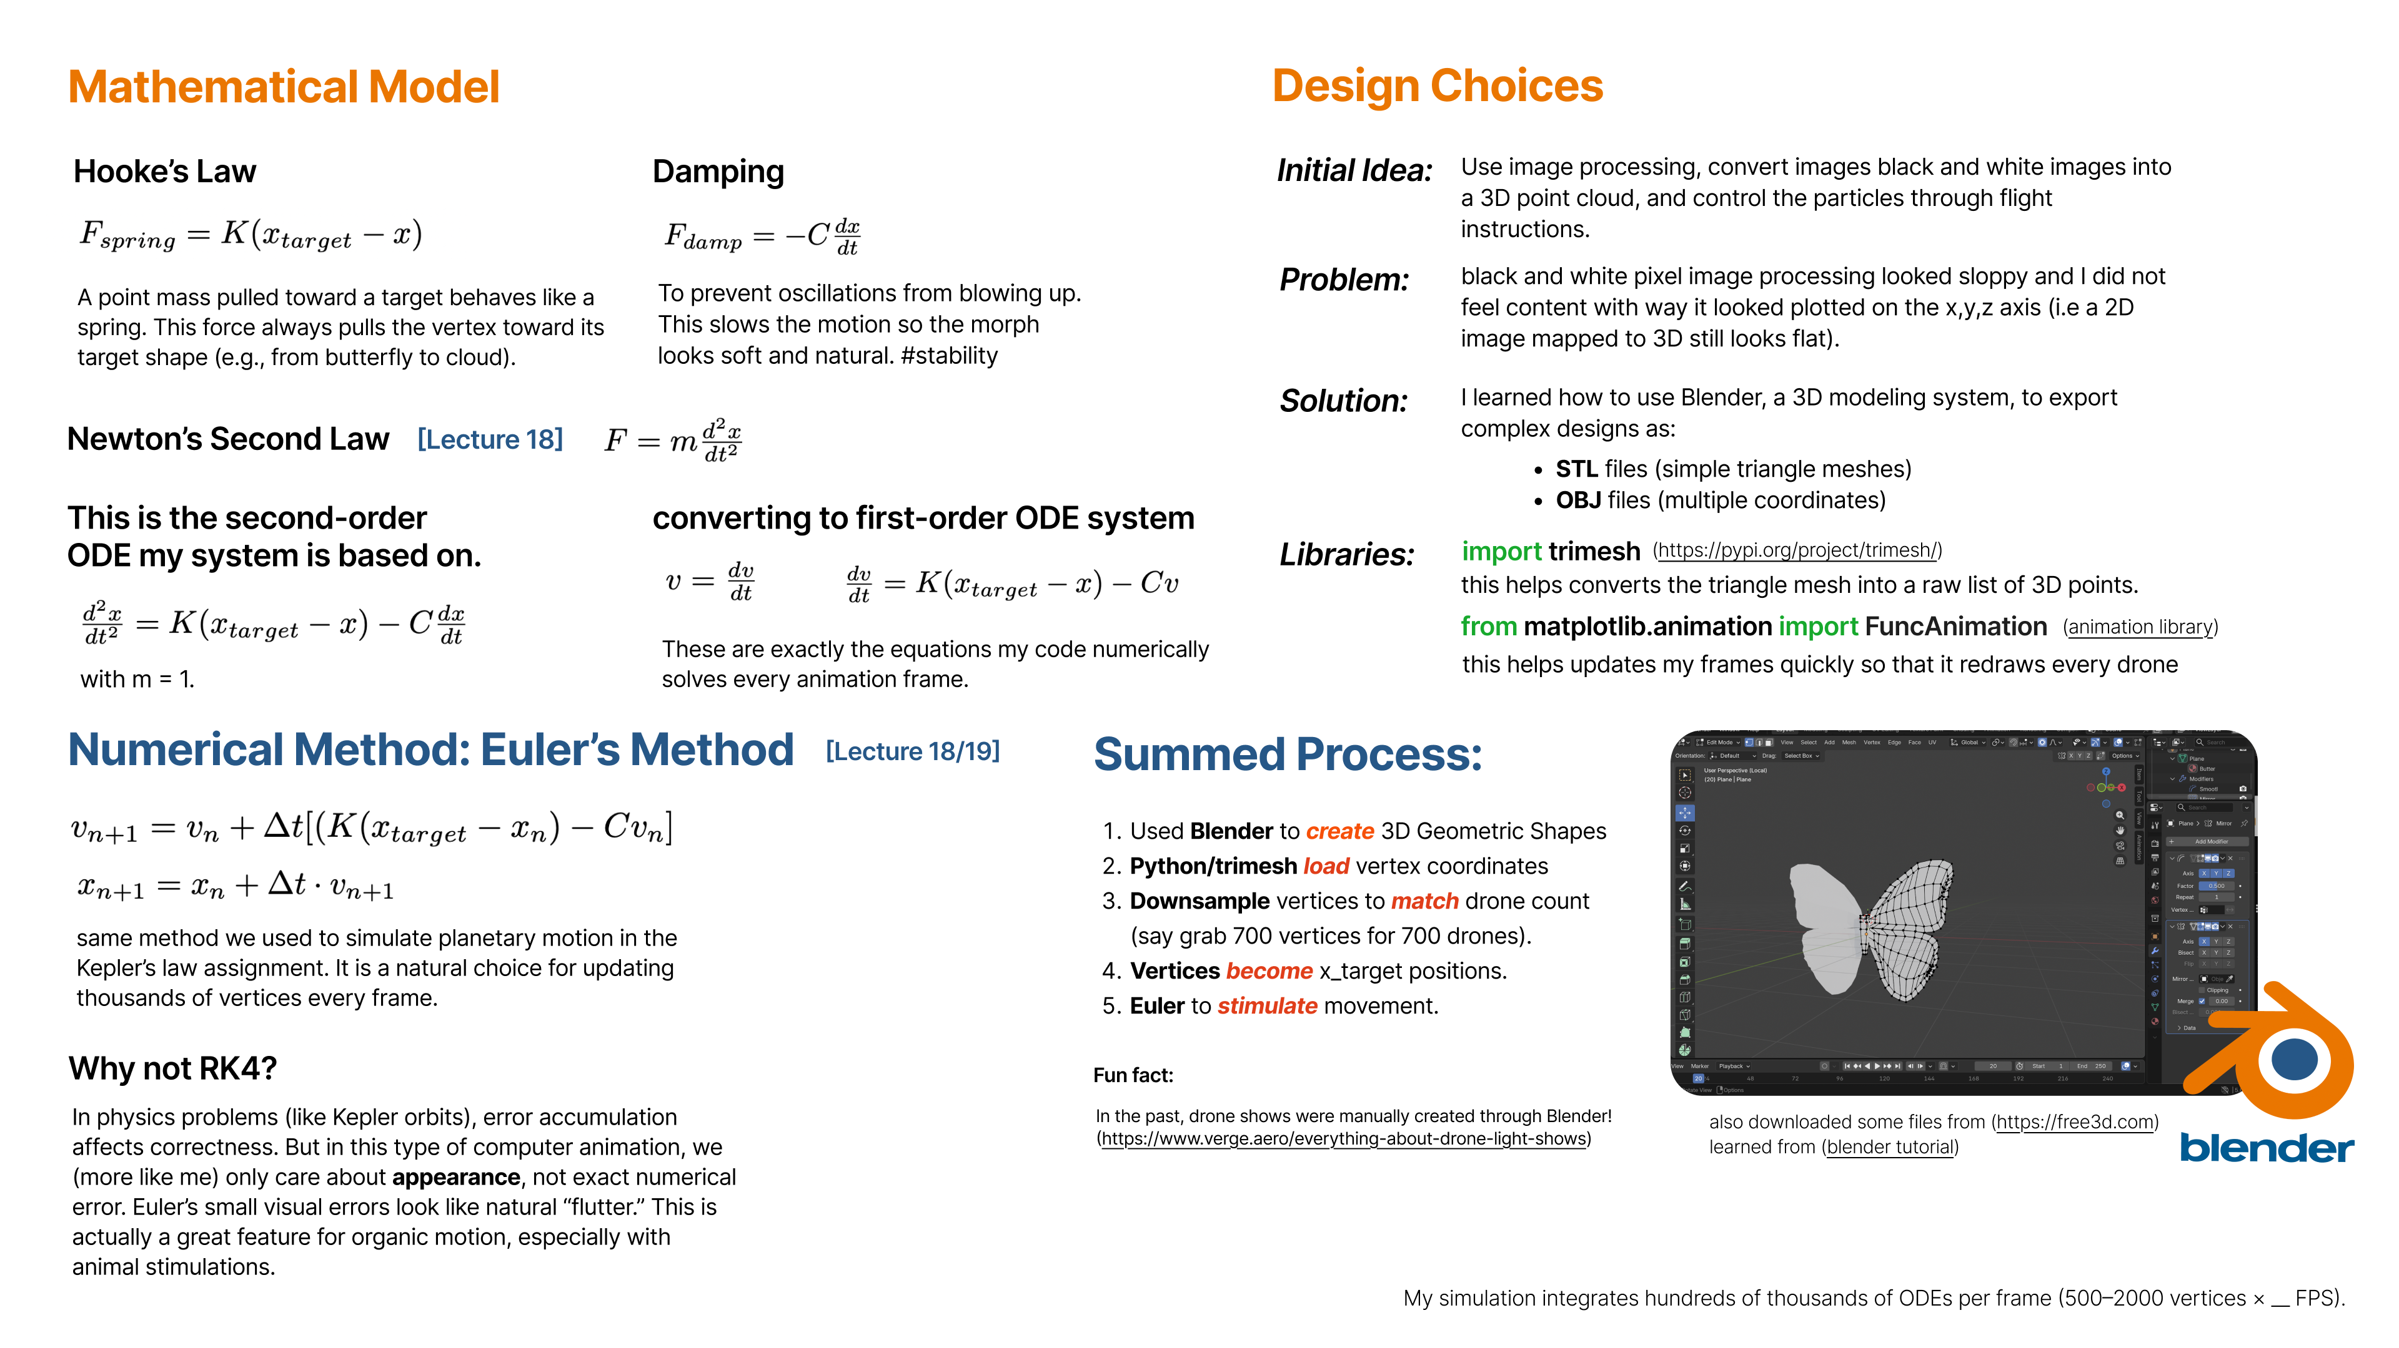

Slide 3
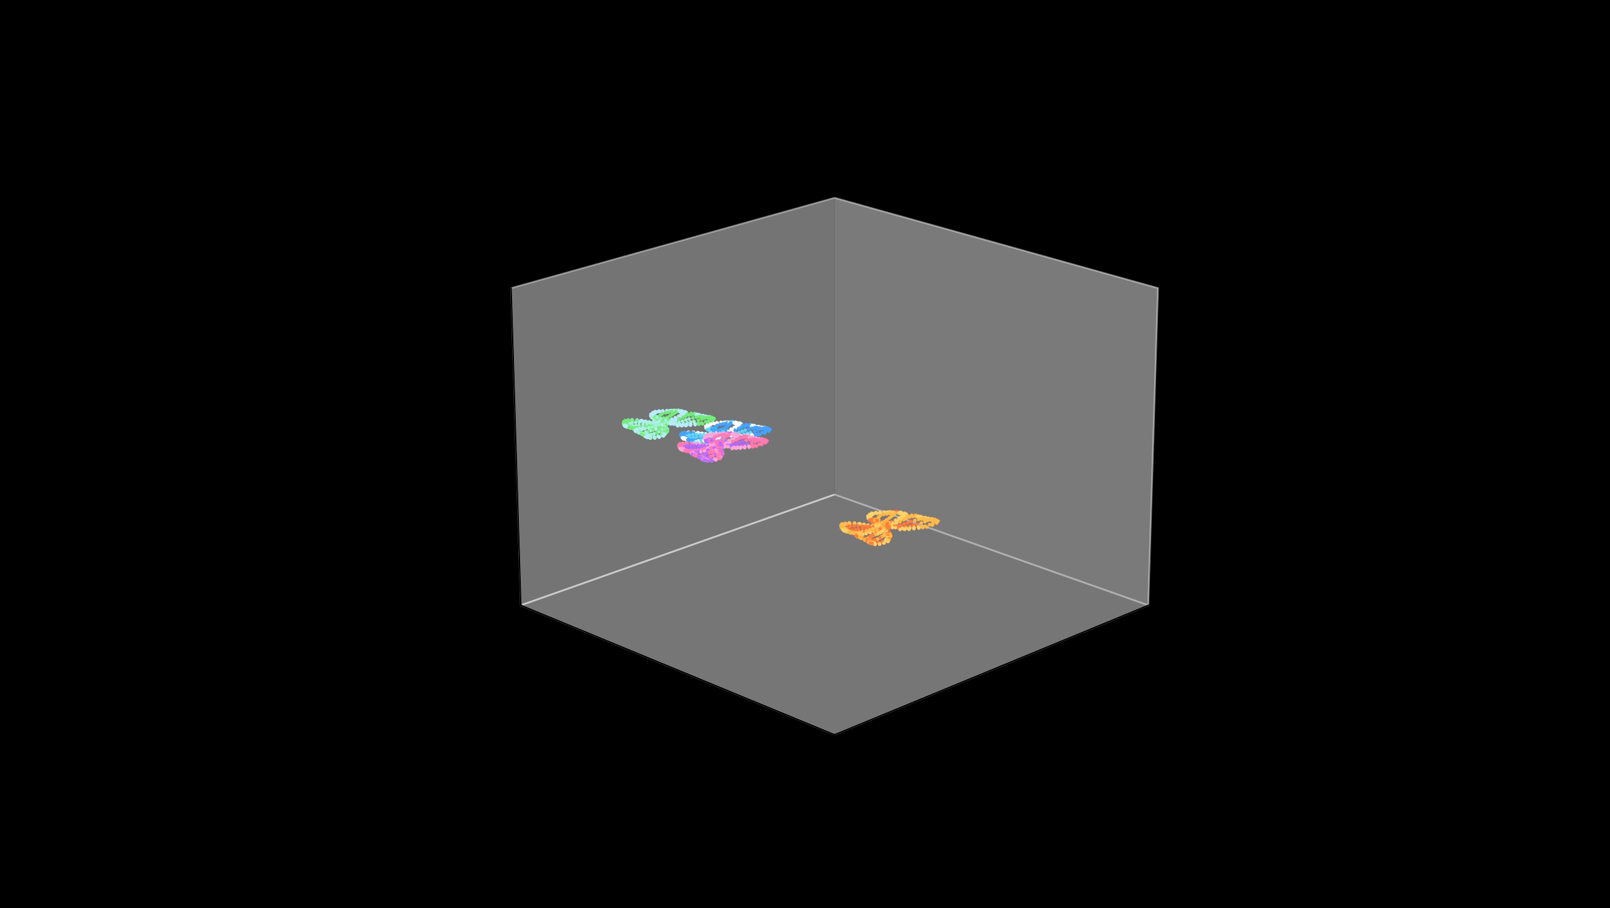

Slide 4
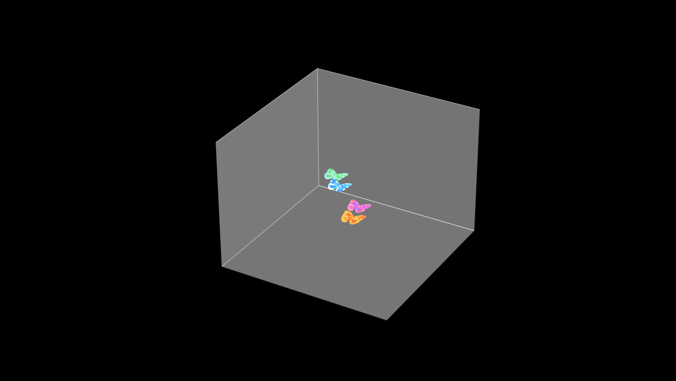

Slide 5
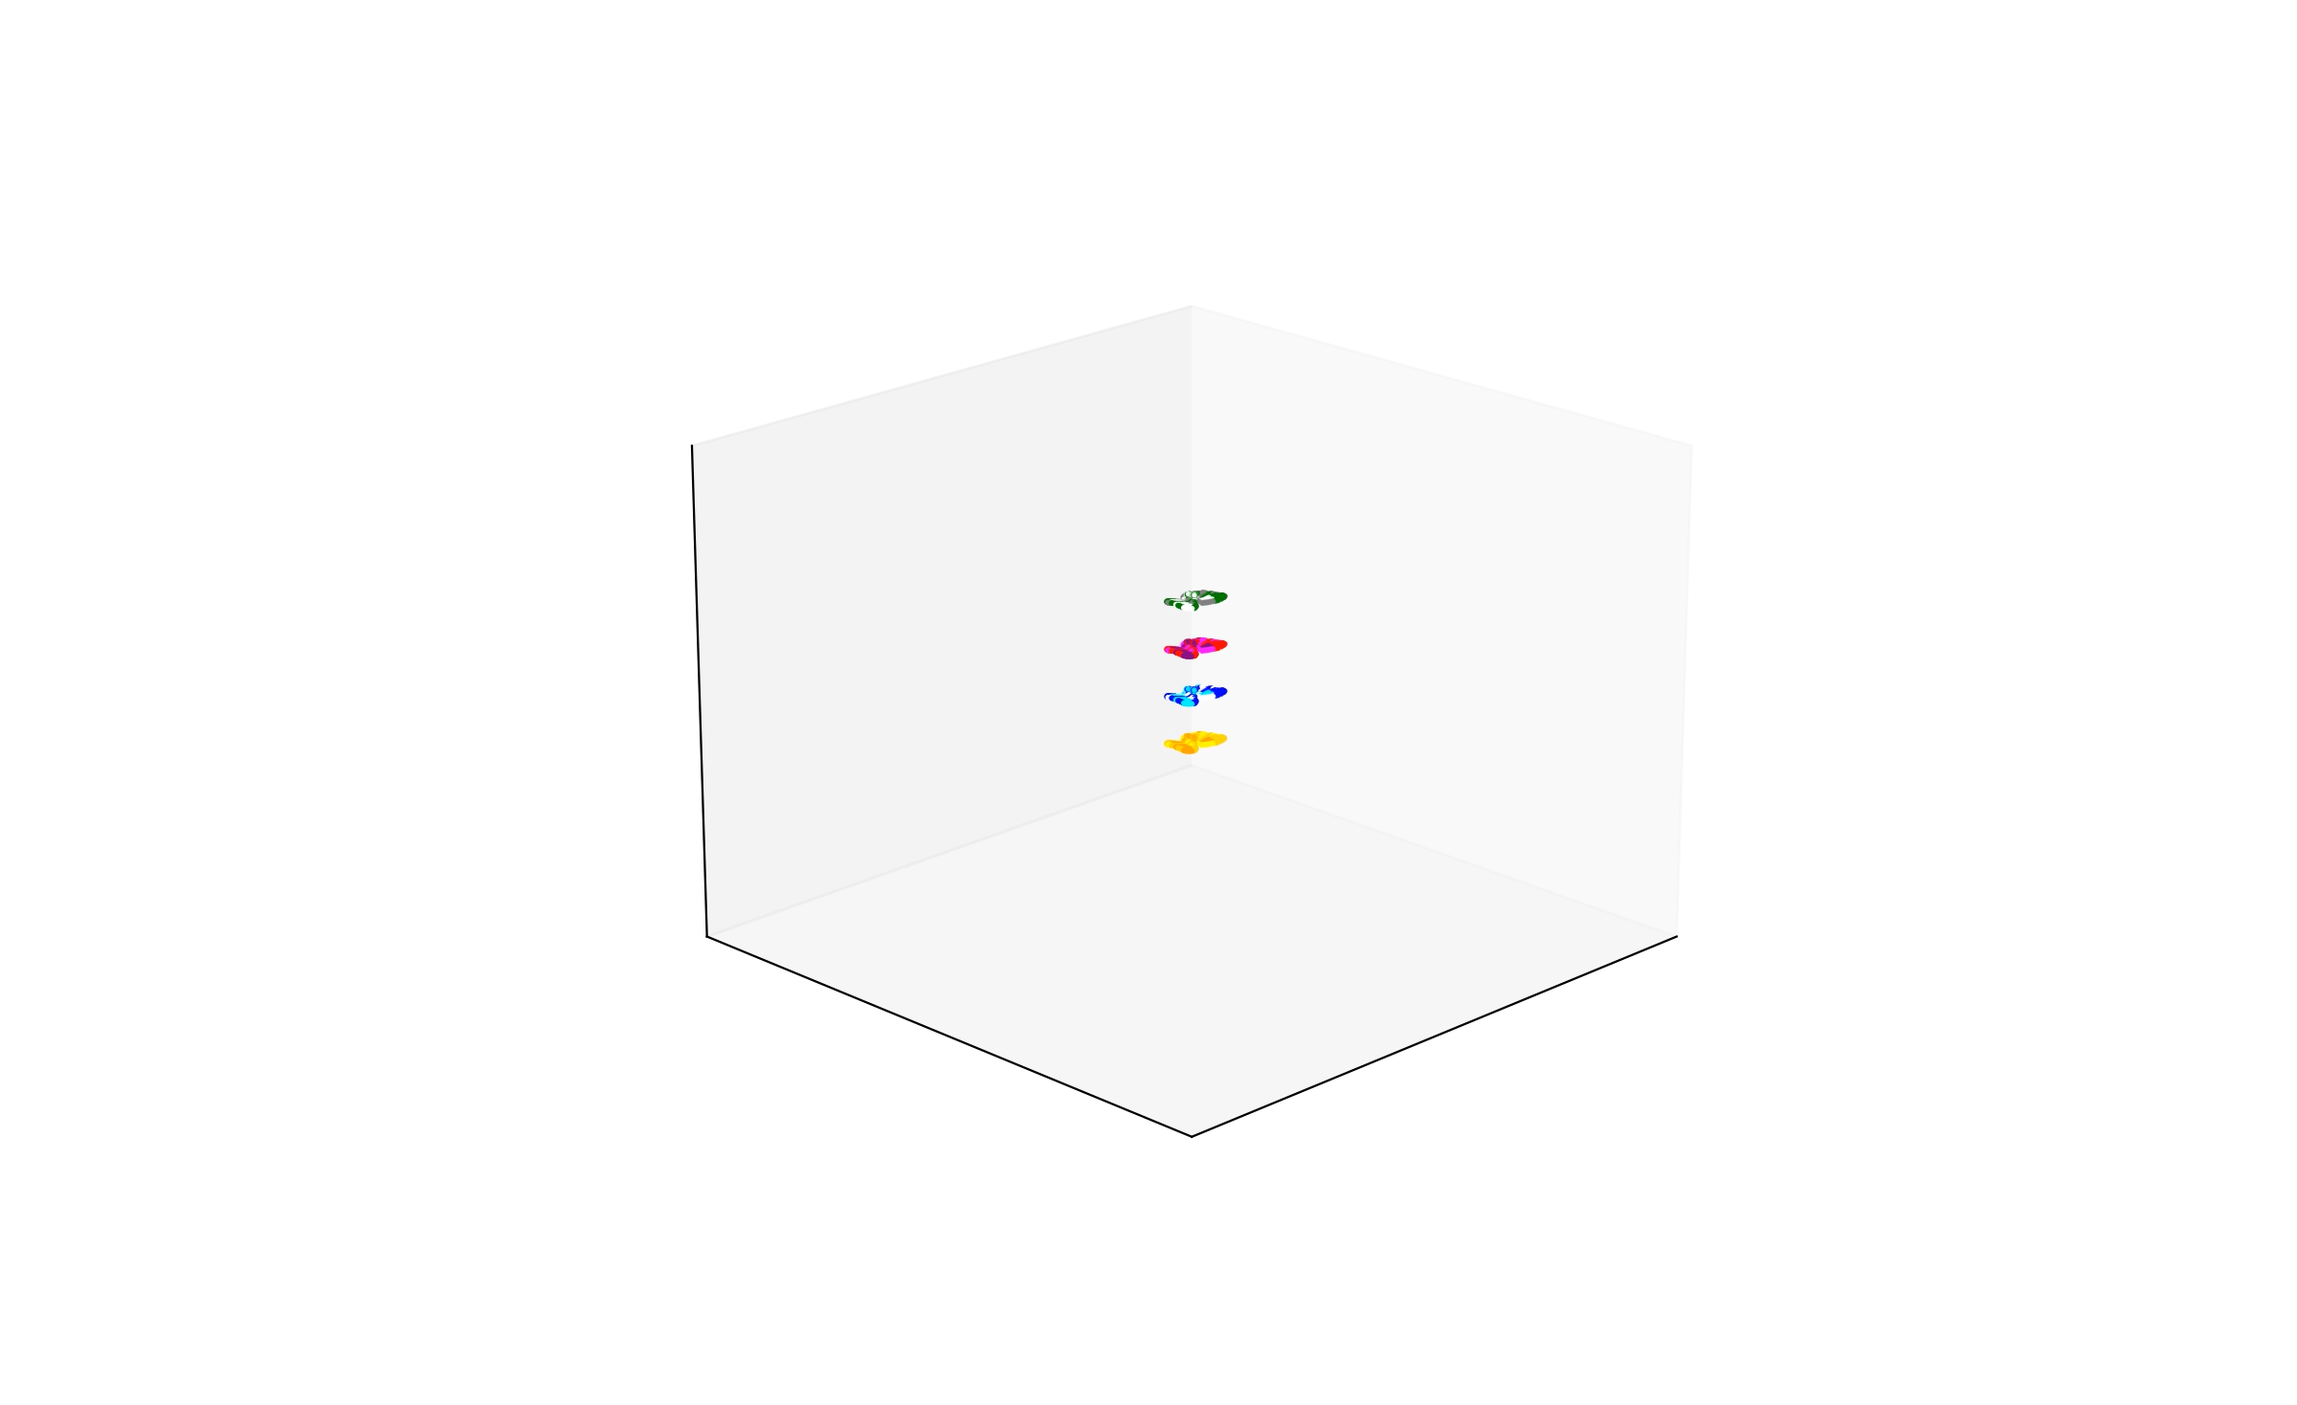

Slide 6
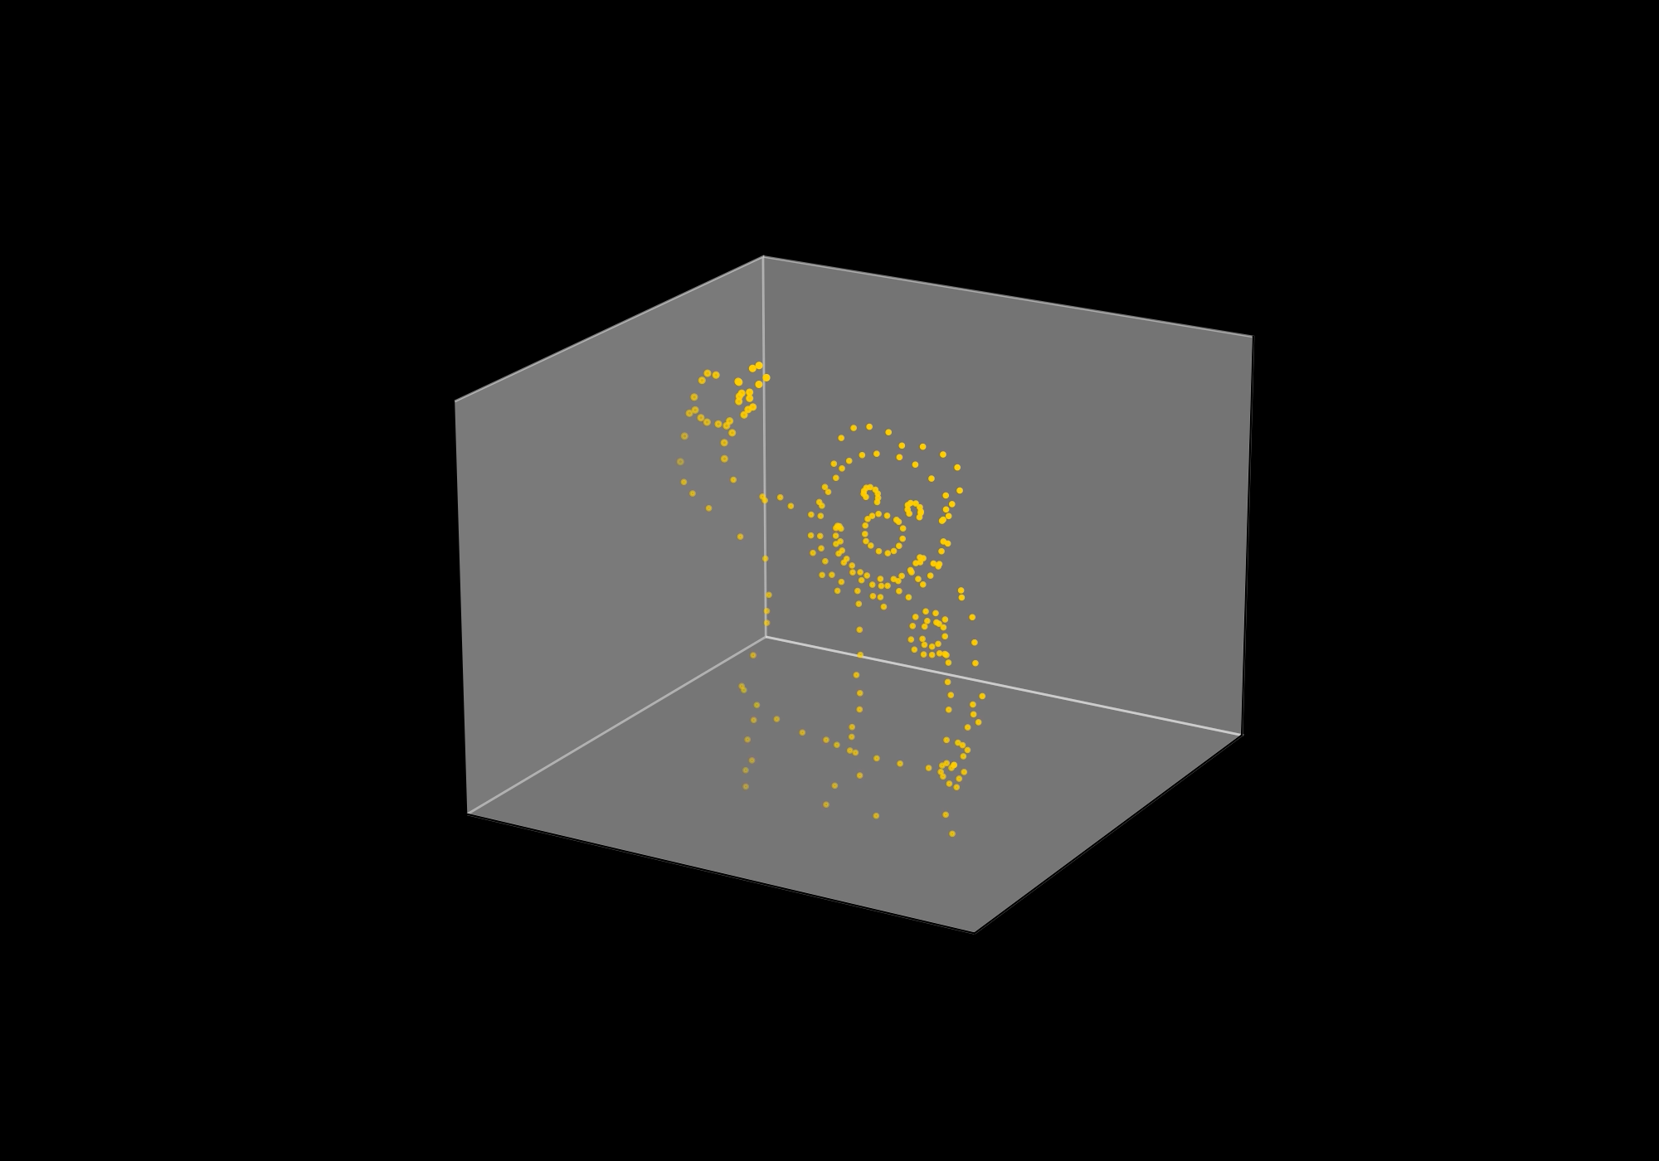

Slide 7
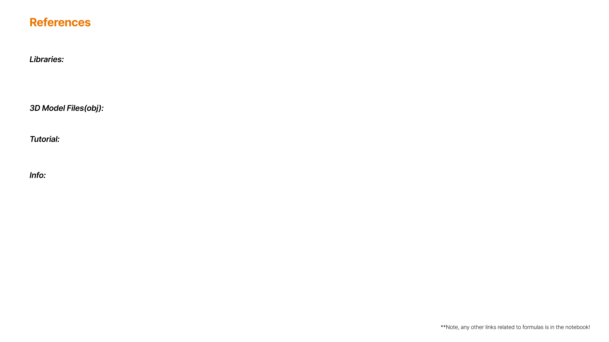
https://pypi.org/project/trimesh/
https://matplotlib.org/stable/api/animation_api.html
https://free3d.com/
https://www.youtube.com/watch?v=e4jqiZO_BqU
https://www.verge.aero/everything-about-drone-light-shows

