Slide 1
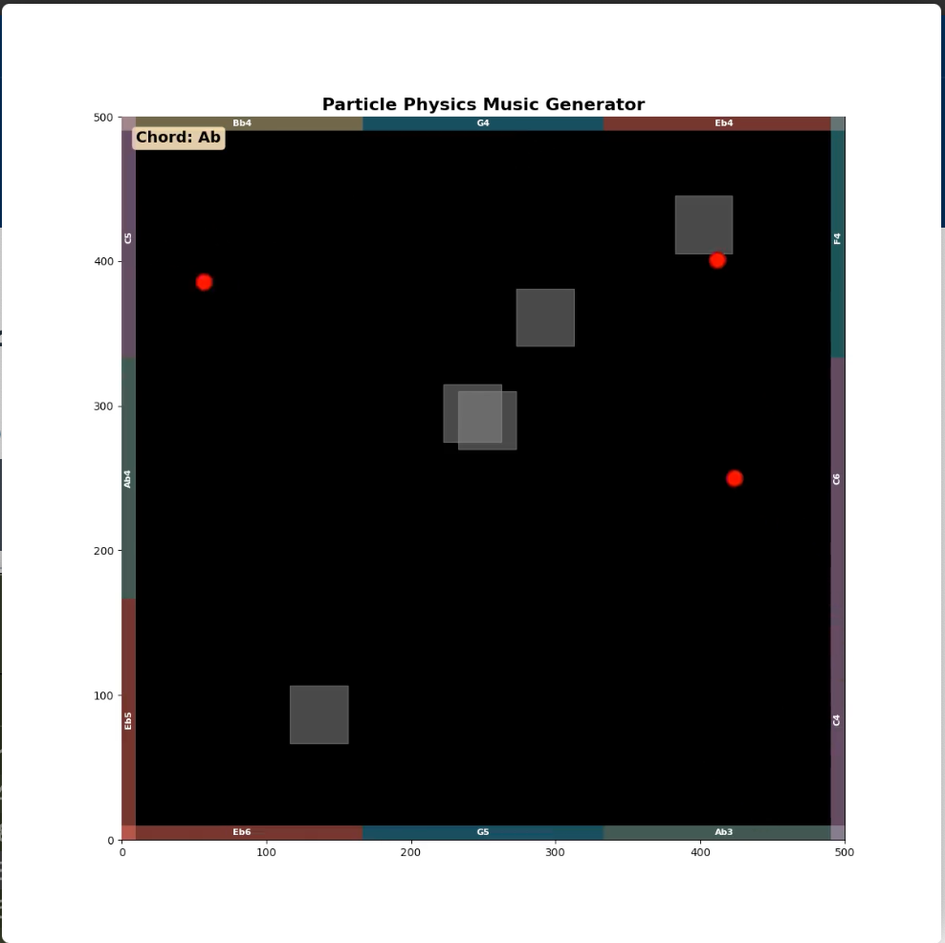
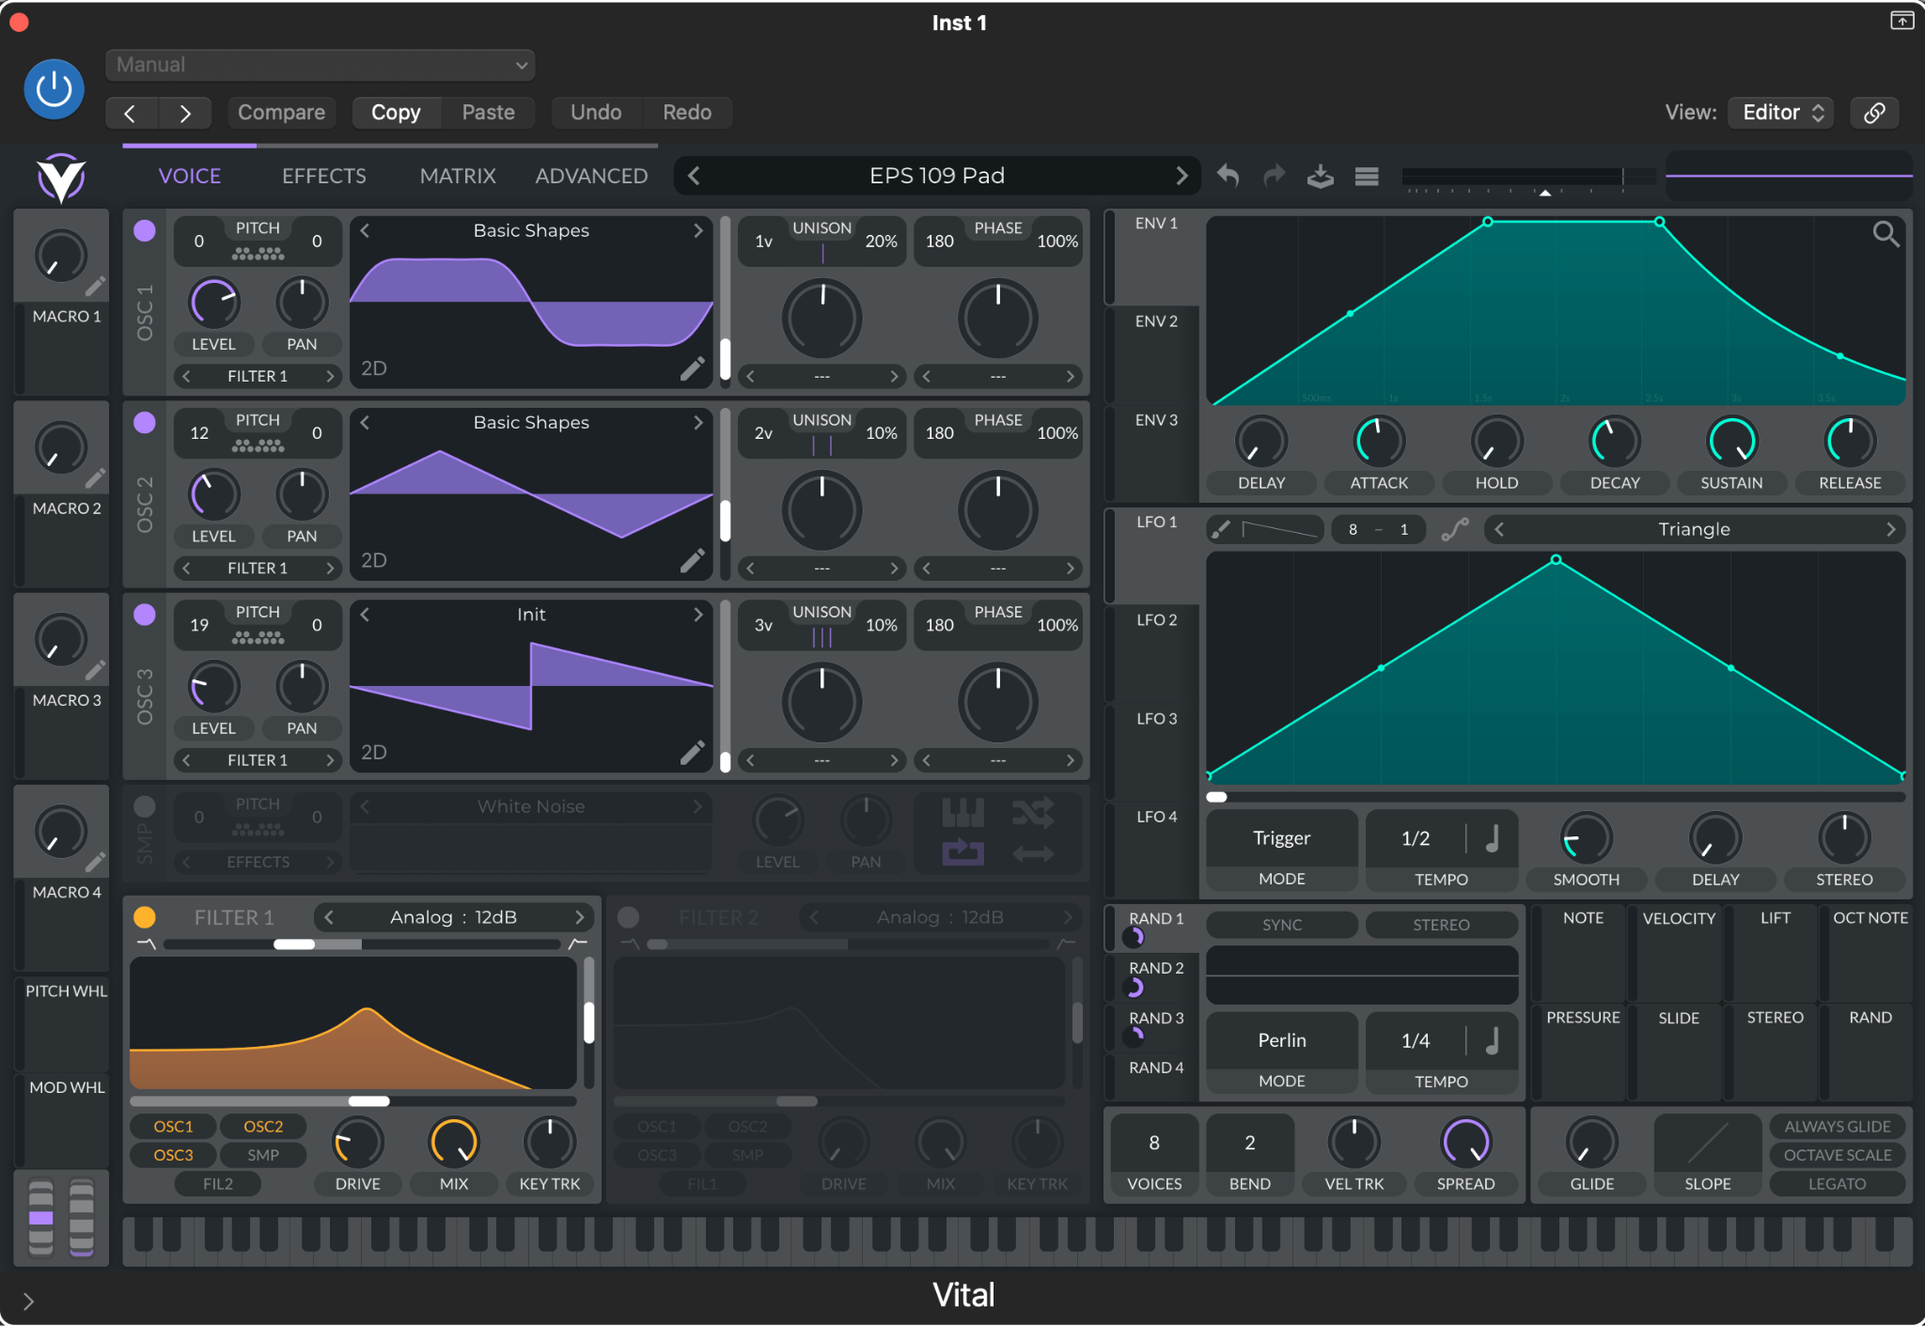
Generative Music Composition with Random Walks and Particle Physics
Anto Kam

Slide 2
Simulation Topic + Methods Used
Topic: Music composition using particle physics and Markov Chain-style chord progressions
Method:
There’s an FSM/Markov Chain that changes the chord playing from one to another with different probabilities (see next slides)
When a certain chord is selected, a random variation of the chord will be played (as a sustained chord pad). Most of these variations were generated by Generative AI, but the output was very bad so most were tweaked by me to actually sound a lot better
When a chord is selected, only certain (self-picked) melody notes are able to play. They are distributed evenly along the walls.
To get more variation in rhythm, obstacles are placed randomly on the field every chord change.
In parallel, there is a particle physics simulation where particles bounce off walls and obstacles
Wall collisions trigger melody notes based on where on the wall it hits
After the animation is simulated, the wall collisions and chord progressions are piped into a MIDI file
the goal was to play ambient music (similar to the style of Disasterpeace)
Python is (sadly) not the best for playing music, so this MIDI file is then inserted into a DAW (Logic Pro) with a free synthesizer. The preset files can be found as additional files to this submission.

Slide 3
Simulation Topic + Methods Used

Slide 4
Simulation Markov Chain
TRANSITIONS: dict[Chord, list[tuple[Chord, float]]] = {
Chord.Eb: [(Chord.Ab, 0.35), (Chord.Cm, 0.3), (Chord.Fm, 0.15), (Chord.Bb, 0.1), (Chord.Eb, 0.1)],
Chord.Fm: [(Chord.Cm, 0.3), (Chord.Ab, 0.25), (Chord.Gm, 0.25), (Chord.Bb, 0.1), (Chord.Fm, 0.1)],
Chord.Gm: [(Chord.Ab, 0.3), (Chord.Cm, 0.25), (Chord.Fm, 0.2), (Chord.Bb, 0.15), (Chord.Gm, 0.1)],
Chord.Ab: [(Chord.Cm, 0.3), (Chord.Fm, 0.3), (Chord.Eb, 0.2), (Chord.Bb, 0.1), (Chord.Ab, 0.1)],
Chord.Bb: [(Chord.Cm, 0.3), (Chord.Eb, 0.3), (Chord.Ab, 0.3), (Chord.Bb, 0.1)],
Chord.Cm: [(Chord.Eb, 0.25), (Chord.Ab, 0.25), (Chord.Fm, 0.25), (Chord.Bb, 0.15), (Chord.Cm, 0.1)],
}

Slide 5
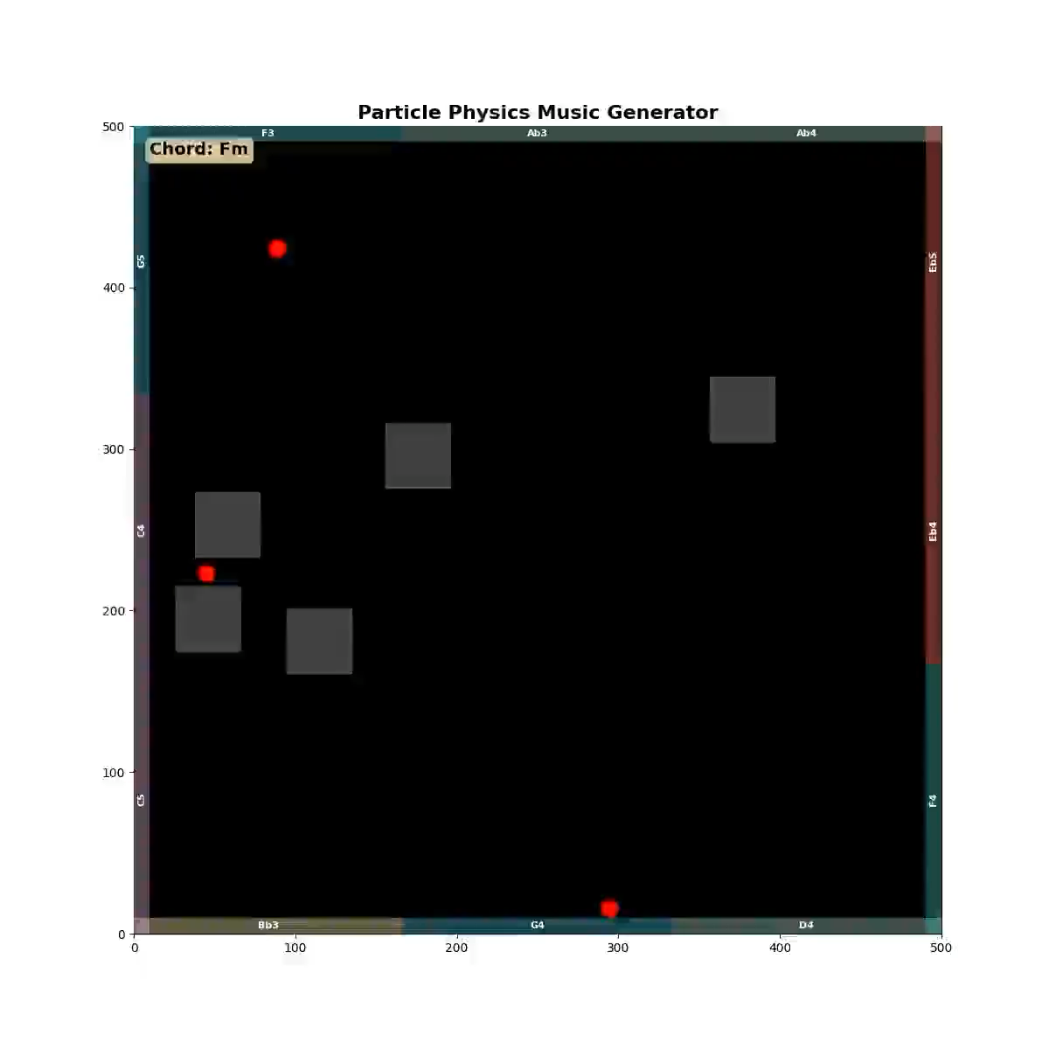
Animation

