Slide 1
Beyond What’s Visible: Flying into The Triangulum Galaxy
“Image Credit: ESA/Hubble”
Notes:
---
This presentation introduces a space-themed template designed to simulate a journey flying into a galaxy. We will explore the various slide templates included to create an immersive cosmic experience.

Slide 2
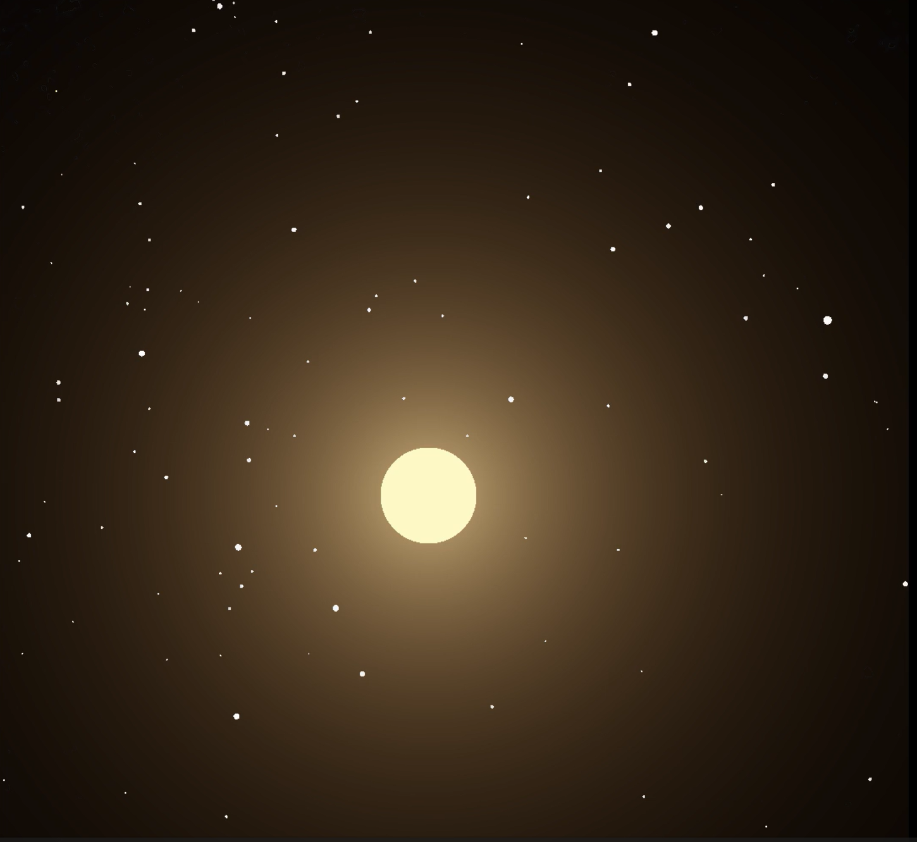
My Simulation Topic
A multi-phase fly through visualization of M33 (Triangulum Galaxy), transitioning from the original Hubble image (4k version) into a starfield fly-through, and then focusing on a single star that undergoes a planetary transit
Notes:
---
The title slide sets the tone with a captivating cosmic background and bold typography. It immediately immerses the audience in the theme of space exploration and the galaxy simulation journey.
Image source: Microsoft 365 content library

Slide 3
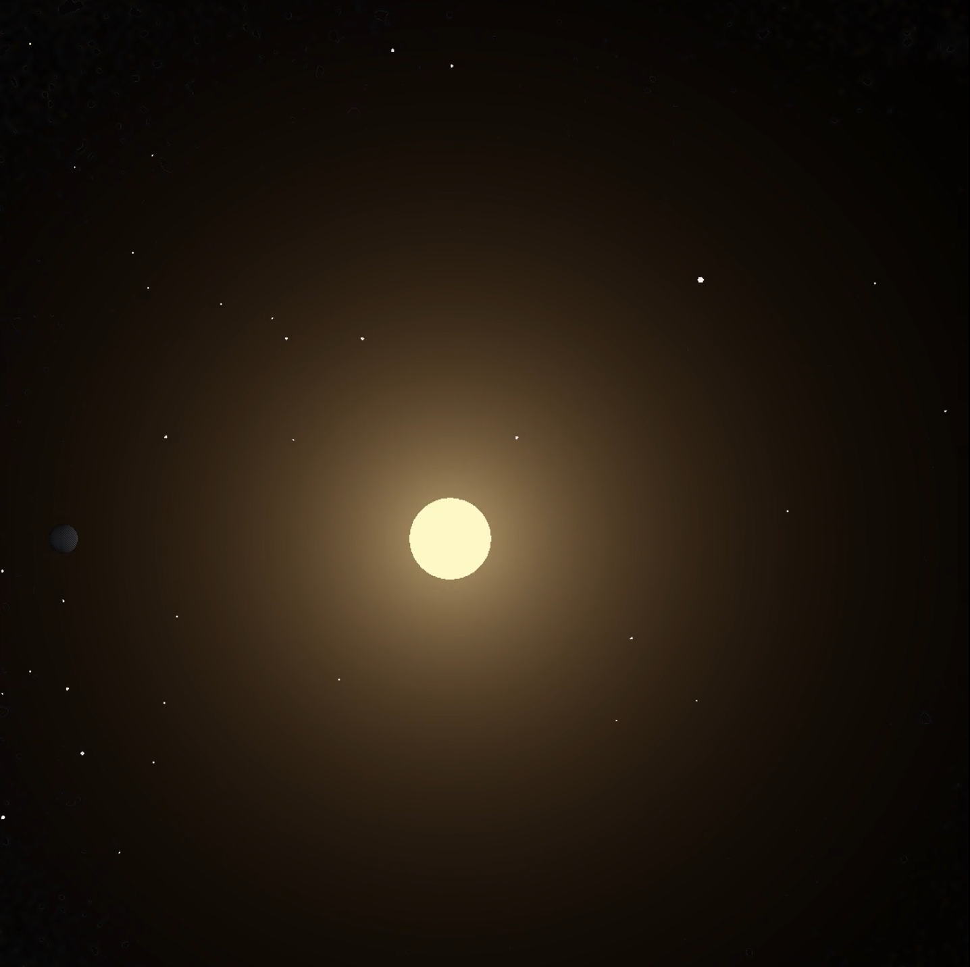
My Simulation Topic Cont
5 Phases:
Phase 1: Galaxy zoom-in and background dimming. Starts 2D
Phase 2: 2D becomes 3D with radial changing of star’s position and changing of star’s brightness. New star generation emerges and adjustment of remaining stars from original image. Create star that will be zoomed in on.
Phase 3: Zoom in on one star
Phase 4: Deceleration of motion to a complete stop
Phase 5: Planetary transit across star
Notes:
---
The title slide sets the tone with a captivating cosmic background and bold typography. It immediately immerses the audience in the theme of space exploration and the galaxy simulation journey.
Image source: Microsoft 365 content library

Slide 4
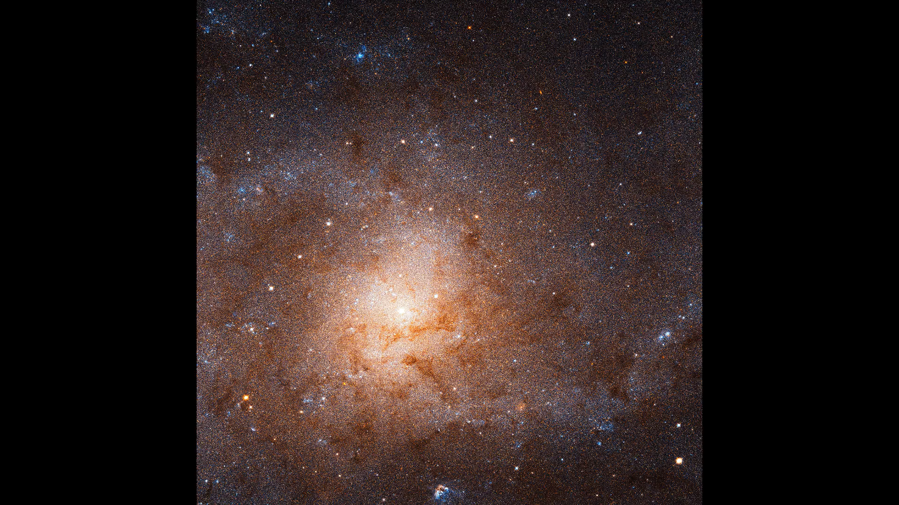

Slide 5
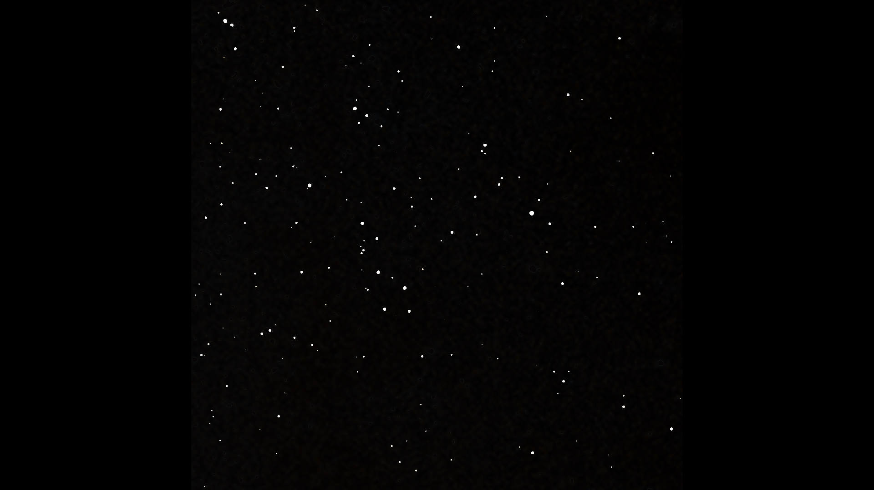
Challenges and Solutions
A major challenge throughout this project was figuring out ways to meld the different phases together without visual discontinuities.
Naturally, things faraway look 2D, like the galaxy, but as you get closer it will become 3D.
Zooming into the picture decreases the resolution and stars become smudged.
2D -> 3D transition solution: Dim the background, speed continuity, upscaling, and score method to determine the center of each star blob
General things necessary for a realistic effect:
Differing the speed and brightness of stars based on radial distance from the frame’s exact center
Continuity of star location and speed across different phases (very challenging but beautiful effect)
Continuing the background star motion while expanding the main star’s radius and its surrounding glow (radius-based inverse-square brightness model)
Simulating the exoplanet’s lighting, size, and motion going out and coming back into frame
Notes:
---
The animation slide template incorporates dynamic effects to simulate flying through the galaxy. Smooth transitions and animated stars or celestial bodies engage viewers and enhance the sense of cosmic travel.
Image source: Microsoft 365 content library

Slide 6
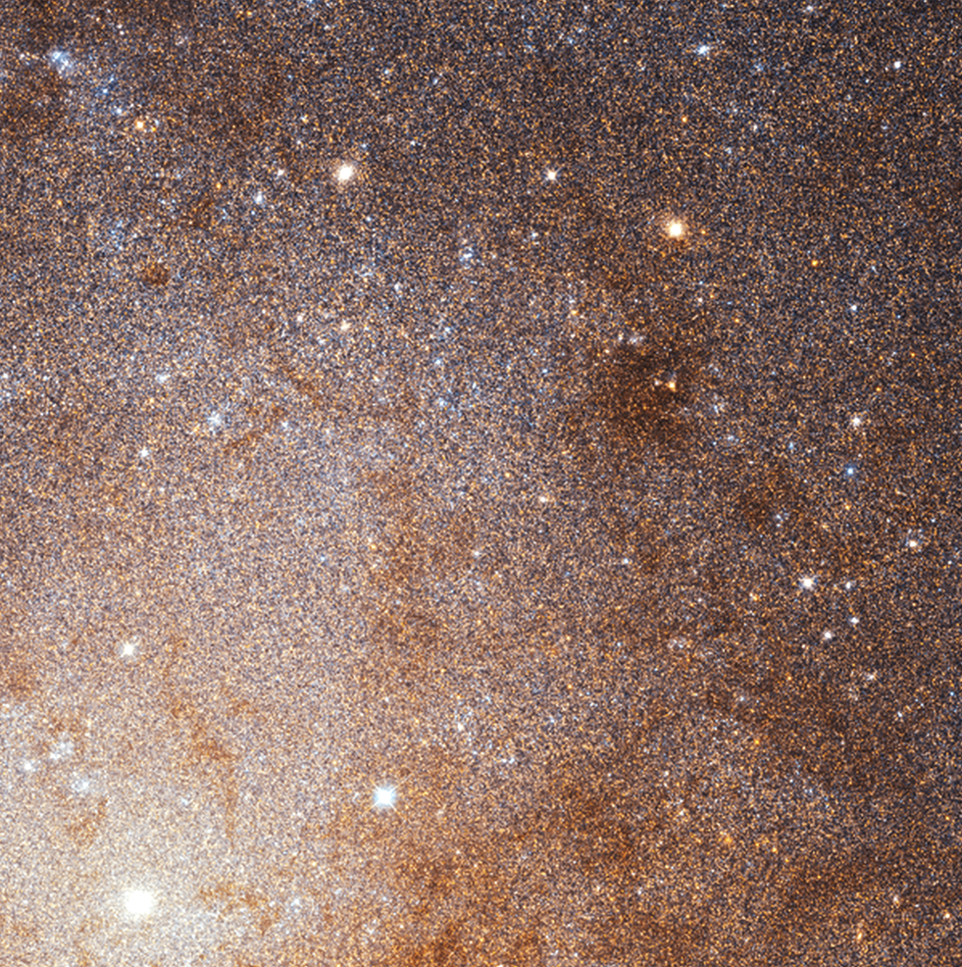
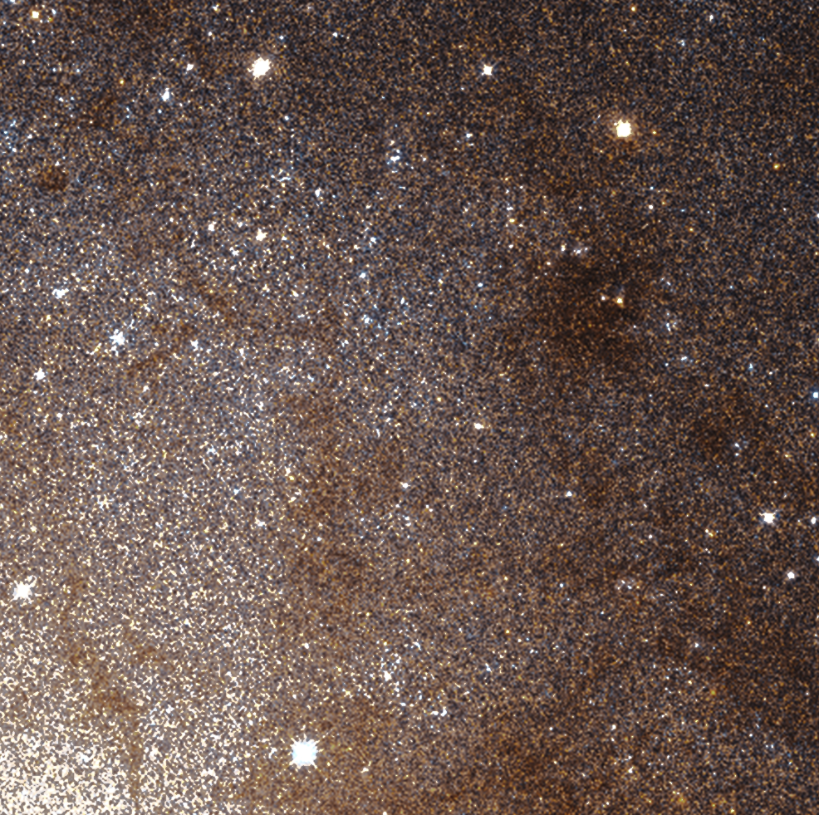
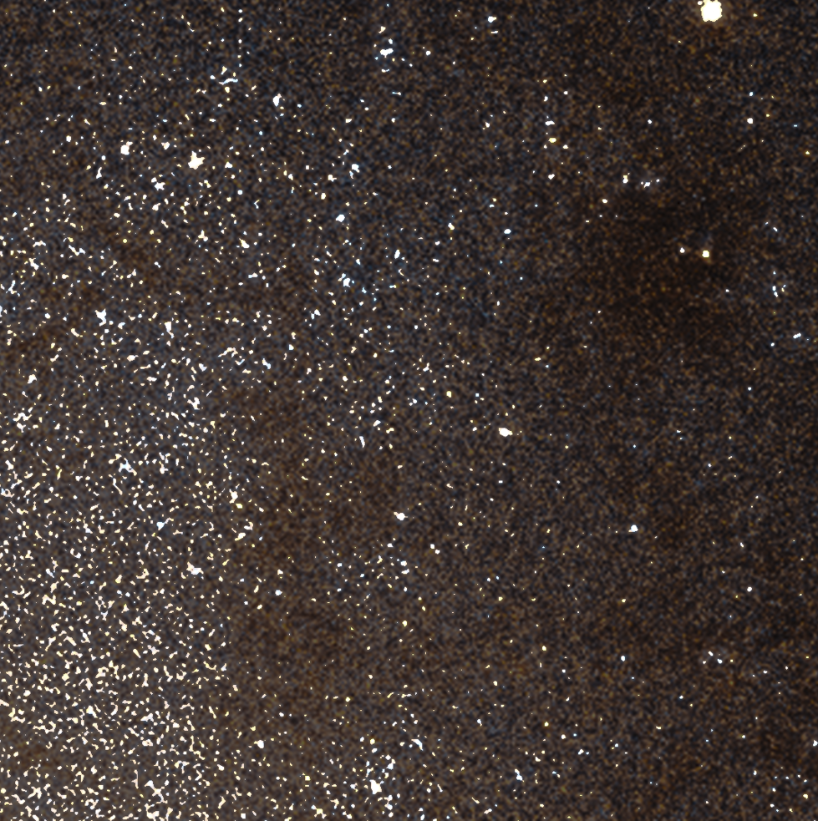
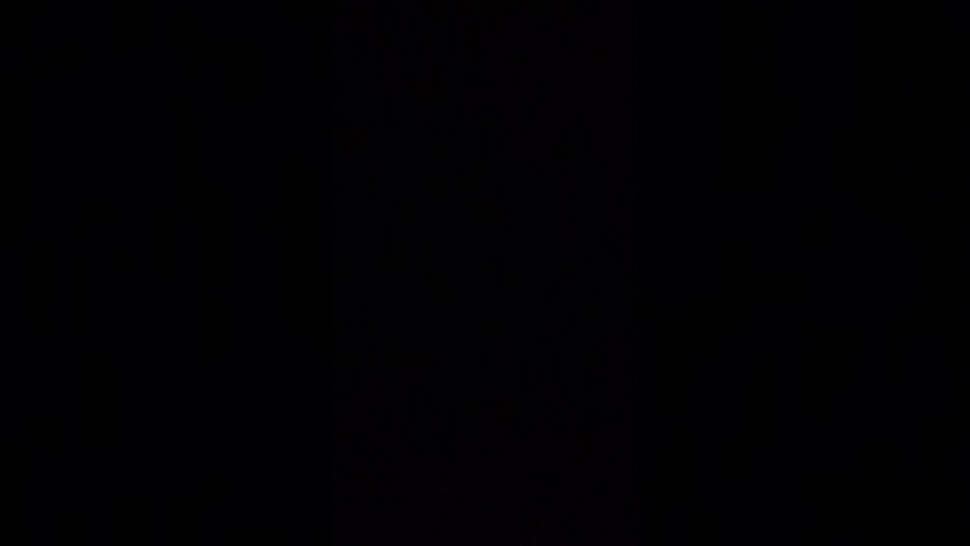
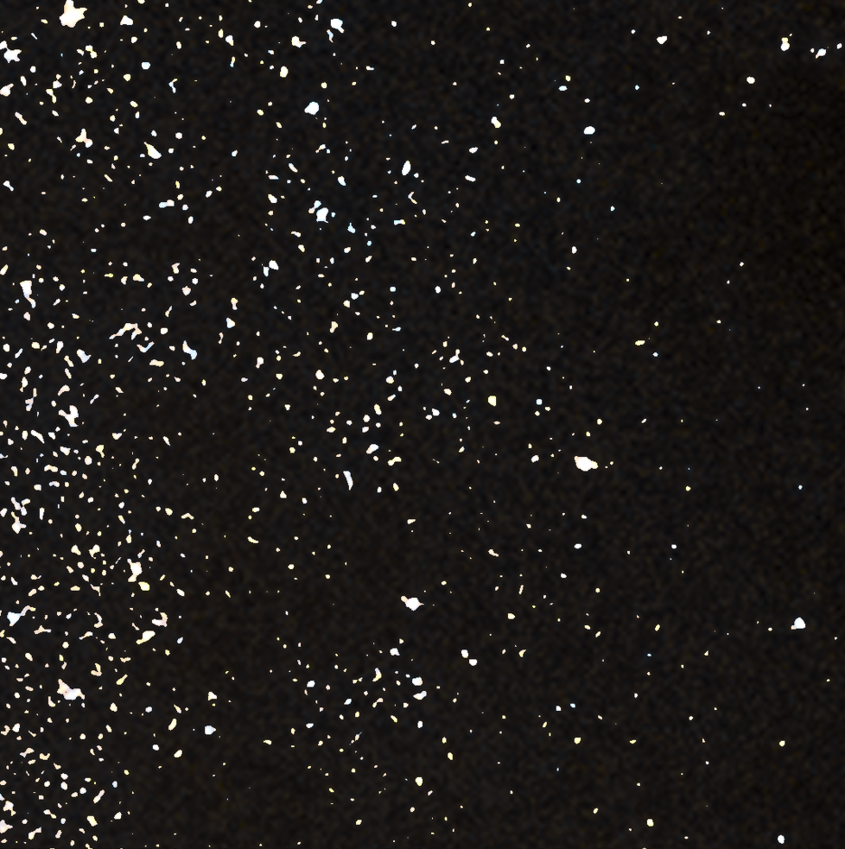
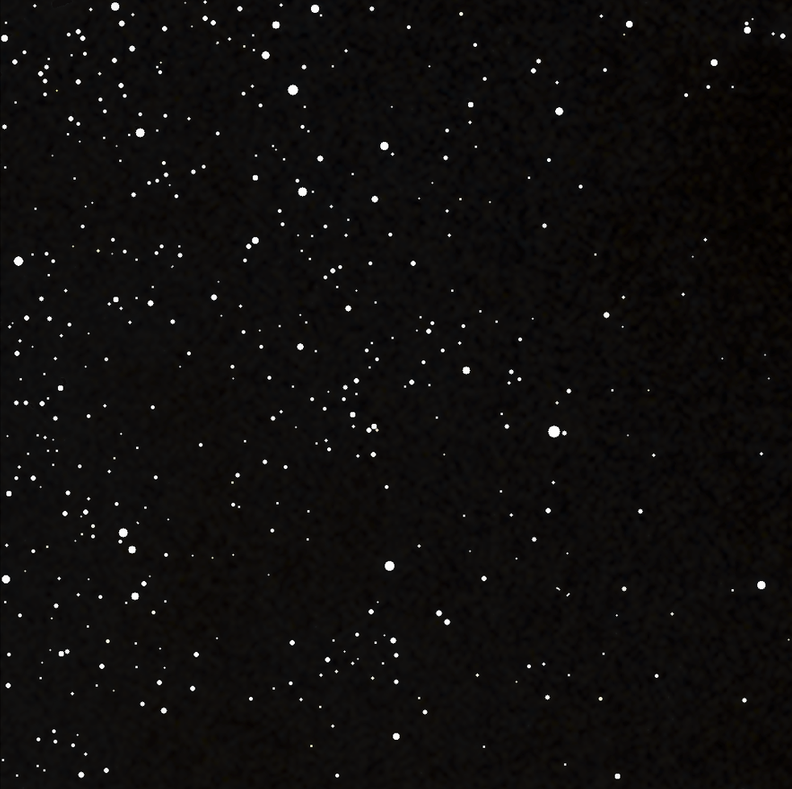

Slide 7
Methods
Cropping
Upscaling
Unsharp-mask sharpening (Gaussian blur + high-pass)
Brightness mapping via Gaussian-smoothed grayscale
Score method to sharpen image resolution
Speed and brightness of stars based on radial distance
Primary star radius growth with linear expansion + inverse-square brightness law with caps
Continuing the radial star motion model with brightness- and radius-dependent displacement to create brightness.
Deceleration
Planet orbit kinematics (circular x–z orbit + linear x sweep)
Lambertian shading for the planet (normal· sun direction)
Procedural rocky texture via position-based sinusoidal modulation

Slide 8
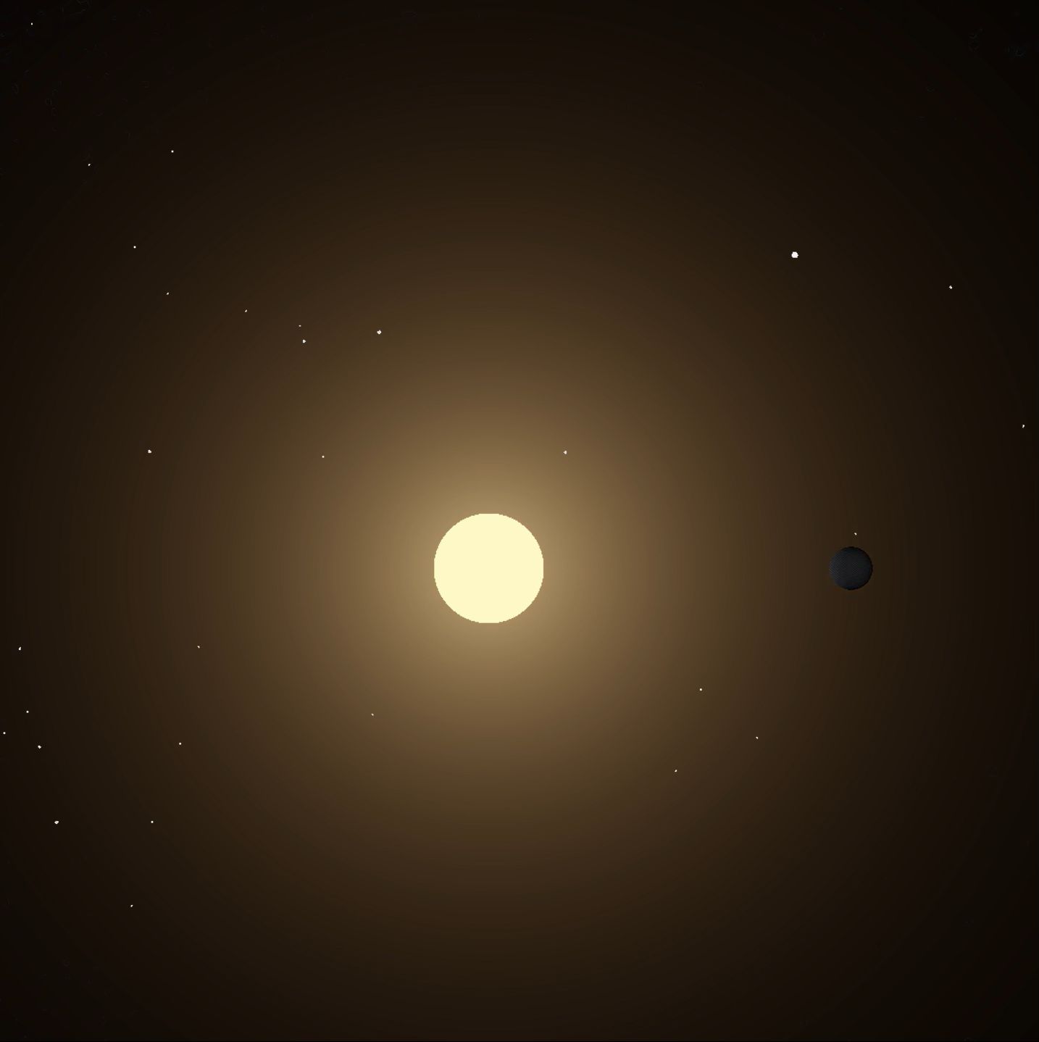
Libraries
Simulation
NumPy
Matplotlib
SciPy.ndimage
  Gaussian_filter
  Zoom (imported as nd_zoom)
  Shift (imported as nd_shift)
Notes:
---
The title slide sets the tone with a captivating cosmic background and bold typography. It immediately immerses the audience in the theme of space exploration and the galaxy simulation journey.
Image source: Microsoft 365 content library

Slide 9
Works CiTED
ESA/Hubble. “The sharpest view ever of the Triangulum Galaxy (HEIC-1901A).” © ESA/Hubble, 7 January 2019. Available at: https://esahubble.org/images/heic1901a/. Accessed 20 November 2025.

