Slide 1
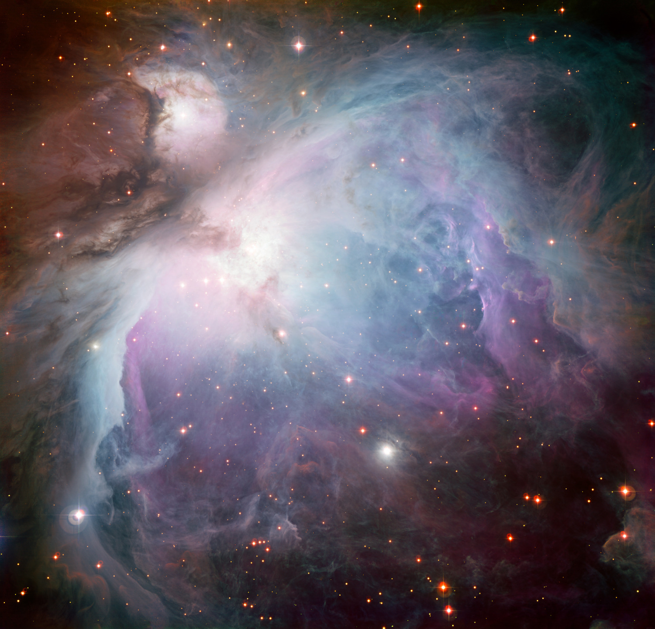
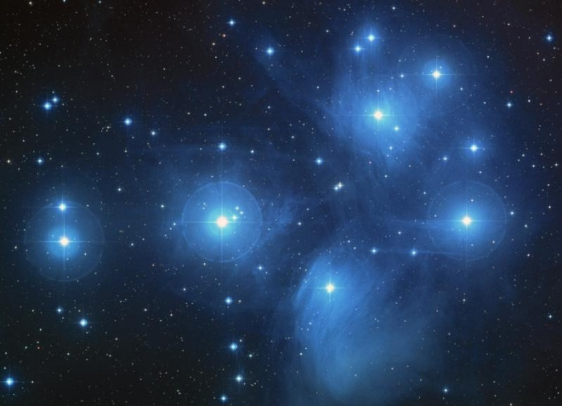
The Birth of a Star Cluster
Riley Patlak – EPS 109

Slide 2
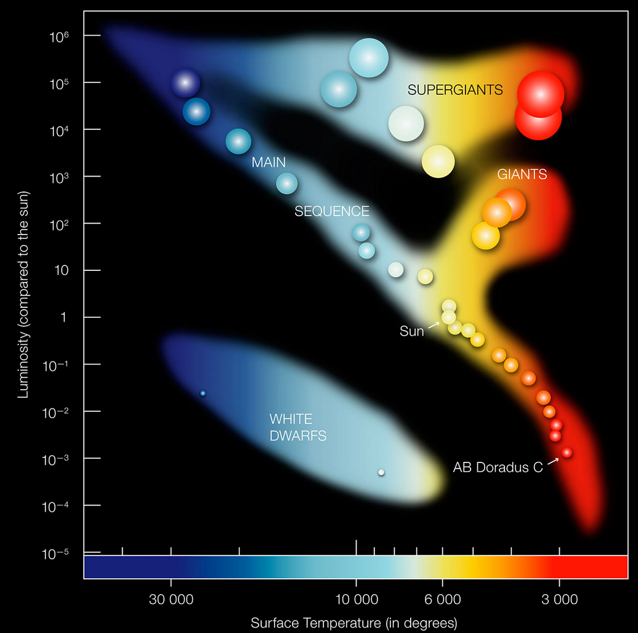
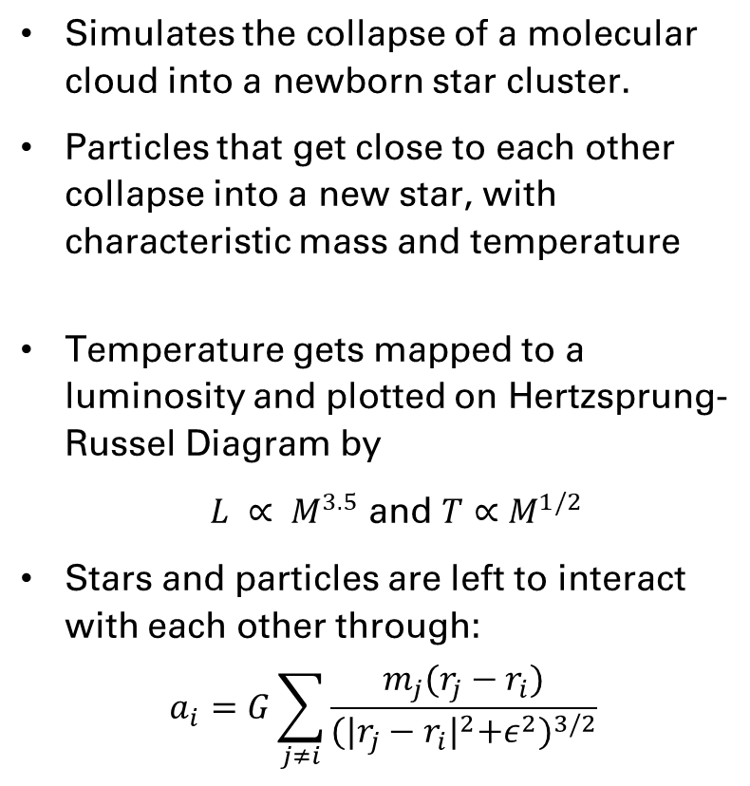
Simulation
Simulates the collapse of a molecular cloud into a newborn star cluster.
Particles that get close to each other collapse into a new star, with characteristic mass and temperature
Temperature gets mapped to a luminosity and plotted on Hertzsprung-Russel Diagram by
$L ∝ M^{3.5}$ and $T∝M^{1/2}$
Stars and particles are left to interact with each other through:
$$a_{i}=G\sum_{j≠i}{\frac{m_{j}(r_{j}−r_{i})}{{{(|r_{j}−r_{i}|}^{2}+ε^{2})}^{3/2}}}$$

Slide 3
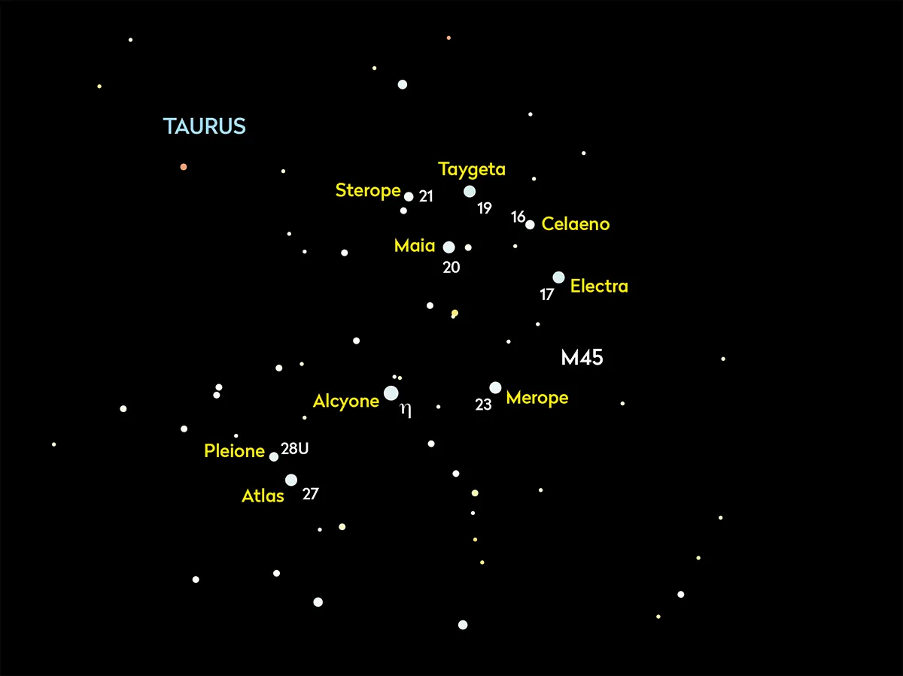
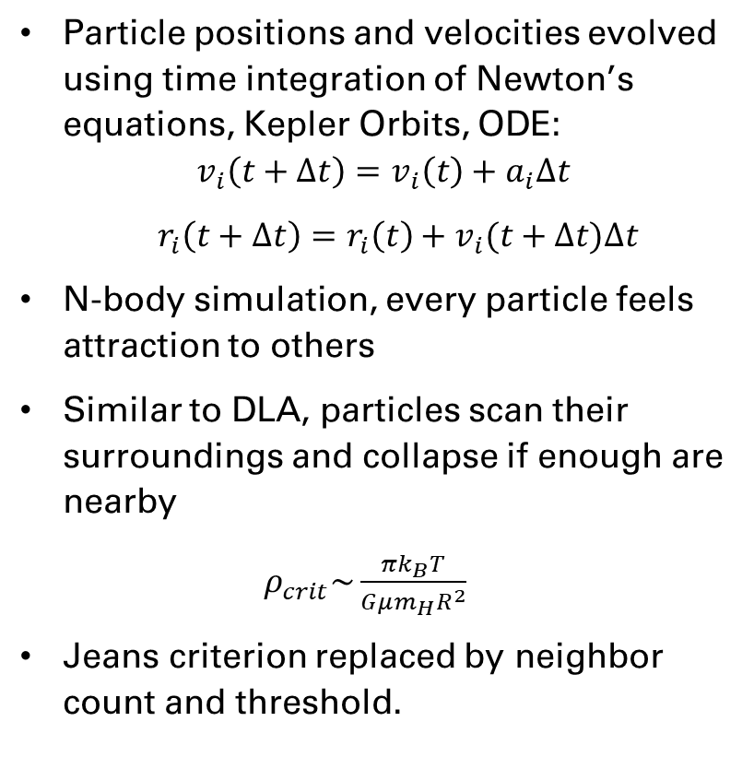
Methods
Particle positions and velocities evolved using time integration of Newton’s equations, Kepler Orbits, ODE:
$$v_{i}\left(t+∆t\right)=v_{i}\left(t\right)+a_{i}∆t$$
$r_{i}\left(t+∆t\right)=r_{i}\left(t\right)+v_{i}(t+∆t)∆t$
N-body simulation, every particle feels attraction to others
Similar to DLA, particles scan their surroundings and collapse if enough are nearby
$ρ_{crit}\sim \frac{πk_{B}T}{Gμm_{H}R^{2}}$
Jeans criterion replaced by neighbor count and threshold.

Slide 4
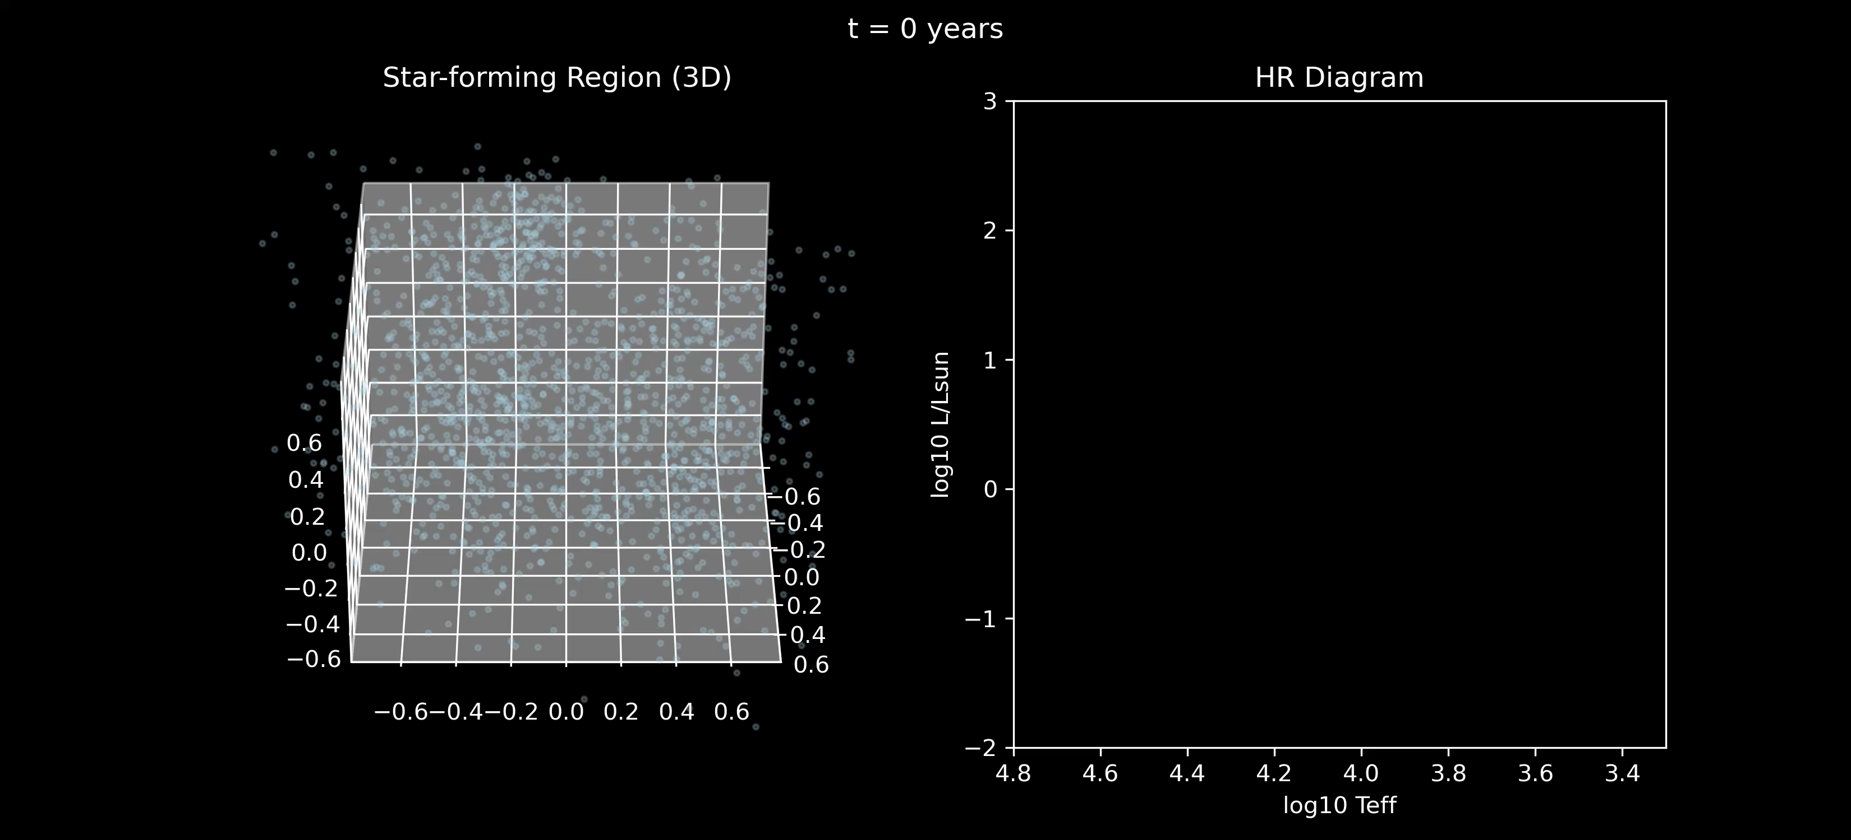

Slide 5
