Slide 1
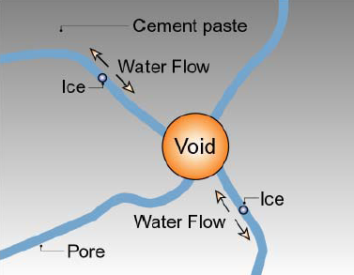
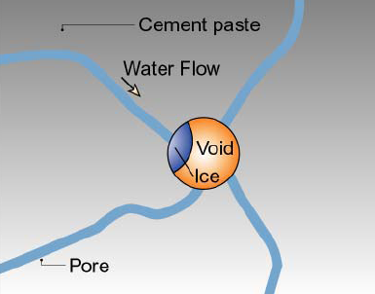
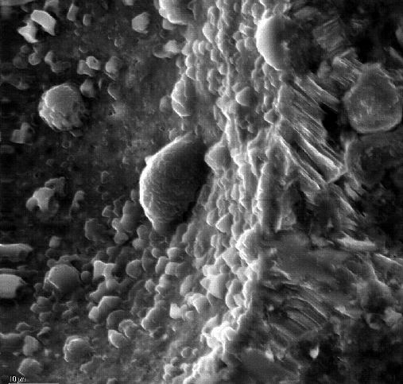
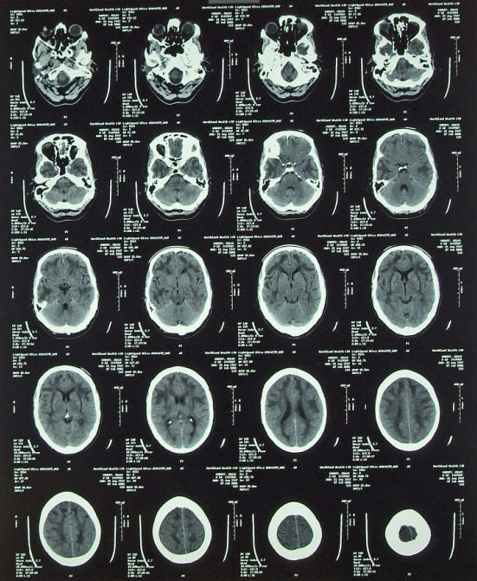
3D void distribution in concrete
2011 Spring, EPS207, Juhyuk Moon
Background:
Objective:
Effects of curing temperature &
ASR(alkali-silica reaction) on void distribution
Method:
Micro-Tomography
Construct 3D void map using Matlab
http://www.ce.berkeley.edu/~paulmont/
Problem!
Solution!

Slide 2
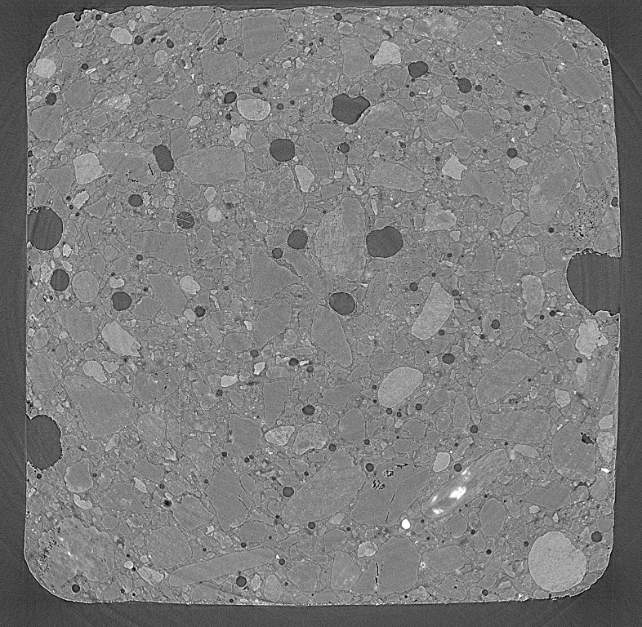
1st image of 500 stacking images
Original :2075 by 2075 Pixels
Resize to 500 by 500 Pixels
Scale: 1pixel = 0.0087 mm
Void
Matrix
Aggregate
4.35 mm
18 mm
0.87 mm

Slide 3
Void segmentation
<original image>
<bw, 0.46 thresh>
<median smoothing w/ size 2>
<erode w/ radius 1>
<close w/ radius 2>
<open w/ radius 2>
<close w/ radius 5>
<void map, larger than 100 pixels>

Slide 4
3D-Reconstruction of void
85°C curing
85°C curing + ASR
20°C curing

Slide 5
3D Void distribution
A
4.35 mm
B
A
B

