Slide 1
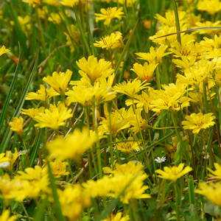
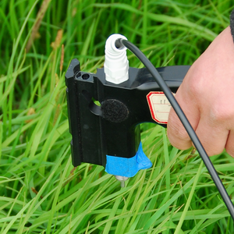
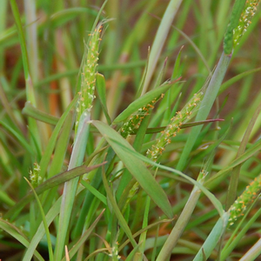
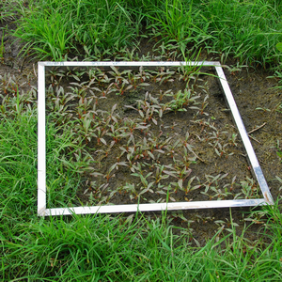
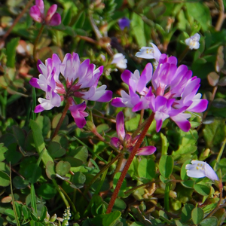
Estimating vegetation coverage from field photography
(an experiment with one human subject)
Iryna Dronova , ESPM
EPS 209 / Spring 2011 Final Class Project
UC Berkeley

Slide 2
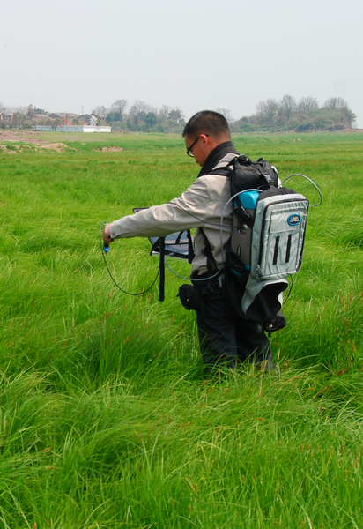
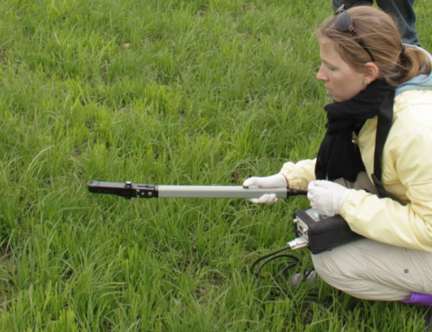
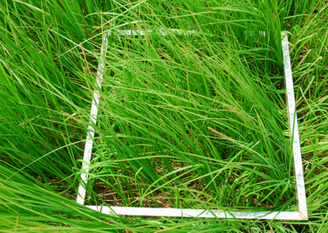
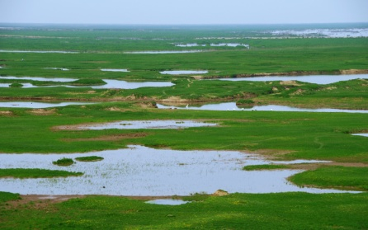
Background
Research: remote sensing of wetland vegetation in Poyang Lake, China
Field-measured plant properties:
  Often need to know %green plant cover
  in a location
  =plant-covered area/total area

Slide 3
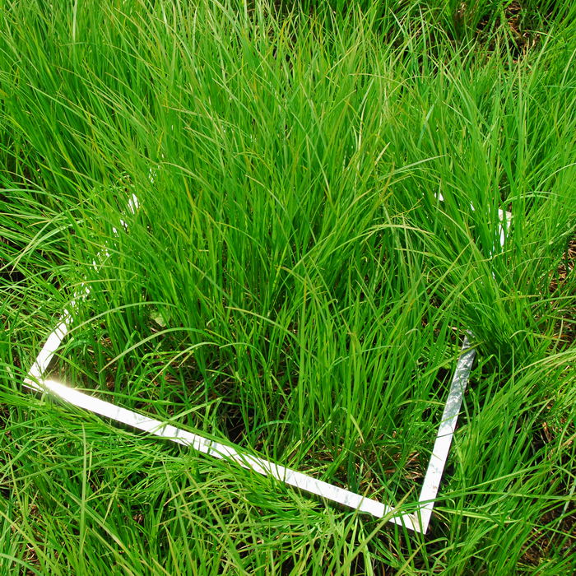
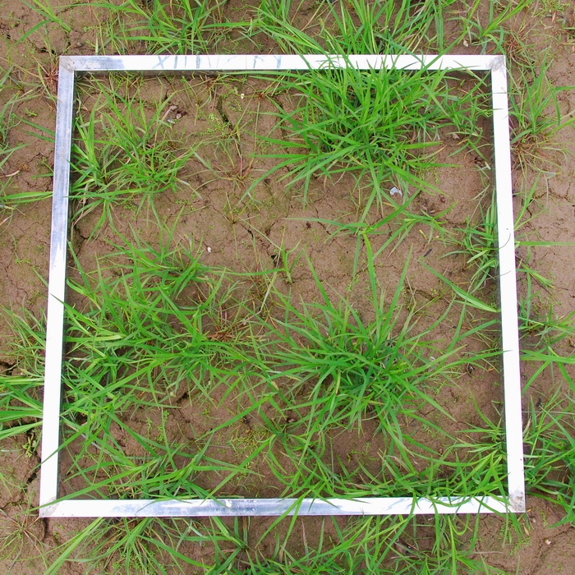
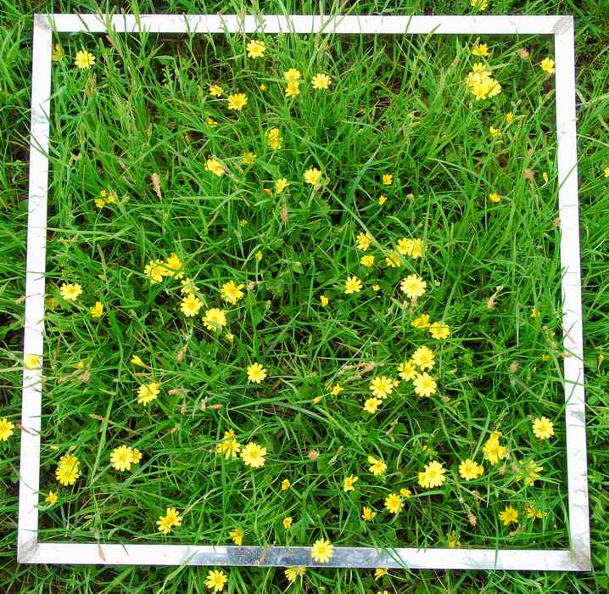
Field photo analysis
Guessing % cover “by eye”: high uncertainty
Objectives:
  estimate %green plant cover from field photos
  Experiment: compare to my visual ‘expert’ guesses?

Slide 4
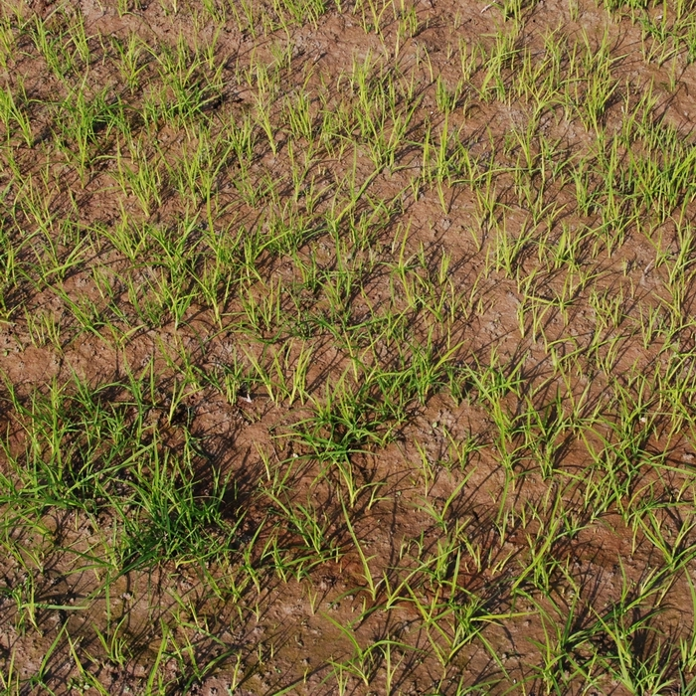
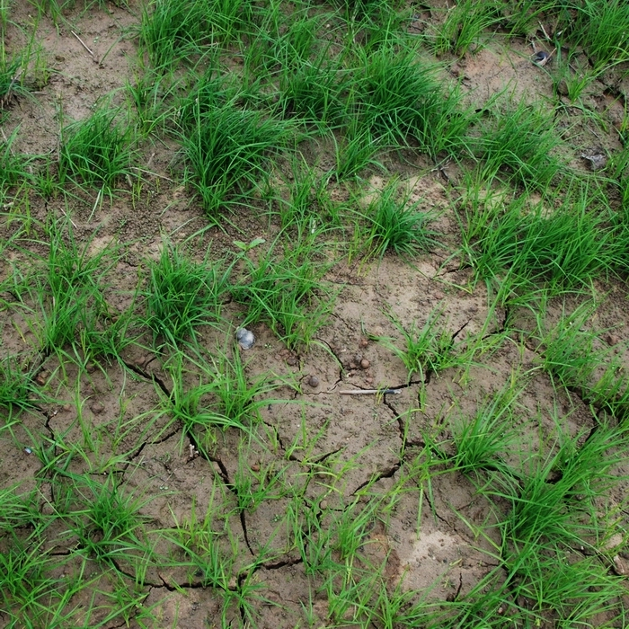
Green sedges (Carex spp.) over mud
High variability: need color-based classification
Smoothing filter ( 3 x 3 average)
Multiple point-clicking to select green
Multiple point-clicking to select background
Mahalanobis distance-based classification
Point-clicking (impixel) for sample selection:
regions hard to delineate; a lot of illumination and color variability

Slide 5
Example results 1
Two classes
(Green&Background)
Original image
One class (Green)
Field guess: ~40-45% green
42.6% green
42.6% green
Consistent here, but sometimes slightly different (dep. on background sample)

Slide 6
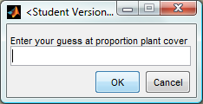
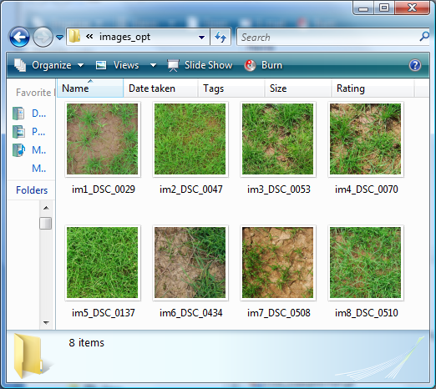
User guess on % cover versus code:
One-class
prompt = {'Enter your guess at proportion plant cover'};
N = inputdlg(prompt,name);
value0=N{1};
value1=str2num(value0);
8 images, 3 st dev thresholds
My underestimation or code overestimation due to biased samples?

Slide 7
How variable are my samples?
The effect of st.dev. threshold versus personal ‘noise’ in choosing samples –10 runs using the same image, 3 st dev thresholds
One class (green)
Two classes (green&background)
My field guess: ~50-55% green

Slide 8
Increasing the number of point-clicks:
Two classes
(Green&Background)
Original image
One class (Green)
My field guess: ~50-55% green
50.2% green
50.2% green
Larger number and more representative point clicks
Notes:
Shell is not classified

Slide 9
Final points:
Point-clicking method compared to guessing:
  Is flexible; accommodates image-to-image differences & thin leaves
  But sensitive to point-click sample selection, results can be variable
  Can be assessed against the original photo, unlike guess
Solutions to be tested in the future:
  Larger number of clicks
  Stronger pre-smoothing to reduce within-class variation
  Averaging multiple run results for the same image and get observation error (unlike with guess)
Code: batch processing multiple images
  This project: individual illumination and phenology differences
  If similar photos are available, easy to adjust for batch processing

Slide 10
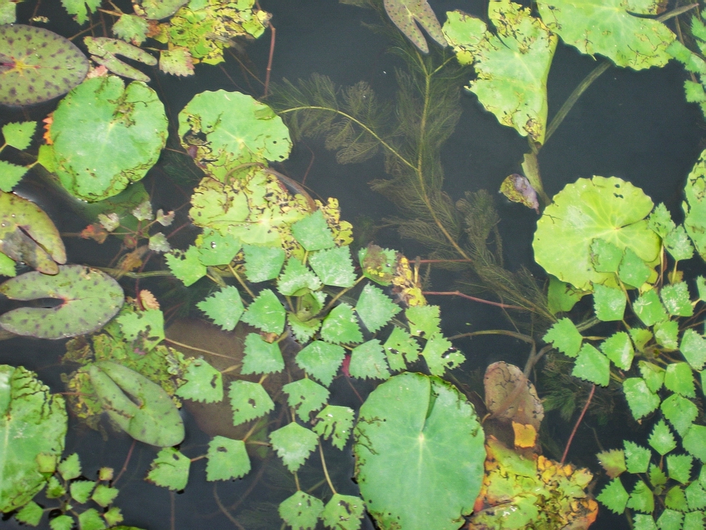
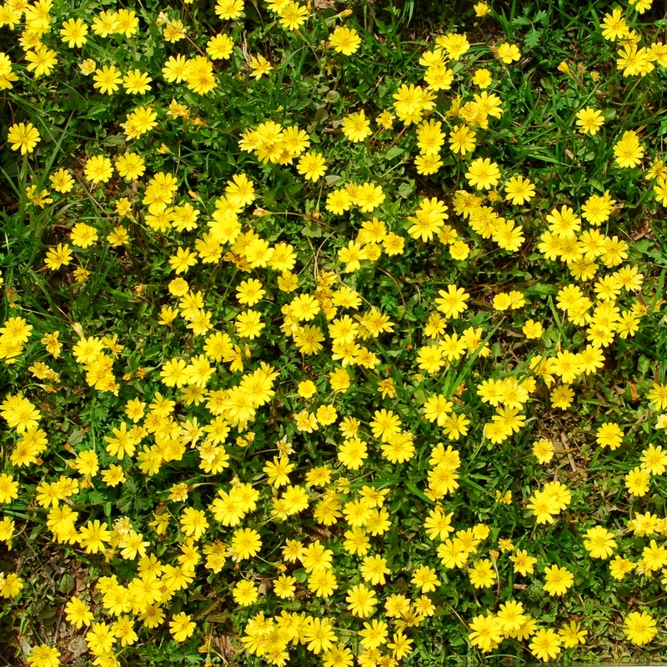
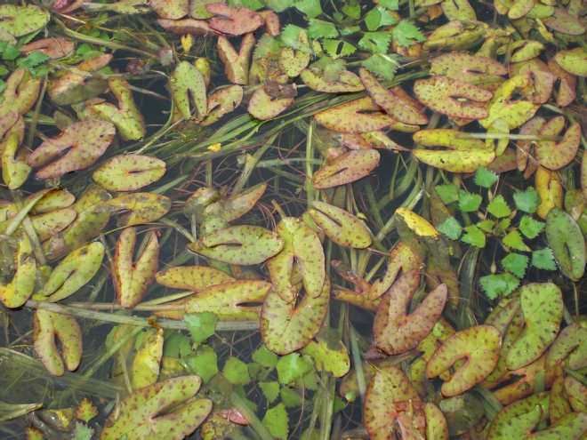
Future work
reduce sample inconsistency
explore other classifiers;
test guesses from different “experts”
use more classes and scenarios

Slide 11
THANK YOU!

Slide 12
EXTRA SLIDES

Slide 13
2. Aquatic vegetation: % plant cover
Basic grey level threshold
62.8%
Histogram equalization
63.9%
Point-clicking and Mahal. dist. classif-n
61.6%
Image 1
Image 2
71.4%
64.0%
93.4%
Filtering and morph. operations: problematic due to thin features
Other contrast enhancements: emphasize dark parts and underestimate %plant cover
Notes:
Challenges: variation in aquatic plant colors and dark spots on plants; grayscale may work much better

Slide 14
3. Yellow flower: % yellow cover
3 x 3 smoothed
Point-clicking and Mahal. dist. classif-n
Contrast-stretched
Small and long regions removed
(regionprops)
Two-class (yellow and background)
Image 1
One-class (yellow)
23.16%
26.2%
25.7%
Image 2
8.2%
7.7%
7.1%

