Slide 1
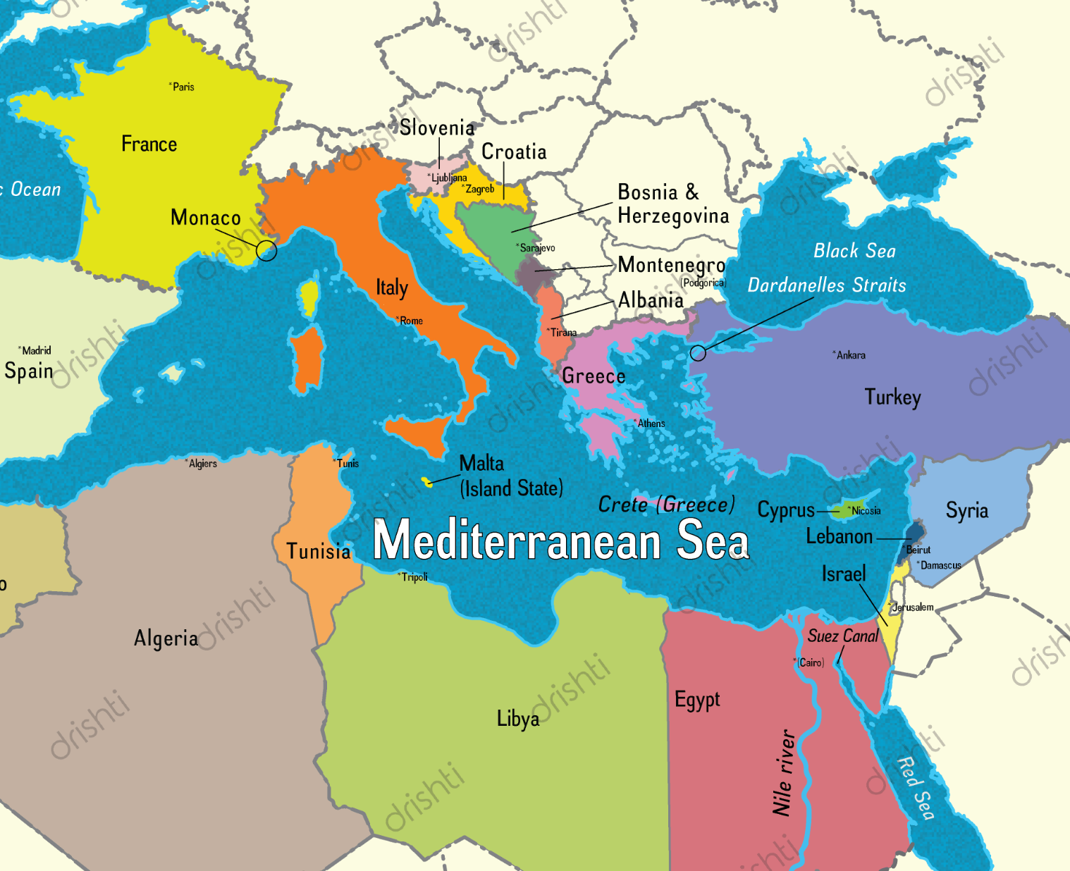
Earthquake analysis in Mediterranean
By: Youssef Salib

Slide 2
Simulation
Simulation aims to identify regions in Mediterranean that are more susceptible to earthquakes by analyzing Earthquakes, trends and spikes in seismic activity
Relied on Obspy and Cartopy to retrieve the data and display the locations.
Captured snapshots of the data at three-year intervals and saved them as PNG images locally
Used FFMPEG to concatenate the PNG snapshots, and display the animation.

Slide 3
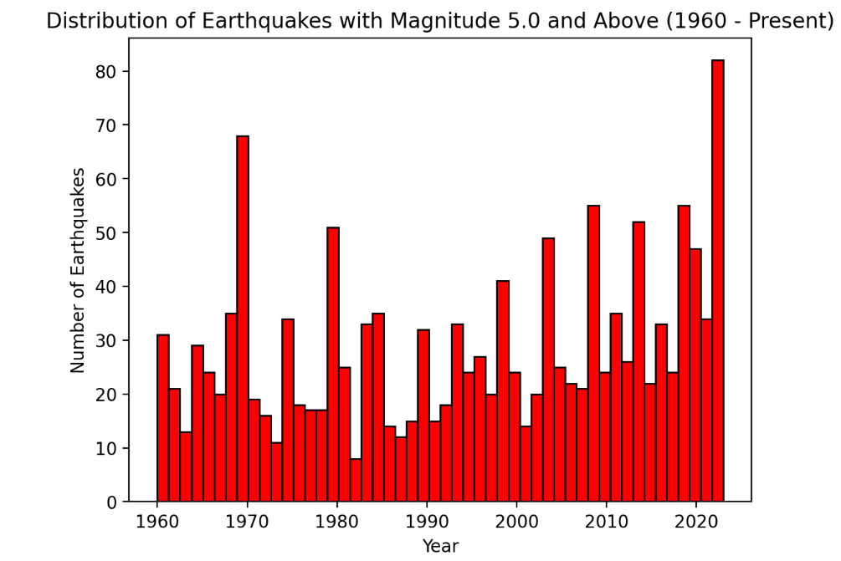
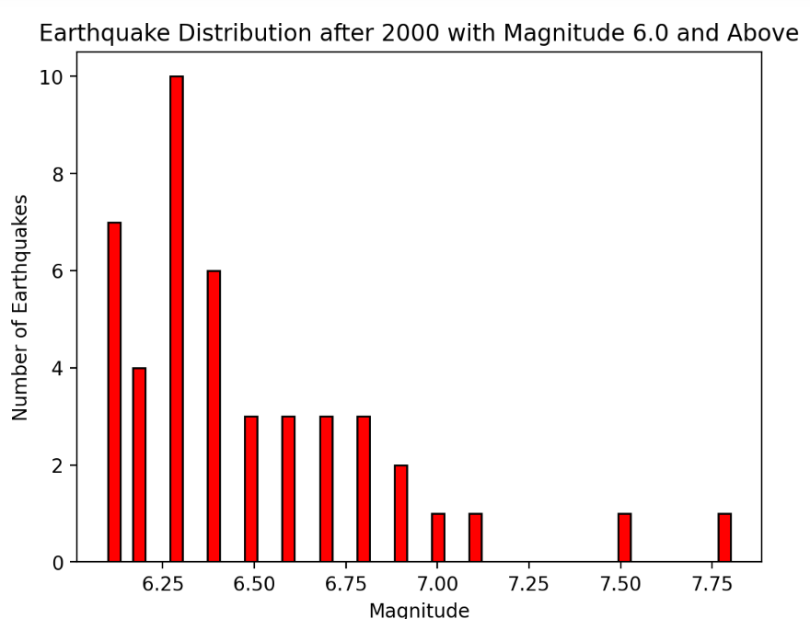
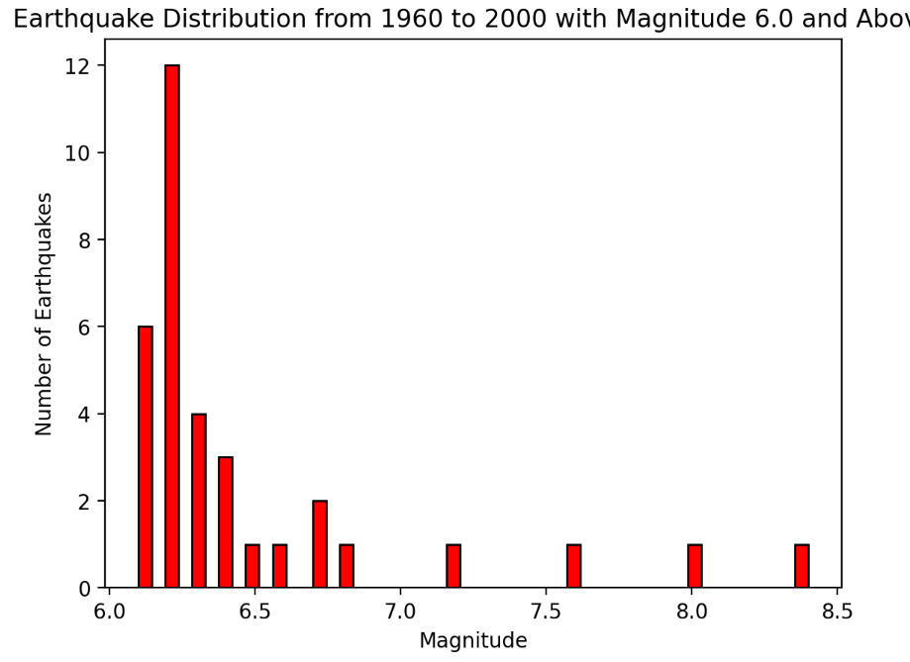
Distribution of EQs
1440 EQs from 1960s with Mag 5.0 +
45 EQs in last 23 years of Mag 6.0 + during this relatively short time frame.
33 EQs from 1960 to 2000 of Magnitude 6.0 +
Notes:
This highlights a concentrated period of heightened seismic events years

Slide 5
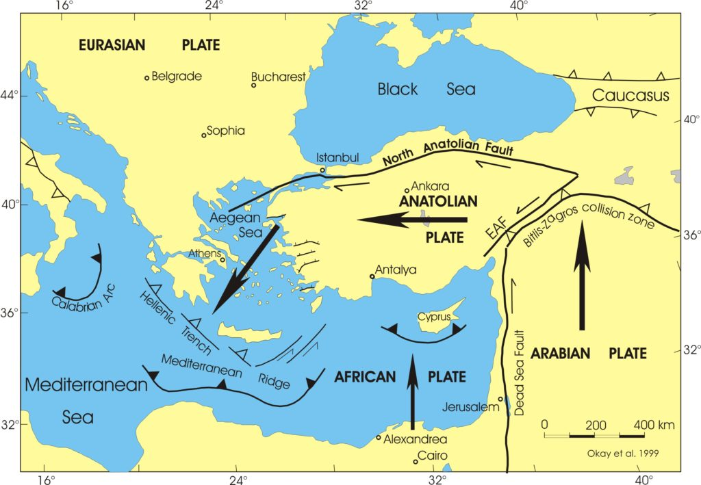
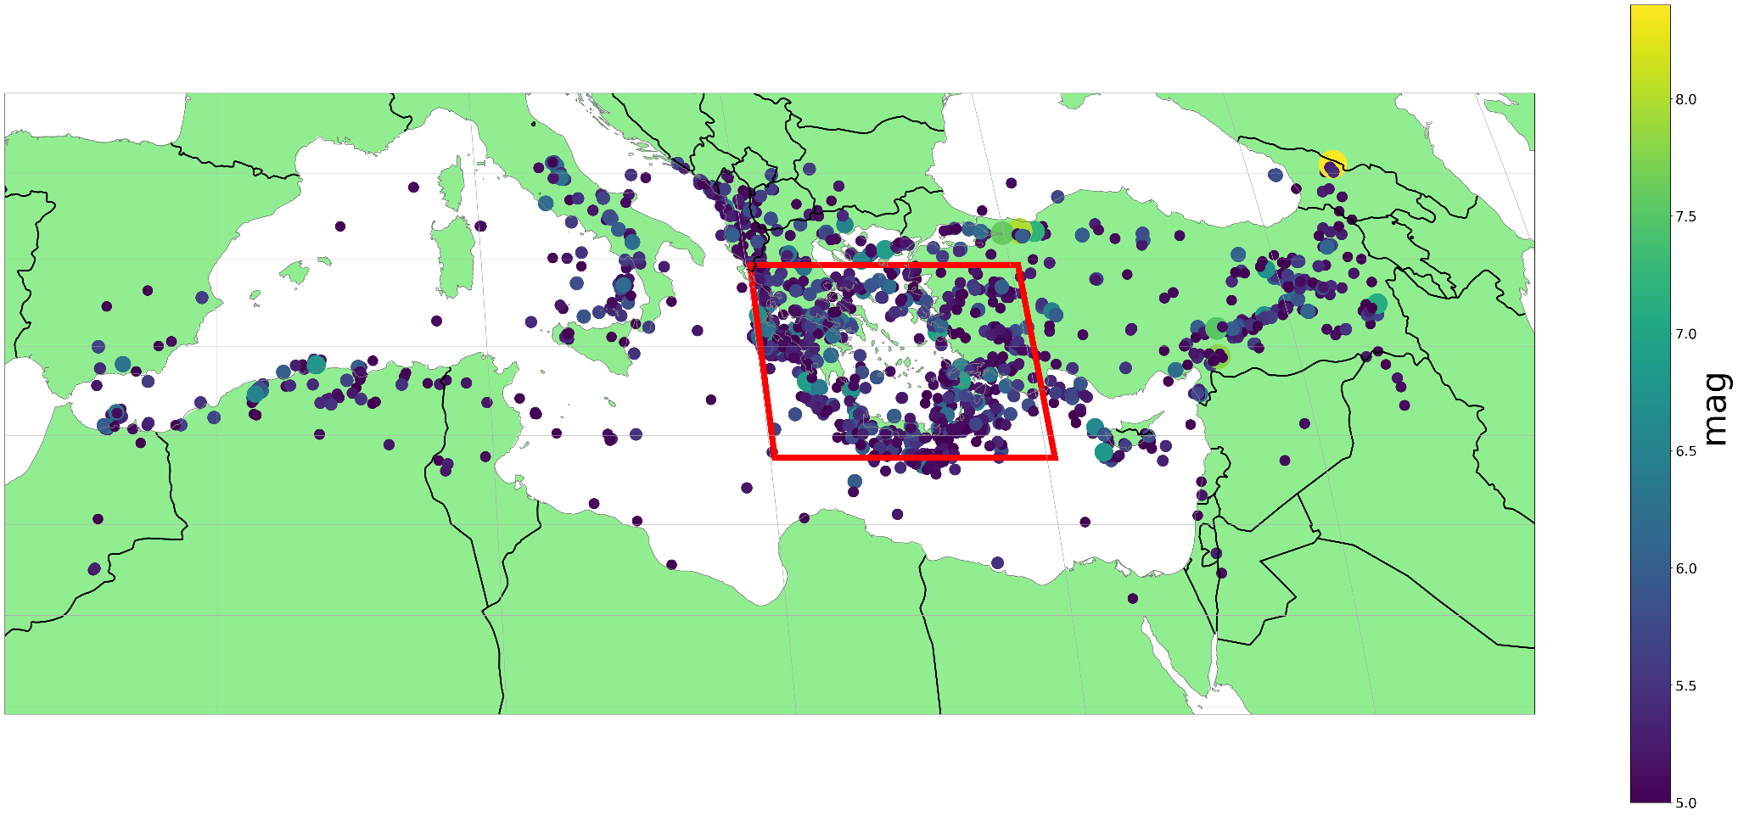
Eastern mediterranean
The eastern Mediterranean is the meeting place a three major tectonic plates, Arabia, Nubia, and Eurasia and two sub-plates Anatolia and Sinai which contributes to a high level of seismic activity.
The way these plates interact makes the eastern Mediterranean particularly prone to earthquakes, result in 48% of earthquakes in the simulation.
Notes:
Earlier this year 2 deadly earthquakes hit turkey and Syri

Slide 6
References
https://docs.obspy.org/packages/autogen/obspy.core.event.Catalog.plot.html
https://hamelot.io/visualization/using-ffmpeg-to-convert-a-set-of-images-into-a-video/
https://faculty.fiu.edu/~swdowins/research-eastmed.html#:~:text=The%20eastern%20Mediterranean%20is%20the,and%20Sinai%20(Figure%201).

