Slide 1
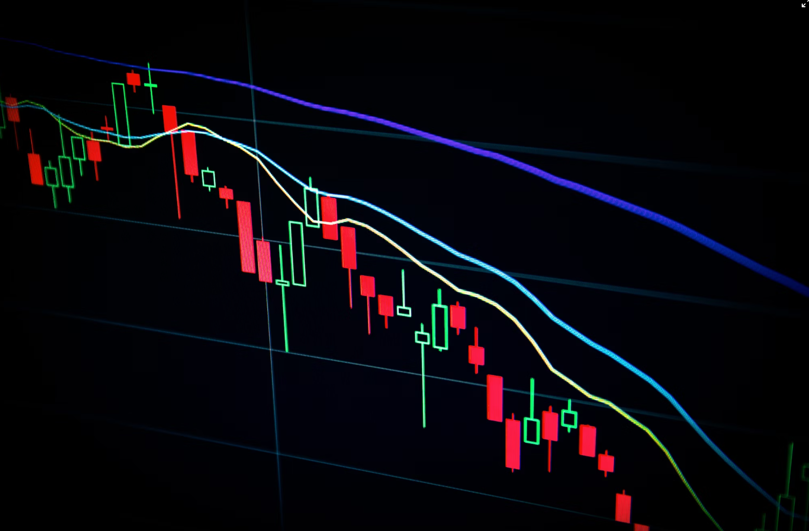
Visualizing Stock Patterns via Diffusion-limited Aggregation
Nathaniel Alexis

Slide 2
Topic and Methods
Goal: Visualize returns on stocks relative to the market
Done by obtaining success probabilities of selected stocks for use in DLA
Success probabilities scored based on comparison to the S&P 500
If a stock is more likely to underperform, outperform, or move with the market, have the random walk bias down, up, and horizontally respectively.
Methods:
Diffusion-limited Aggregation
Yahoo Financials API
Independent and identically distributed stock selection
Sources Used: EPS 109 Lab/Homework Resources

Slide 3
Relative Performance
Steps

