Slide 1
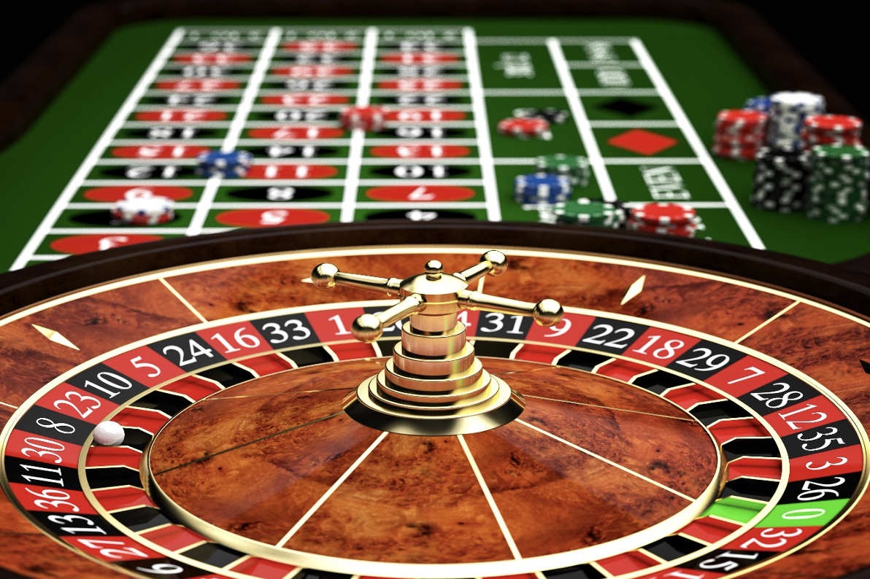
Roulette Simulations
Lisa Meng

Slide 2
Topic/Methods
Topic: Roulette Simulations
In my code, I simulate 500 roulette plays, with each play randomly choosing to place bet(s) on the numbers 00,0,1,2,...36.
Methods:
Random Walks
to randomize the numbers the roulette ball lands on and the respective payout
If win (2.63%): player gets 35*amount they bet
If lose: player loses amount they bet
Each iteration graphs player’s current balance for each roulette play on the y-axis and the number of bet(s) the player makes for each roulette play on the x-axis

Slide 3
https://drive.google.com/file/d/1EIEFU12ekw_8Dja9EZ1PvDhZA9_U3TXV/view?usp=drive_link

