Slide 1
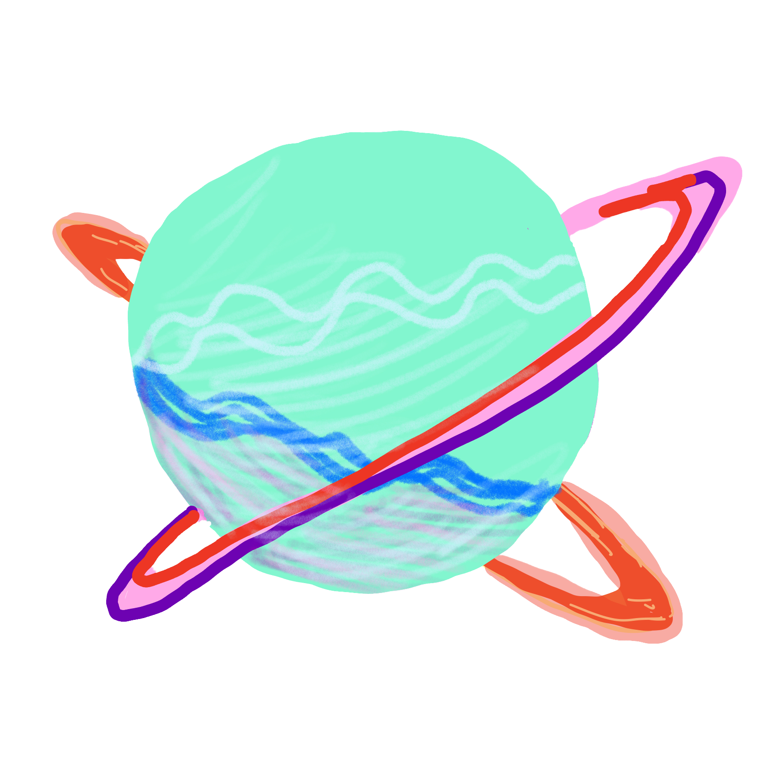
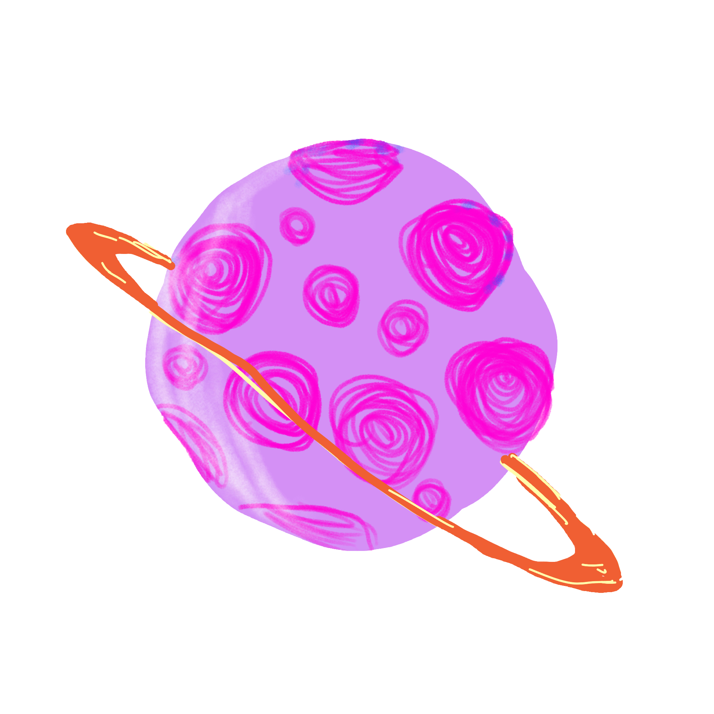
Solar System
By Sofia Daubert

Slide 2
Topic and Methods Used
I made a solar system with a star and two planets
I used notability to draw my own planets
The background picture of space is from NASA
Methods used
Physics of gravity to calculate the motion of each planet in the system
Gravity function “gravity”
ODE integration
Numerically solving the gravitational ODE for each planet using ‘scipy.integrate.odeint’
Each planet has dynamical orbits influenced by gravitational interactions
Matplotlib’s animation module
Sources used: NASA, https://astro-330.github.io/Lecture2/Lecture2.html, https://personales.unican.es/corcuerp/python/tutorial/Python_OOP.html,

Slide 3
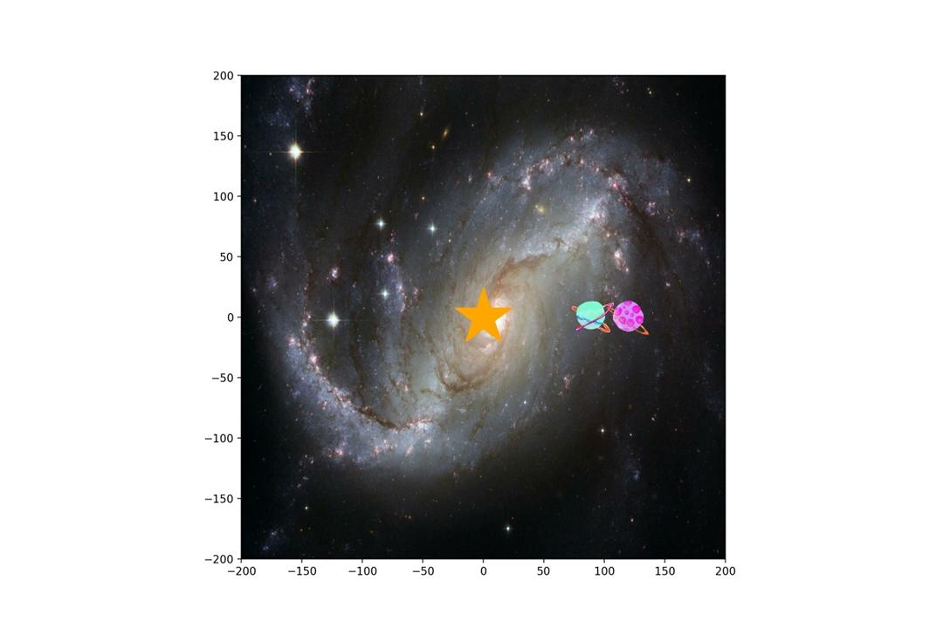
Animation

