Slide 1
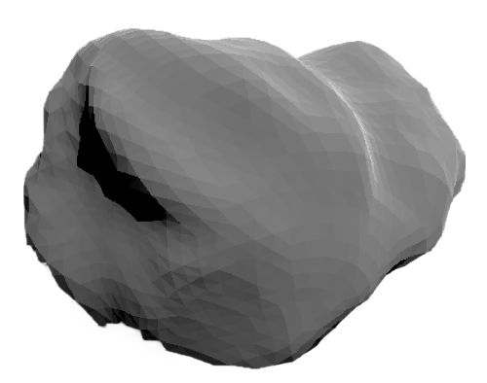
Apophis Simulation
Blake Grantham (EPS 109)

Slide 2
99942 Apophis
2004 MN4 2029 Close Approach
My goal is to visualize the orbit of a NEA called Apophis. Which has a close approach in 2029 with Earth. I hope to emphasize its orbital velocity differences compared to Earth as well as orbital radius and other important parameters which are demonstrated through the animation.
I will use vpython and orbital equations such as Newton's gravitational equation and angular/velocity equations
Size
340 meters across-diameter
1100 feet
Mass
4 x 10^10kg
Based on an Assumed density of 2.6g/cm^3
Shape
Bilobed peanut shape, not enough mass/
Gravity to be spherical

Slide 3
Animations

Slide 4
What I wished to achieve
its orbit before and after its flyby with Earth attempting to demonstrate its change in classification from Aten to Apollo class asteroid.
Sources:
https://ssd.jpl.nasa.gov/tools/sbdb_lookup.html#/?sstr=Apophis&view=OPDR
https://www.comet-toolbox.com/neos.html
https://pypi.org/project/vpython/
https://www.asteroidmission.org/?attachment_id=33287

