Slide 1
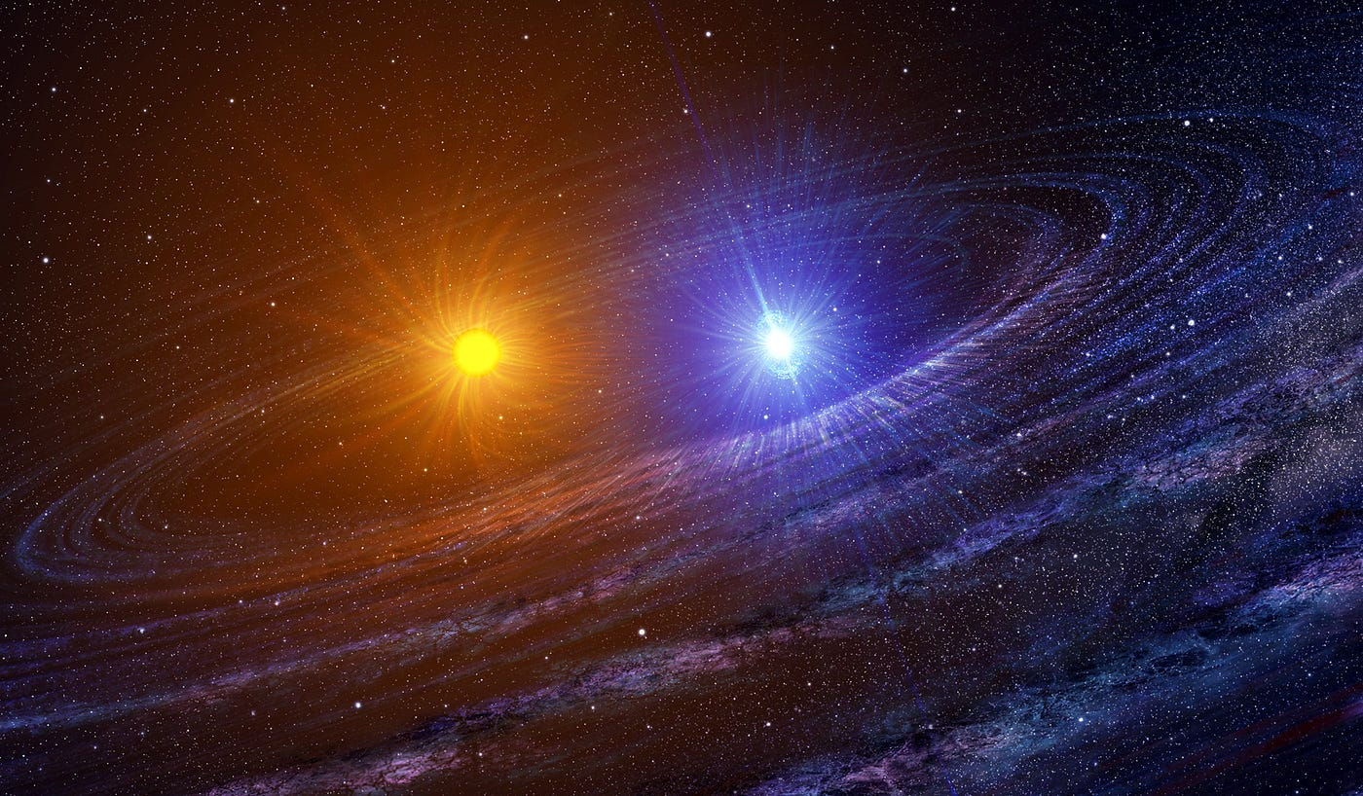
Simulating Binary Star Systems
Alicia Roberts
Image source: https://medium.com/predict/what-are-binary-stars-5f4a9e9fa340

Slide 2
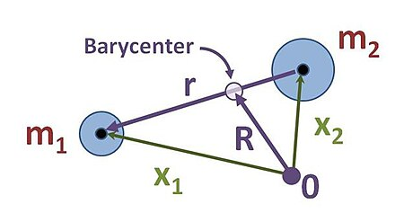
Some theory
A system of stars orbiting each other around a shared center of mass
If the orbit is eccentric, then the orbits of each star are of equal eccentricity and one focus of each ellipse overlap one another.
Considered a two body problem, so to solve:
Break up into 2 one body problems
One from the center of mass reference frame
Another from the reduced mass reference frame
Sources used:
https://levelup.gitconnected.com/the-two-body-problem-in-python-6bbe4a0b2f88
https://stackoverflow.com/questions/37146420/saving-matplotlib-animation-as-mp4
https://en.wikipedia.org/wiki/Two-body_problem

Slide 3
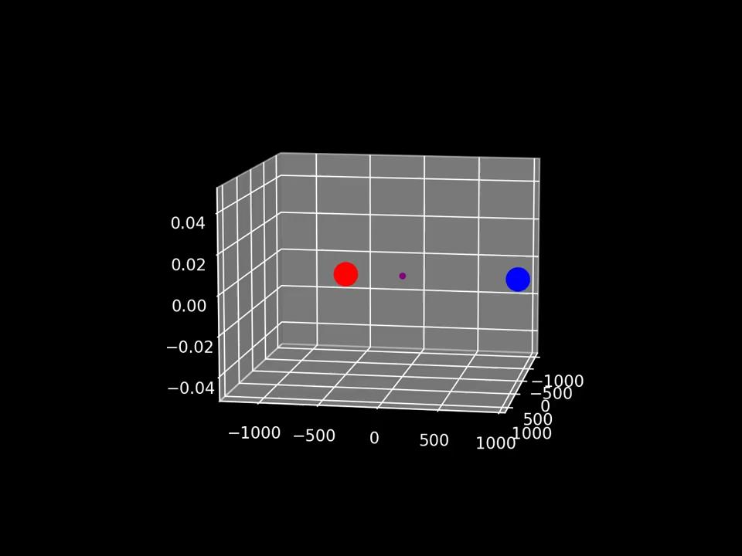
The simulations
Equal masses Different Masses

