Slide 1
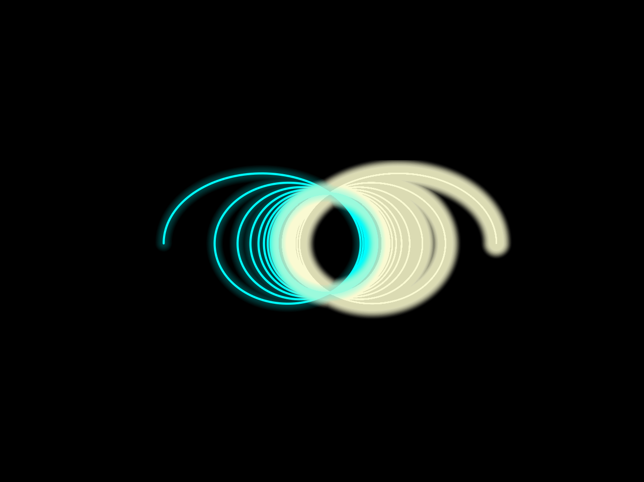
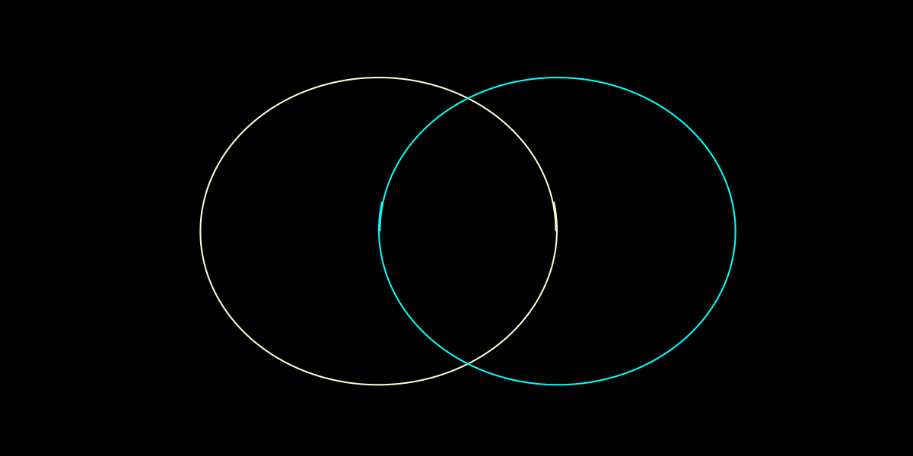
Binary Star Orbits and Collisions
Emily Rossiter (3038163741)

Slide 2
Topic and Methods
The goal of my project is to represent a binary system. To start, I simulated a binary star system (ie. two objects/stars orbiting one another); from here, I used that base to increase the weight of each object and decrease the gravitational constant to 6.67e-11. After this, I edited the code in various ways to attempt to get the two stars to collide. Finally, I determined I had to change the radius and velocity equations so each loop updated the radius for each star as time went on.
I began my project by utilizing code from Lab/Homework 11, which was the skeleton for my orbit code. This lab/homework uses the Runge-Kutta method, which is a family of implicit and explicit iterative methods (including Euler’s method) that approximate solutions to non-linear equations.

Slide 3
Animations

