Slide 1
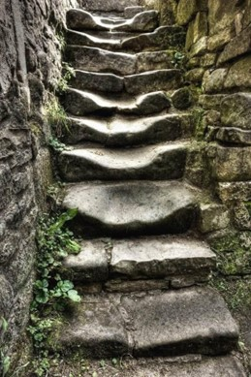
Erosion Of Stairs
Craig Spengler
Fall 2023

Slide 2
Introduction
My goal for this project is to simulate the erosion on stairs after long term wear and tear.
Years of people walking on stone can erode the stone away and show patterns. [ex: Right foot vs. Left foot first]
This yields a staircase with concave indents from the constant footprints.
My animation will show stairs beginning at an initial condition of perfect right angles and over time show a gradient of use.
My simulation is a drastic oversimplification
Materials erode at different rates.
Environment would speed up the process.
Different weight and size of footprints

Slide 3
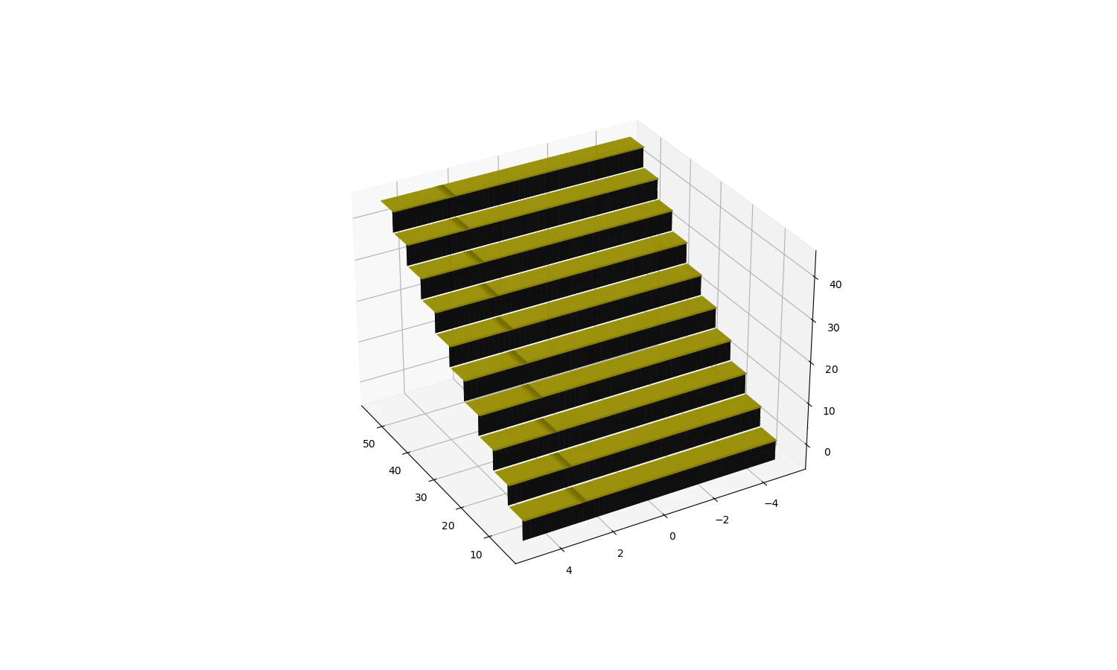
Simulation

Slide 4
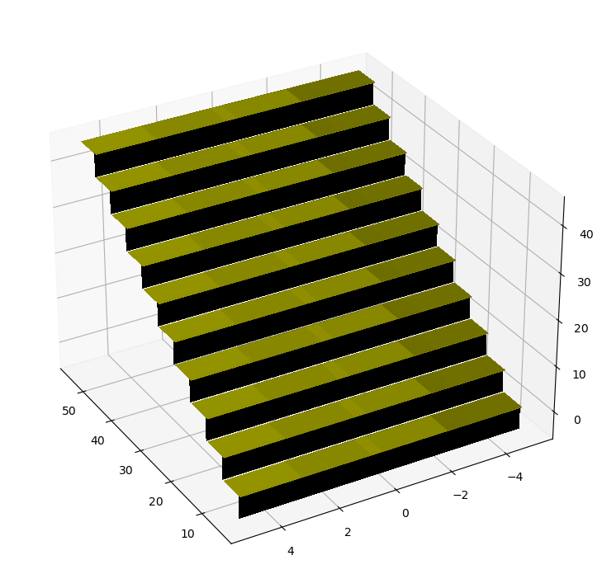
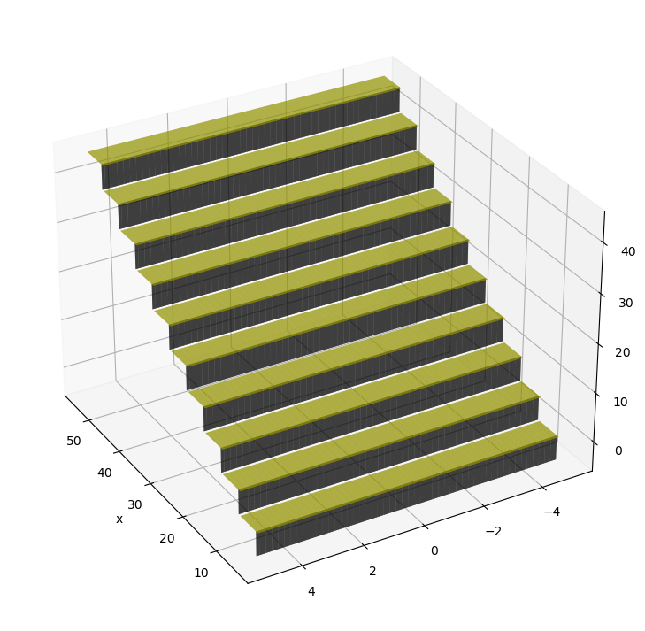
Simulation

Slide 5
Questions?

