Slide 1
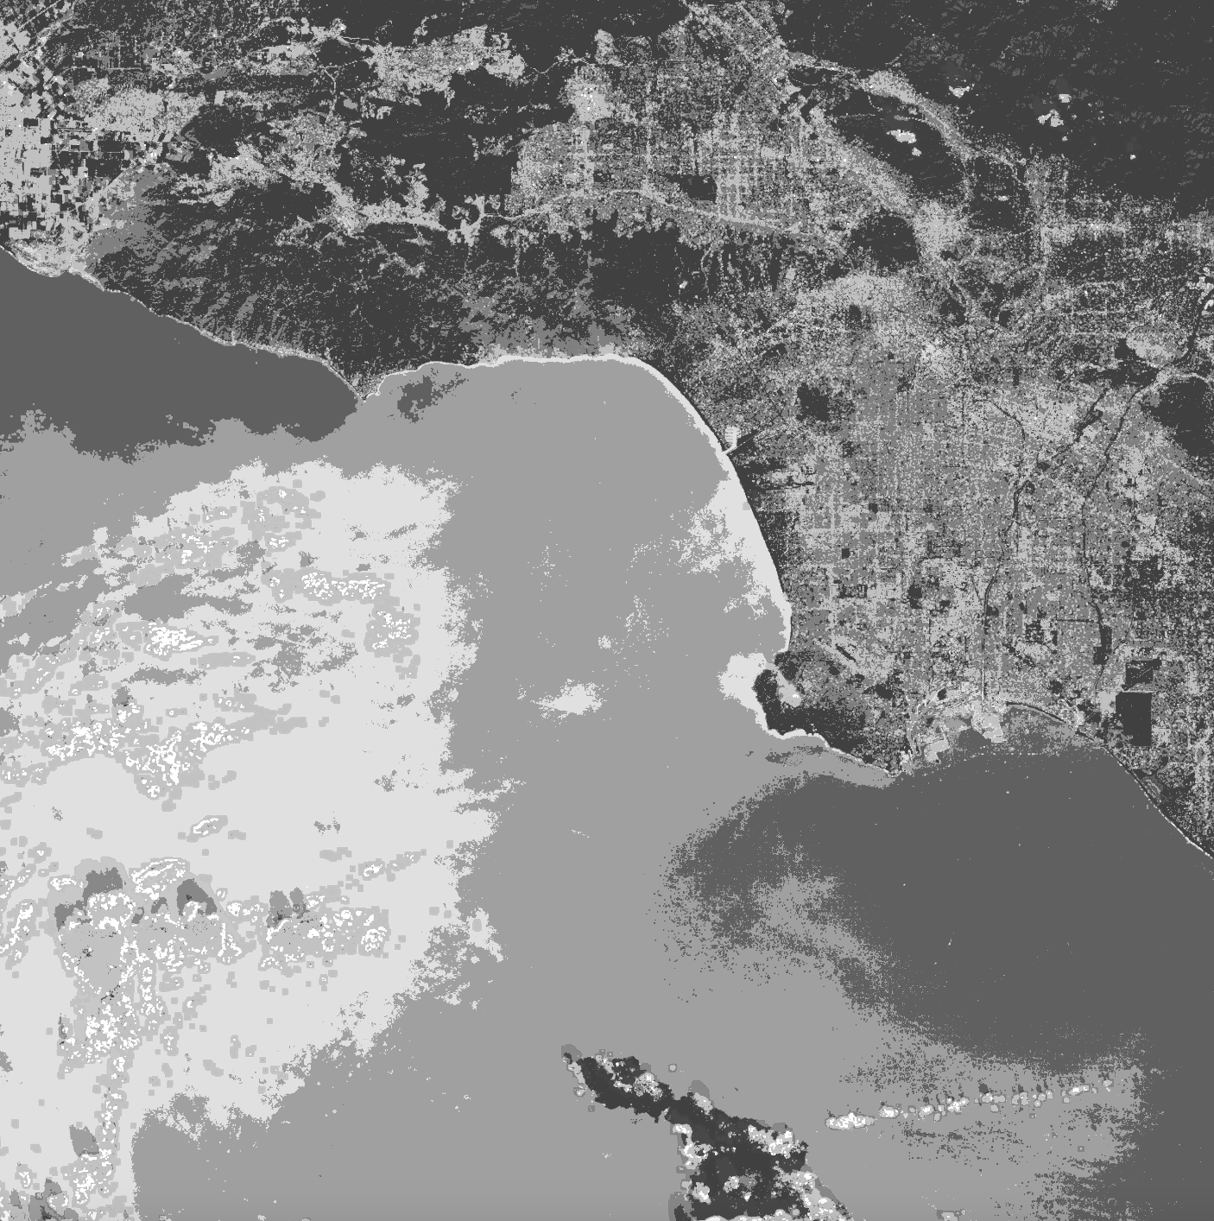
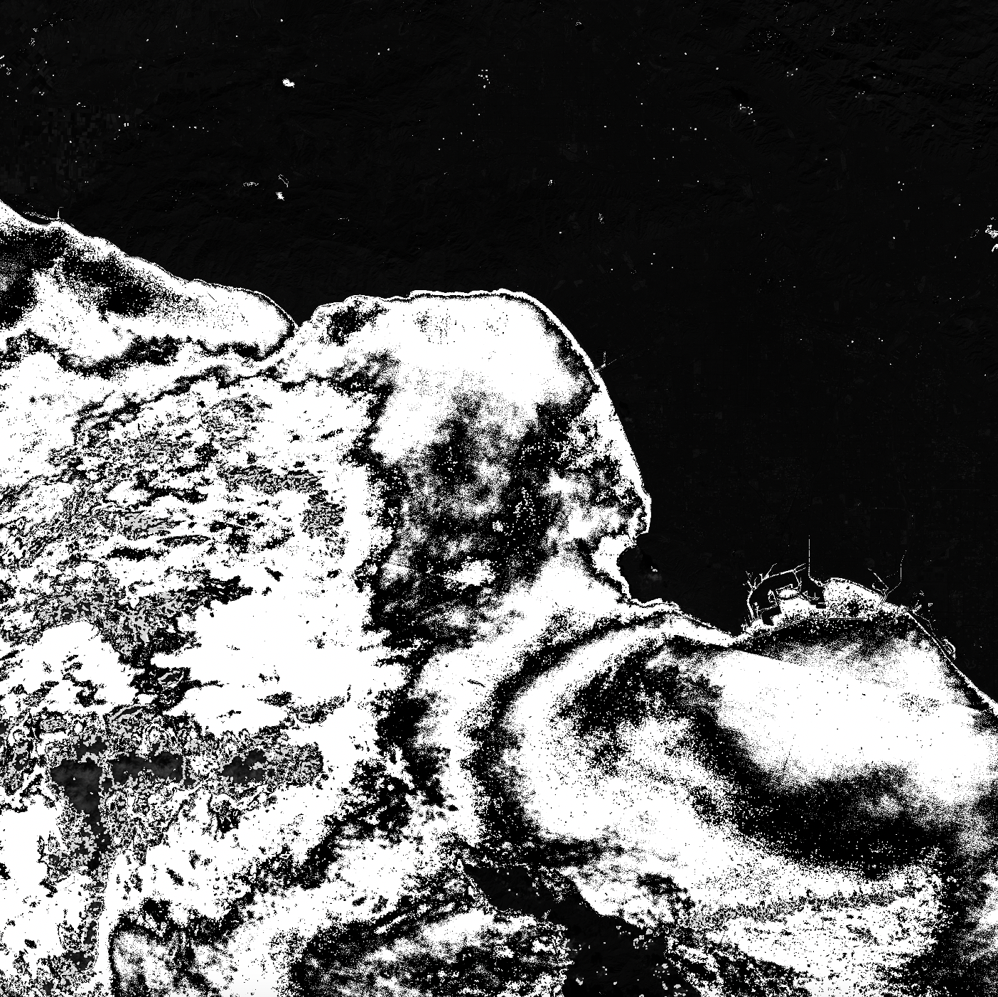
Visualizing and Approximating Coastal Terrain Proportions Using LANDSAT Data
Abhinav J. Vedati

Slide 2
Topic and Methods
My topic is visualizing changes in terrain over time using open source satellite data.
I collected 4 RGB satellite images of the Southern California coast using NASA’s Earthdata search engine and the LANDSAT collection.
Each of these images was sampled roughly one year apart.
I then simplified these images into 7 distinct colors using the techniques from Lab 12.
My animation shows the change in the coast over time, with approximations made between each of the 4 images using averages.
i.e., the animation begins with image 1 and slowly blends into image 2, which slowly blends into image 3, etc.
Limitation: my animation is quite short, as it takes a lot of processing of LANDSAT data (finding, centering, cropping, and filtering) to generate each image.

Slide 3
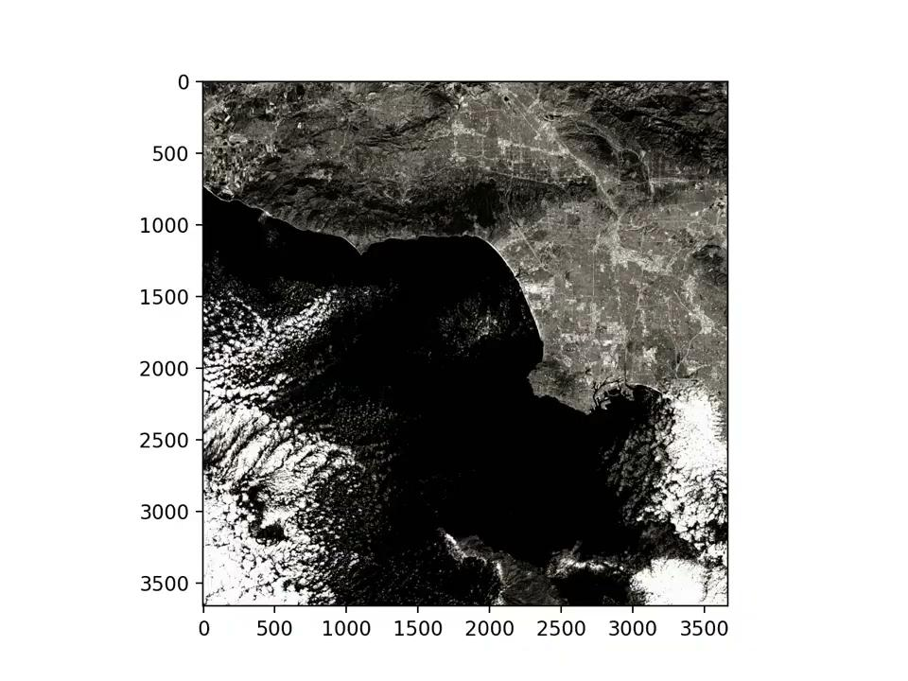
Animation
Any questions?

