Slide 1
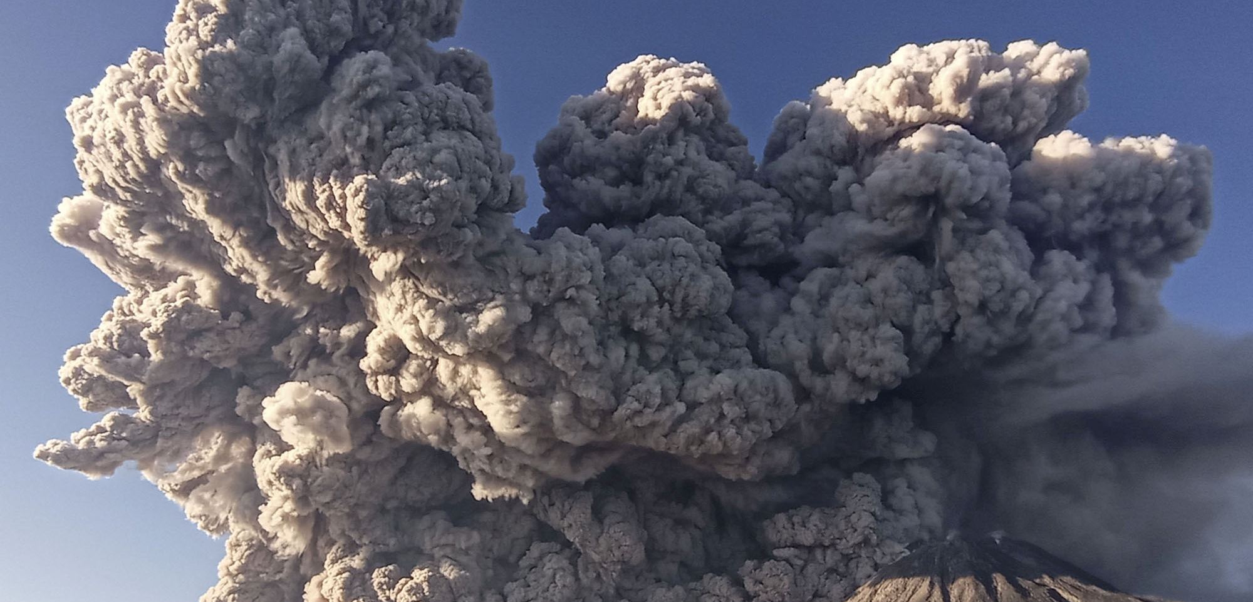
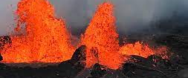
VolcanoScope: Global Eruption Patterns Visualized
- Kartik Aggarwal

Slide 2
Description and Methods Used
This project is an explorative project that delves into the intricate patterns of volcanic eruptions worldwide. Utilizing a comprehensive dataset, this simulation aims to unravel the distribution, frequency, and intensity of volcanic activities across the globe.
Methods:
Data Analysis: Using Python and libraries like Pandas, the project begins with a thorough examination of the eruption data, focusing on aspects such as eruption dates, locations, and Volcanic Explosivity Index (VEI) values.
Geographical Mapping: Employing Plotly, an interactive map visualizes the spatial distribution of eruptions. Each eruption is marked, with its size indicating the VEI, offering a clear view of the eruption's magnitude.
Temporal Visualization: A line chart animation tracks the frequency of eruptions over time, revealing trends and patterns in volcanic activity across years.
Intensity Distribution: A histogram animation showcases the distribution of the VEI over different periods, illustrating how eruption intensities have varied historically.

Slide 3
Animation 1 – Global Eruptions Over Time

Slide 4
Animation 2 – VEI Distribution Over Time

Slide 5
Plot– No. of Eruptions/Year Over Time

