Slide 1
Roulette Revelations
Juan Aldama

Slide 2
Overview
Objective:
Explore the dynamics of American Roulette and understand how different types of bets impact a player's budget over time.
Methods Used: Monte Carlo Simulation:
Simulate the outcomes of roulette spins based on random number generation.
Analyze statistical patterns and trends in the simulation results.
Utilize Python for coding and executing the simulation.
Employ libraries like random for generating random numbers and matplotlib for visualization.

Slide 3
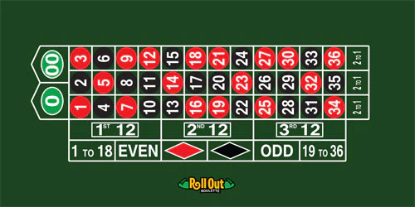
Parameters and Visualization
Key Parameters:
Initial Budget: $1000
Number of Spins: 50
Bet Amount: $25
Bet Types:
Straight Bets on a specific number.
Even Money Bets (e.g., betting on red).
Visualization:
Graphically represent changes in the player's budget over the course of the simulation.
Highlight moments of significant gain or loss

Slide 4
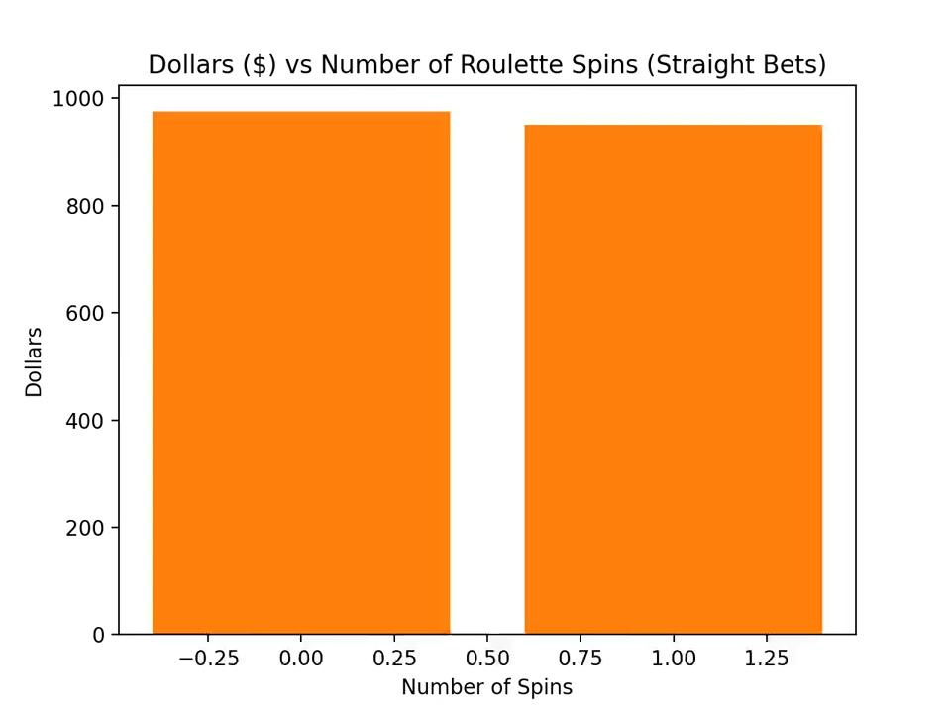
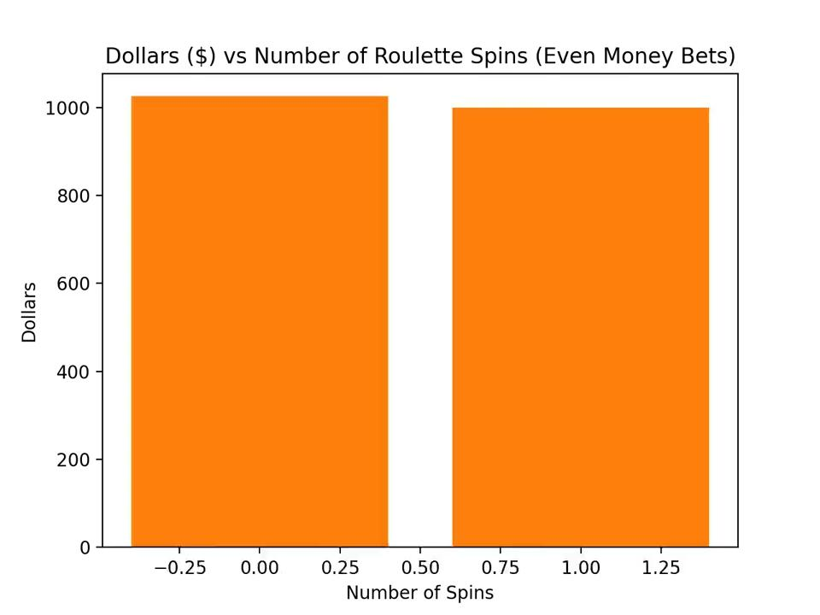
Animations

