Slide 1
E Coli Bacterial Growth
Sami Anathakrishnan 11/29

Slide 2
E Coli Growth
E Coli population against time:
bg[n] = 2*E[n-1] => twice the previous growth
t[n] = t[n-1] + tincrement => measuring the growth every 20 minutes
Simulation model - exponential growth without considering other factors
Plot(bg,t)
bg=>number of bacteria
t=> time for bacterial growth

Slide 3
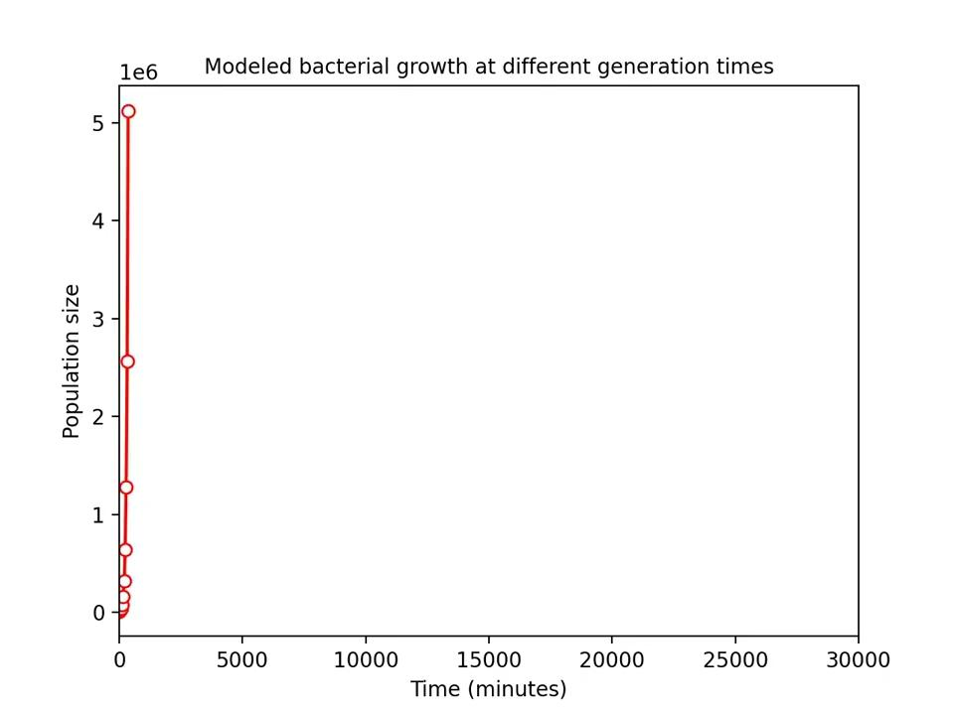
E Coli Growth vs Time Animated

Slide 4
E Coli Growth with other factors impacting growth
Factors for Optimal E Coli Growth:
Temperature
Oxygen Concentration
pH
Temperature for Optimal Growth:
Optimal growth conditions for E. coli are 37 degrees Celsius (98.6 degrees Fahrenheit, aerobic (with oxygen), and a pH of 7.
Optimal growth occurs between 20-45 degrees Celsius (68-113 degrees Fahrenheit).
pH for Optimal Growth:
The optimal pH for E. coli is 7.0. The pH in the large intestine where E. coli live is 4.0 to 7.0.
Oxygen Concentration:

Slide 5
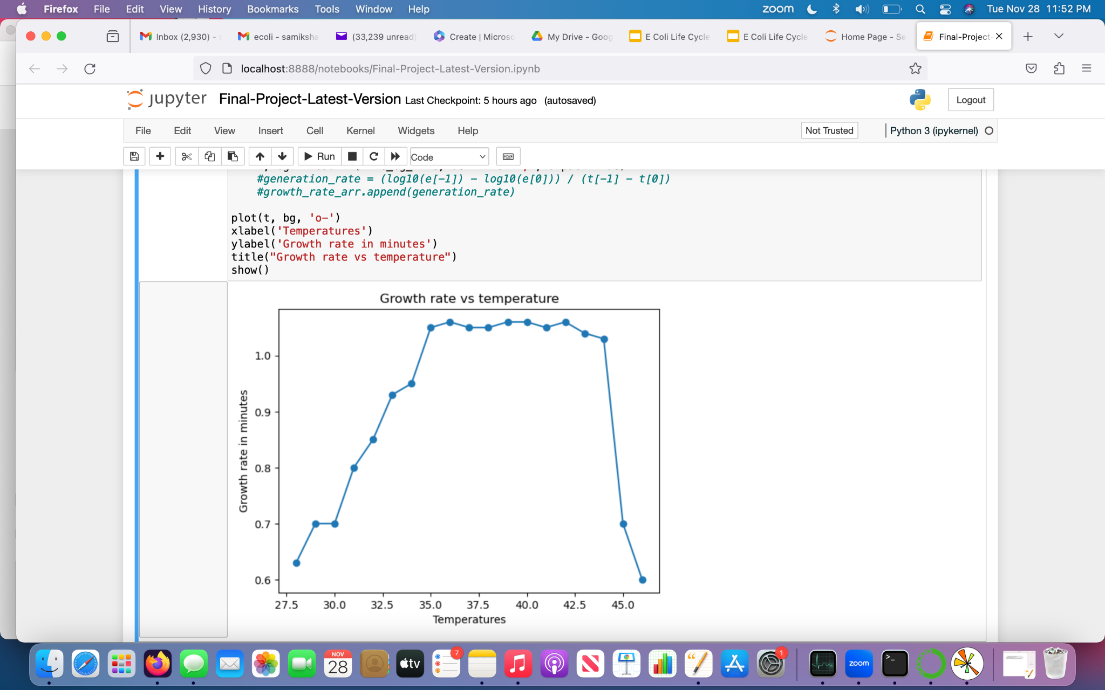
E Coli Growth Impacted by Temperature

Slide 6
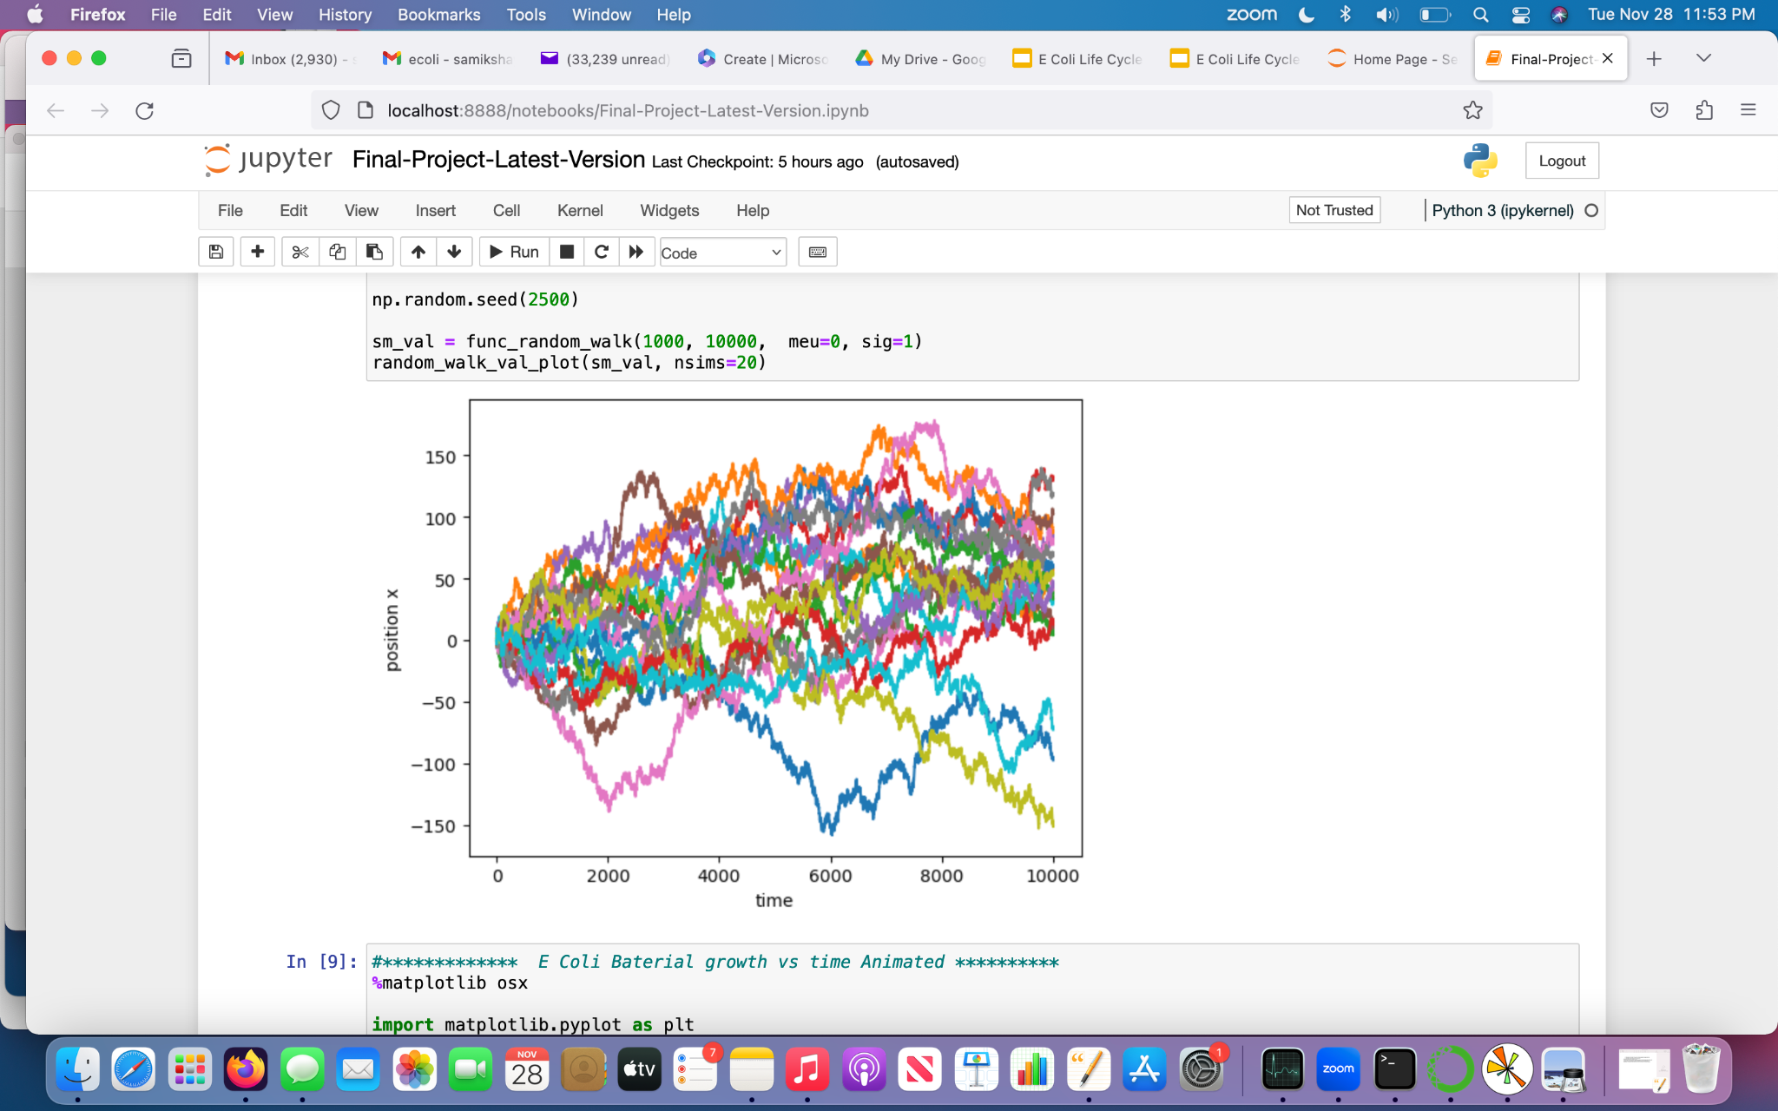
E Coli Random Walk

Slide 7
Thank you!

