Slide 1
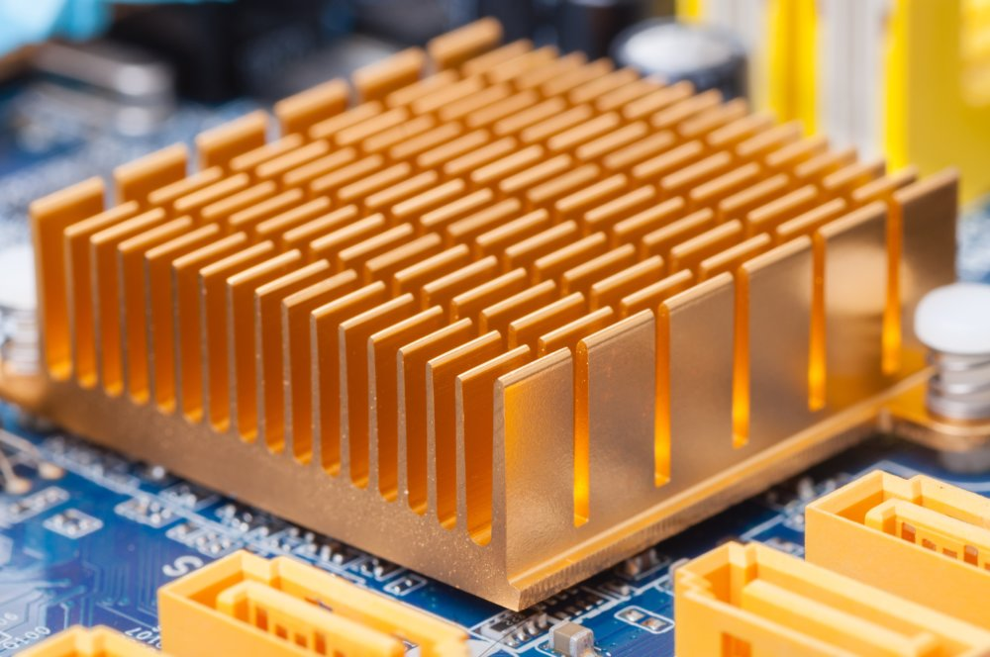
3D CPU Cooling Simulation
Gilberto Diaz

Slide 2
Voxels and Partial Differential Equations
Built off what we did in Labs 7 and 8, with a few distinctions
In labs, we used both color and the Z axis to represent the heat levels, meaning our physical objects were only 2D
In this simulation, I represented 3D objects with matplotlib’s voxel feature, and left color as the only representation of temperature.
Simulated a CPU, and a CPU with a heatsink on it
Used the 3D version of the discrete heat distribution PDE (as seen in lecture 12)
color coding source Voxel guide source

