Slide 1
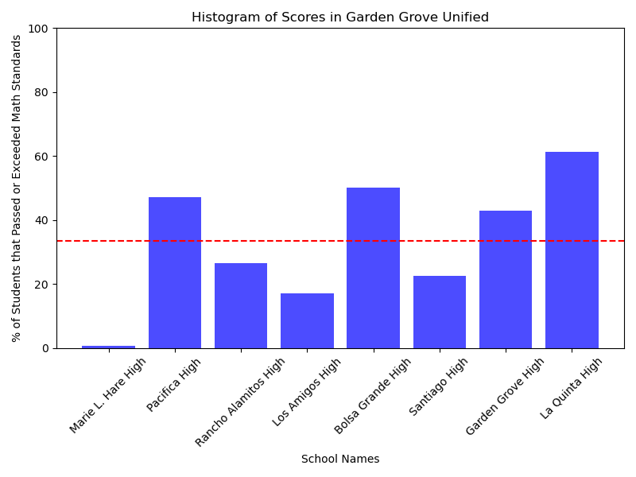
Are Some Districts
Better than Other?
my local district!
EPS 109 Final Project
By: Tiffany Hoang

Slide 2
Method
Discrete event simulation
Filtered through dataset to look at 11th grade, math, met & exceeding math standard
Created histograms for each district
X-axis was each high school in the district
Y-axis was the number of students (in percentage) that met or exceeded the state math standard
Added an average line for direct comparison
People always talk about one school district being better than the other
Focused on 11th grade math scores in California (CAASPP)
Dataset from California Department of Education: https://www.cde.ca.gov/ds/ad/assessmentdata.asp

Slide 3
Animation
Don't forget
...

