Slide 1
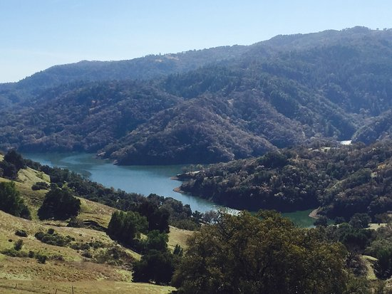
Erosion at Lake Sonoma
Jamison Lumetta

Slide 2
Topic and Methods
Lake Sonoma was created by Warm Springs Dam in 1983, the lake provides flood control and irrigation for Sonoma County.
Satellite LiDAR data of Northern California was used to create initial conditions for the erosion simulation
Used erosion model from Perron et al. 2008 and erosion.py from class with real world elevation data
The simulation shows leveling of the landscape, but this is not likely due to uplift and new sediment deposition
Additionally this region is densely wooded, which slows erosional processes

Slide 3
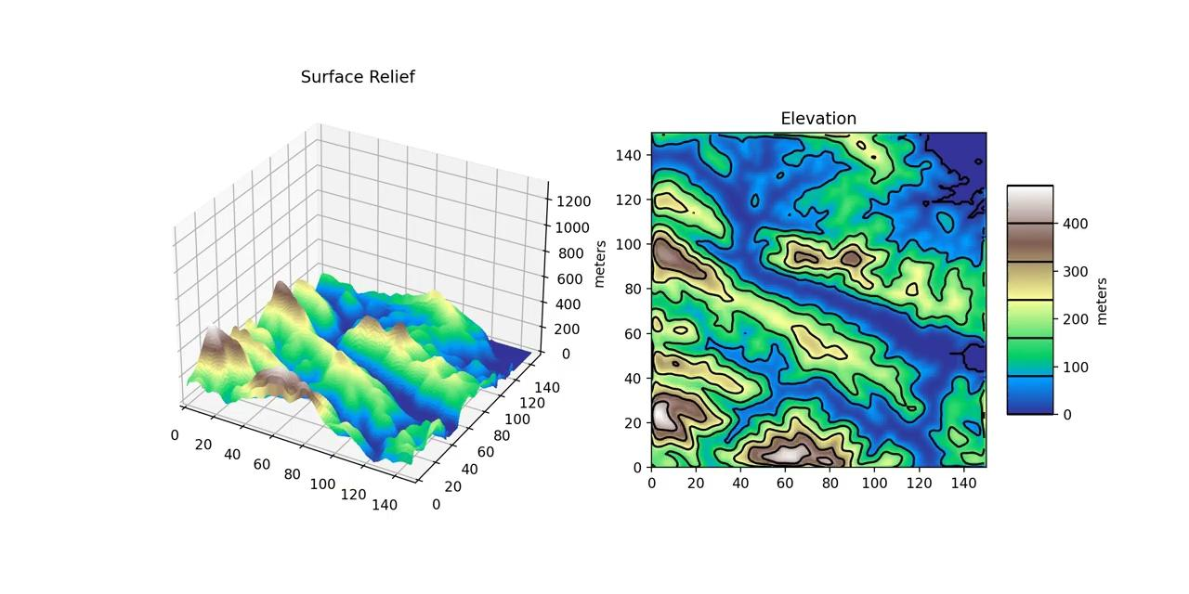

Slide 4
