Slide 1
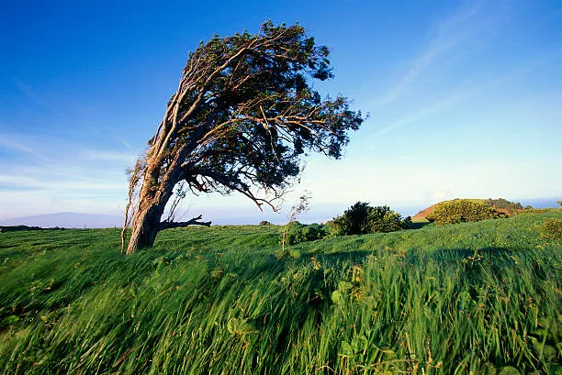
Trees in the Wind
Tyler Marino

Slide 2
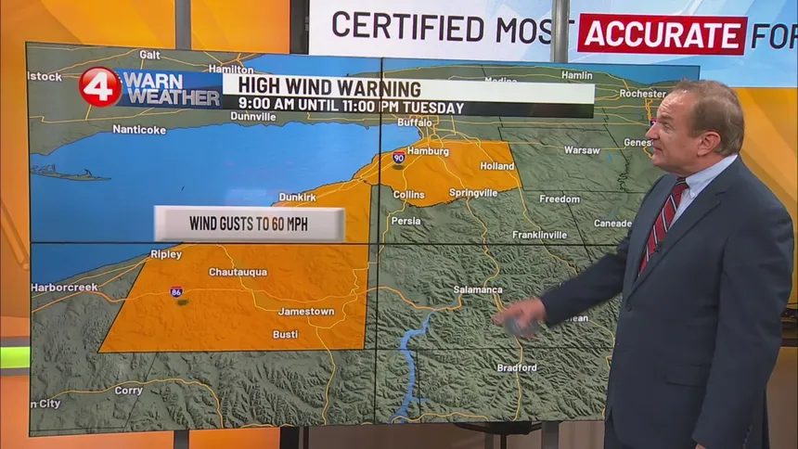
Process
Open Weather Map API
https://openweathermap.org/api
Understanding data format/types:
Nested Dictionaries, lists, strings, ints
Getting the Data wanted/needed:
Current time, sunrise, sunset, wind degree, wind speed, main weather description
Creating Backdrop:
Finding proper Color gradient to make sky backdrop and dirt on the ground
Adding a sun or moon
Where will it fall in the grid?
Val = (CT-SR)/abs(SS-SR); if Val <0 or >1
then the moon is out; else sun falls at Val*maxX position
Is it Cloudy?
If so, use the equation y = (25*np.sin(2*x) + 300)
Building Trees
Trunks:
DLA model favors going down.
Starts at the Bottom
Forms a denser structure
Branches:
DLA favors going whichever direction the wind blows
Starts at the top of the trunk
Forms a loose structure
Set growth limit so tree doesn’t go into sky.

Slide 3
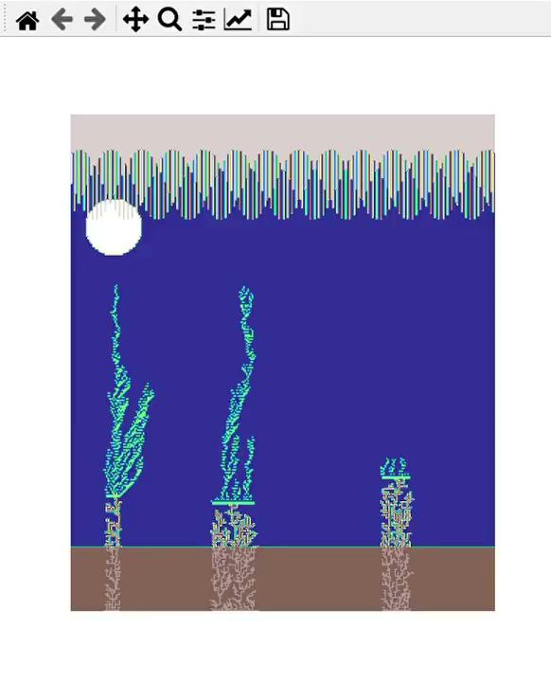
Final Product

