Slide 1
Fractal Animations
Tony Xin

Slide 2
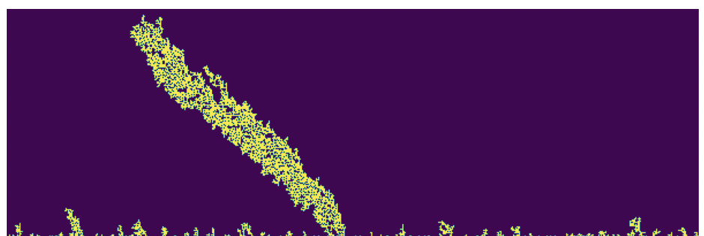
Two concepts
Images
Diffusion Limited Aggregation
Beautiful ‍💫

Slide 3
Object Guessing Game → Pretty Animation

Slide 6
