Slide 1
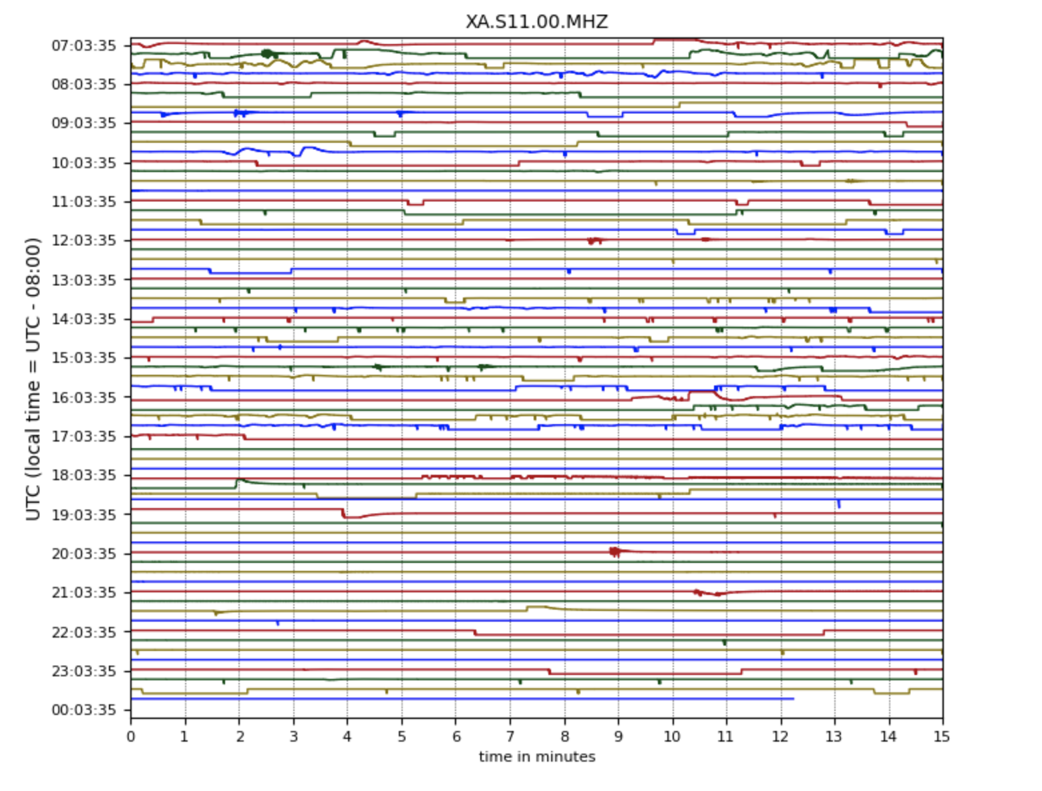
Lunar Seismic Data
Gabrielle Aladjem

Slide 2
Methods
Initial goal: map moonquakes using data from Apollo mission seismometers
First major issue: data was collected before the digital era → not in a usable format
Switched to modeling the raw lunar seismic data, using the NASA Planetary Data System
I had to individually link urls to the data for each day, so I decided to focus on one specific day (the first day of data collection → July 21, 1969, right after the first seismometer was placed on the moon during Apollo 11!)
4 different data streams from 4 different sensors
I plotted this data using obspy, generating 8 plots, 2 for each sensor (examples on the previous slide for the MHZ stream)
Then, for the MHZ stream, I created a gif of the changing seismic data over the course of the day (using hours instead of minutes for efficiency)

