Slide 1
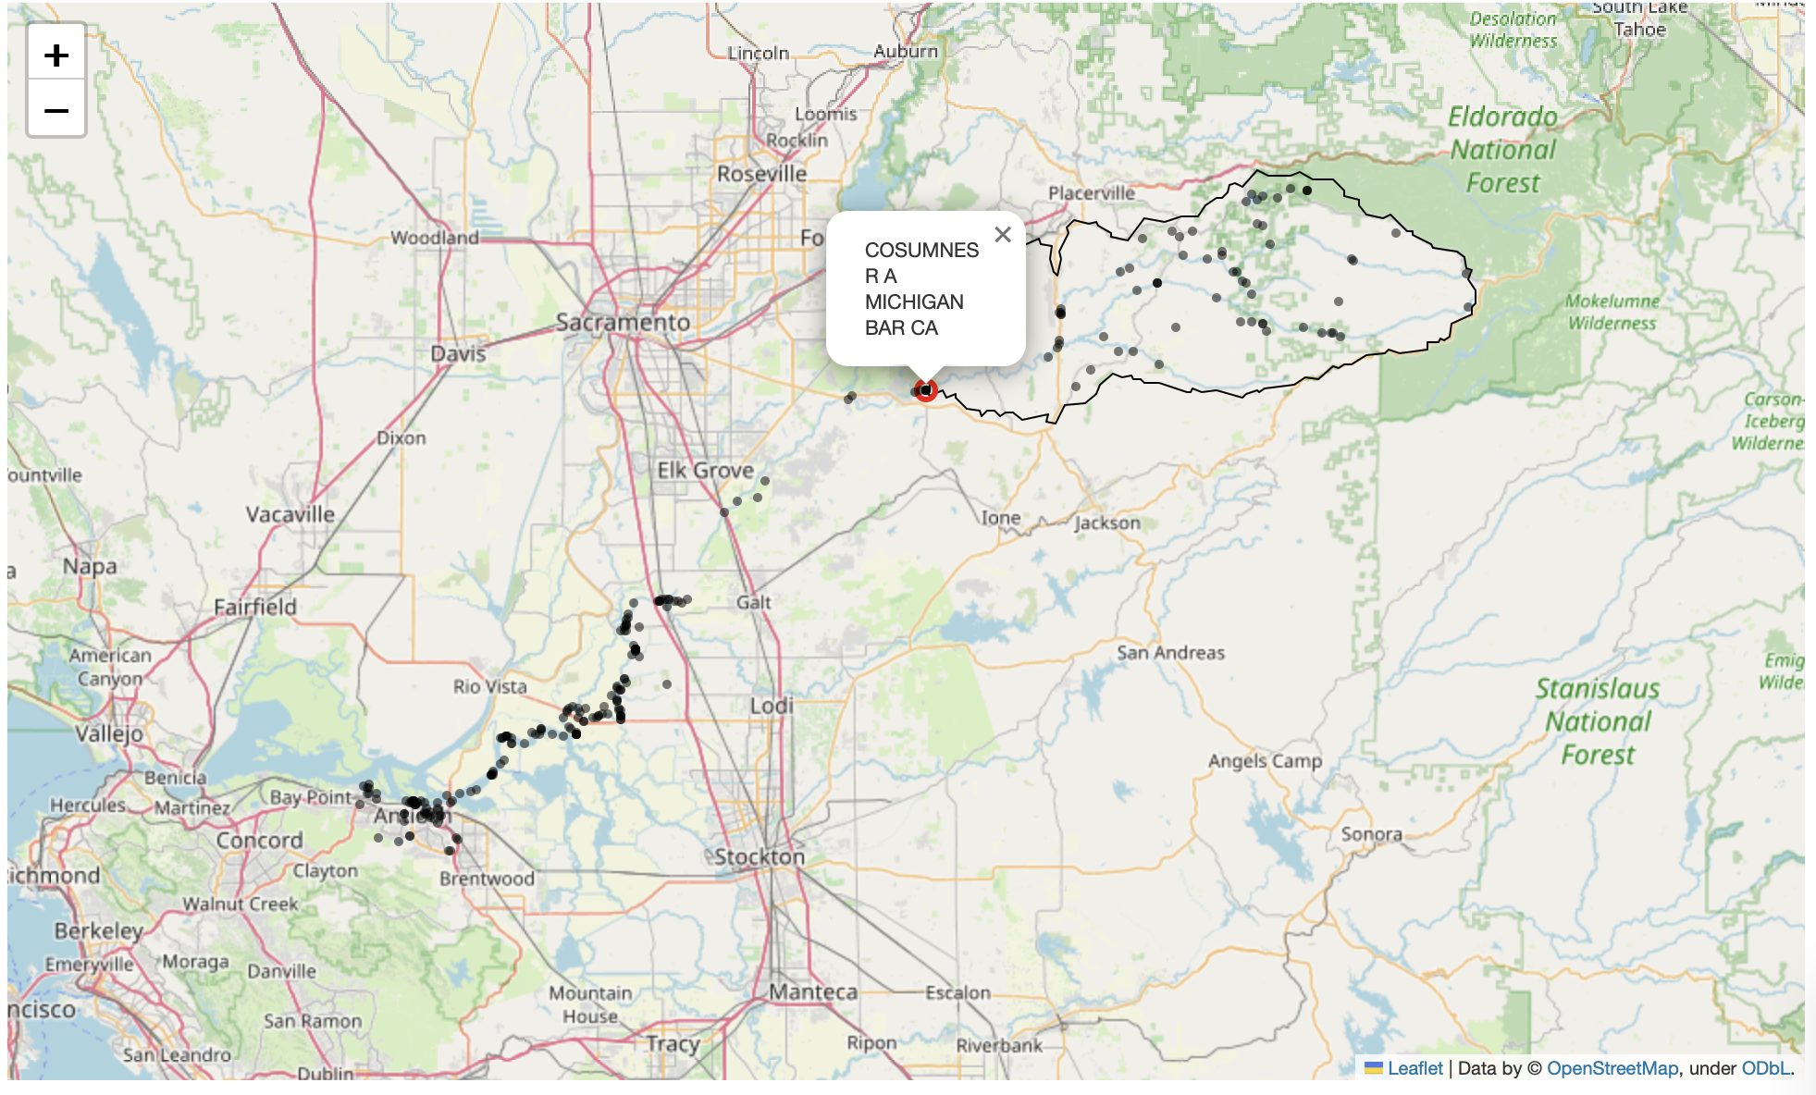
Stream Flow Simulation
Name: Heroda Abera

Slide 2
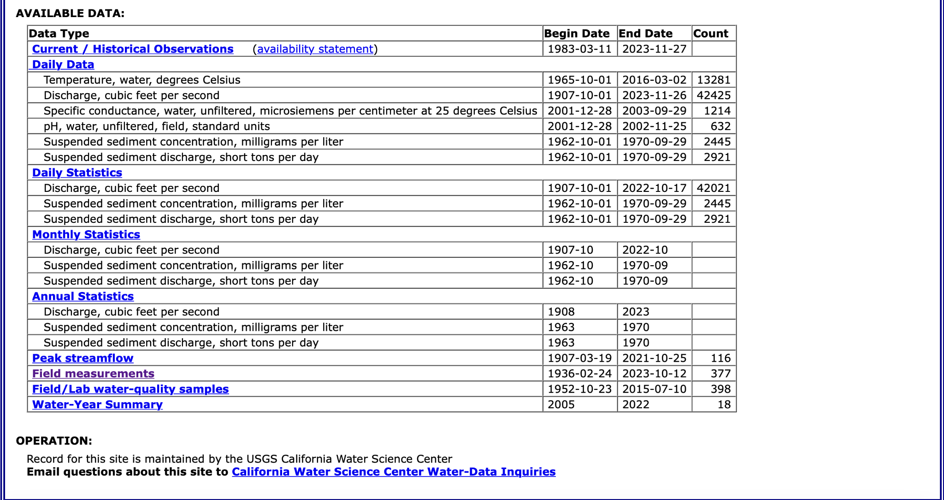
Stream flow simulation method
Goals and Method:
Data analysis of stream flow and temperature with seasonal variations to understand hydrological relations
Retrieved a historical stream flow and temperature datas using NWIS API provided by USGS water Quality portal
Visualizing/animating daily streamflow and temperature fluctuations over time for a site at Cosumnes River at Michigan Bar, CA
Site number = 11335000
Parameter code:
discharge/streamflow = 00060
Temperature = 00010
Created an interactive map showing the sampling sites and names for california

Slide 3
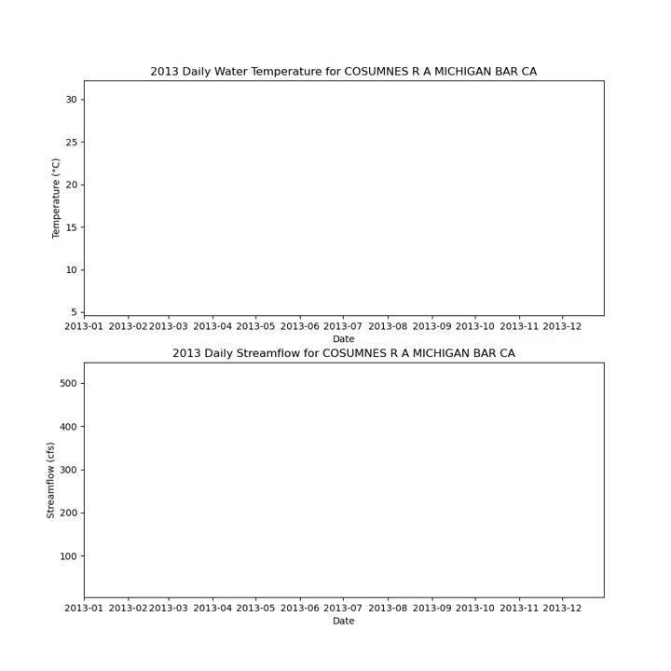
Animation and Plots
Findings:
In general, higher streamflow rates or discharge may be associated with low water temperatures during winter seasons, possibly due to increased precipitation. However, spring seasons may also contribute to increased stream flow due to snowmelt.
Stream flow may be expected to be low during summer seasons due to increased temperatures causing evaporation. However, there is not a direct relationship between streamflow and water temperatures because many other environmental effects, such as vegetation cover, infiltration, rainfall/precipitation patterns, and snowmelt, can influence this dynamic relationship.

Slide 4
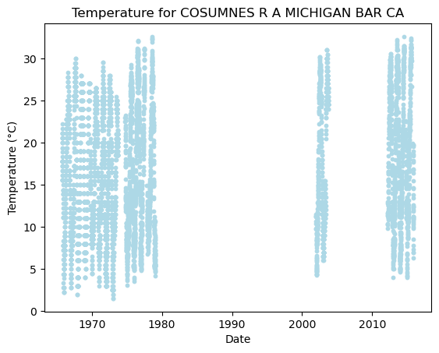
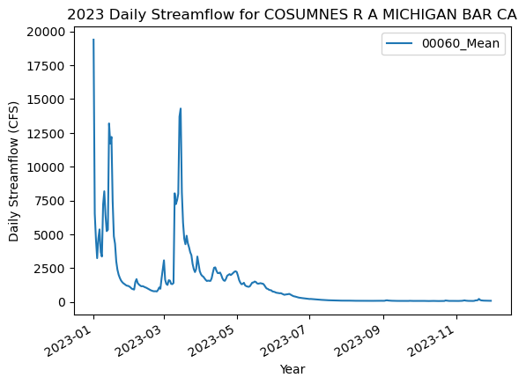
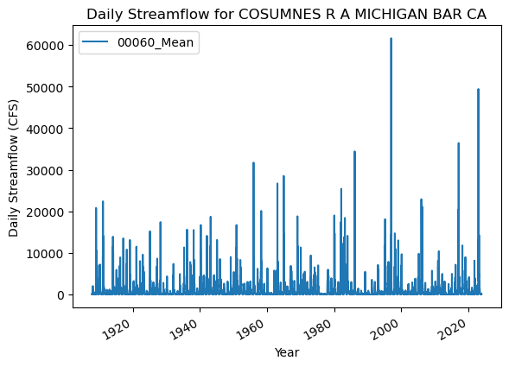
Interactive map/more plots

Slide 5
Work citation
Blodgett, David. “The Hydro Network-Linked Data Index.” Water Data For The Nation Blog, 20 Nov. 2020, waterdata.usgs.gov/blog/nldi-intro/.
“USGS 11335000 COSUMNES R A MICHIGAN BAR CA.” USGS 11335000 Cosumnes R A Michigan Bar Ca, waterdata.usgs.gov/nwis/inventory/?site_no=11335000&agency_cd=USGS. Accessed 28 Nov. 2023.
“Welcome.” Welcome - Dataretrieval 0.1.Dev1+g185ebe4 Documentation, doi-usgs.github.io/dataretrieval-python/index.html#. Accessed 28 Nov. 2023.

