Slide 1
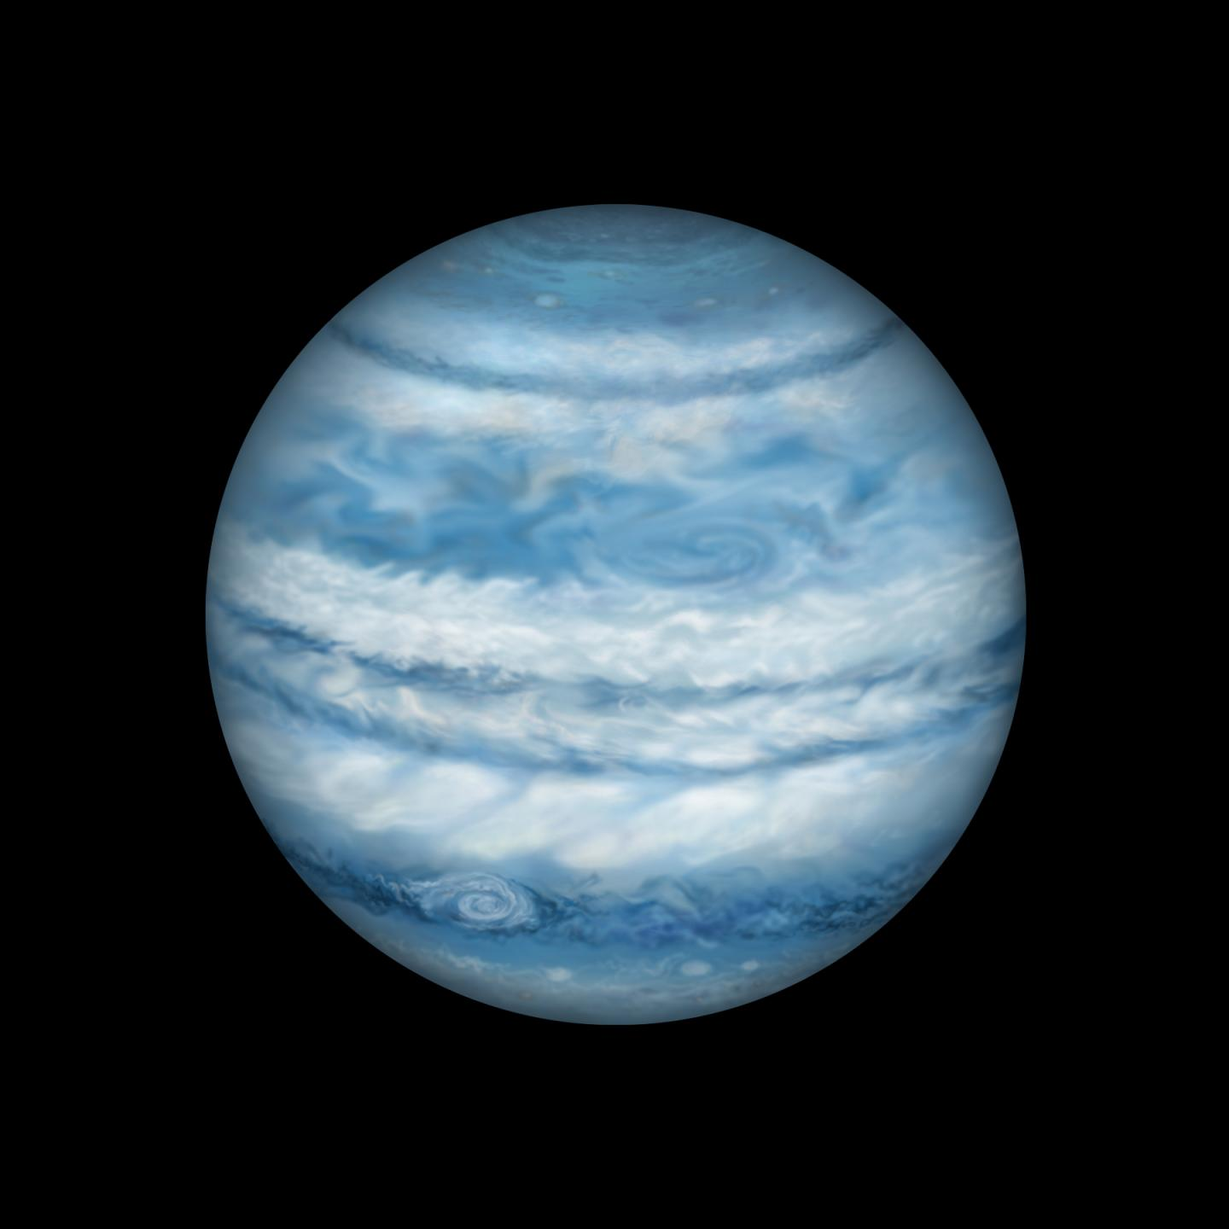
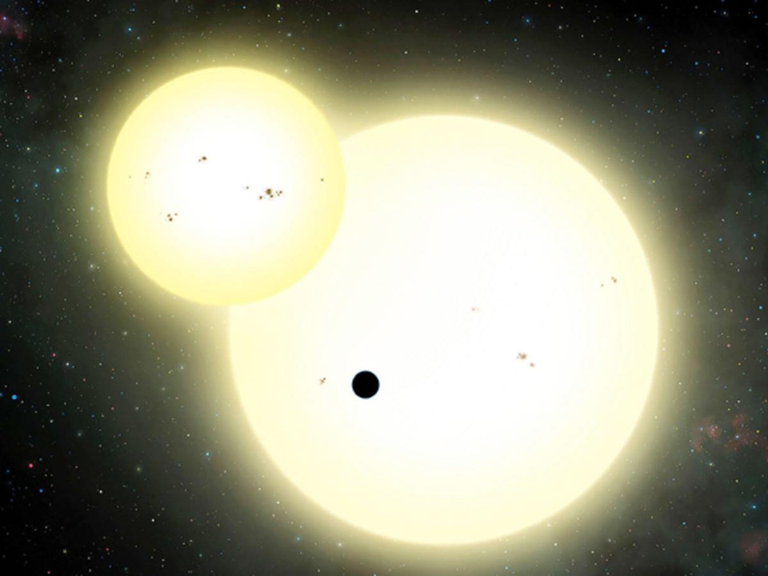
Examining Kepler 1647 Binary Orbit
Benjamin Aleman

Slide 2
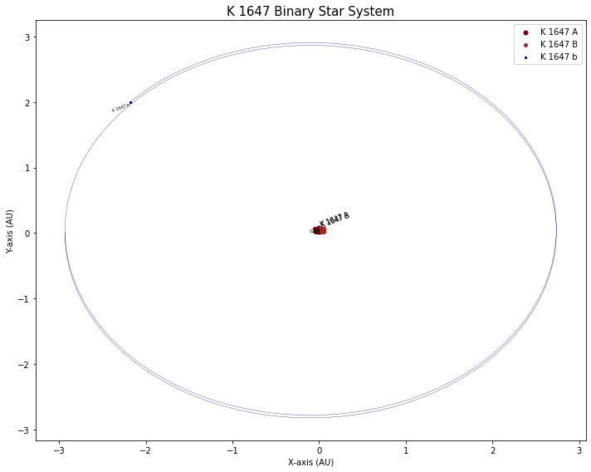
The Binary System
  Kepler 1647
  Eccentric Orbits
  False Candidate
  Test different semi-major axis
Methods
Object Oriented Programs
  Vectors
    Defines changeable x,y,z
  Bodies
    Parameters & Graph parameters
ODE and Variables
  Gravity Equation
  Integration and acceleration
  Observed and Calculated positions
    Applying acceleration to velocity
  Plotting and Animating the orbits

Slide 3
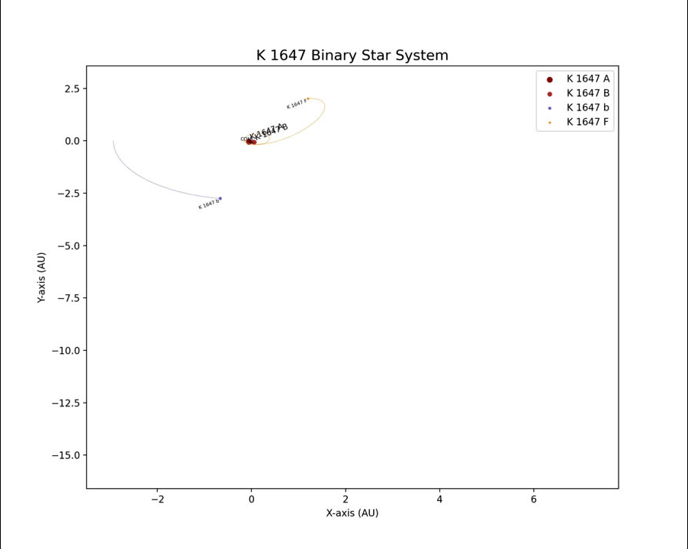
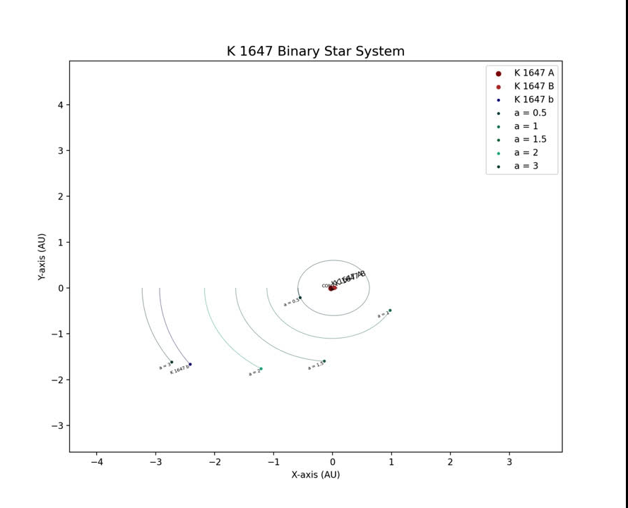
False Candidate Orbit
Test Exoplanet Orbits

