Slide 1
INDONESIA IS SINKING(?)
By Fayra Amarizkia

Slide 2
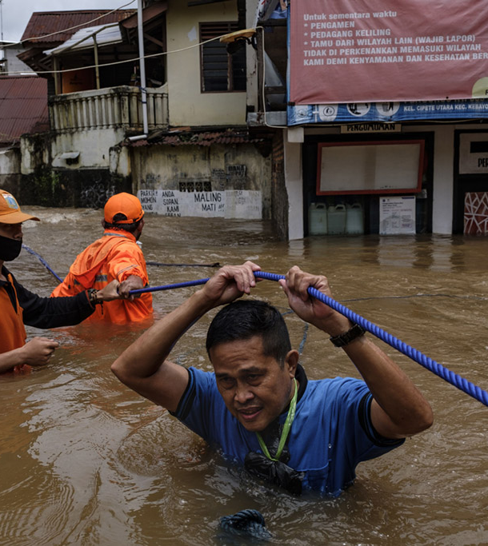
Jakarta is apparently sinking.
With more severe rainfall alongside with rising sea levels, flooding has been occurring more often.
The National Research and Innovation Agency (BRIN) explained the projected sinking of Jakarta in 2050.
Jakarta is one of the most vulnerable coastal city to climate change in Southeast Asia
As a metropolitan city, economic demands have made development very rampant
Over time, impacting the structure of land

Slide 3
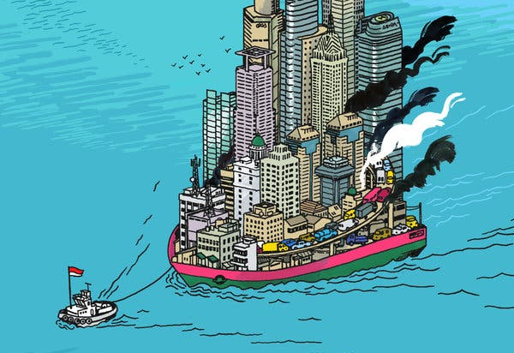
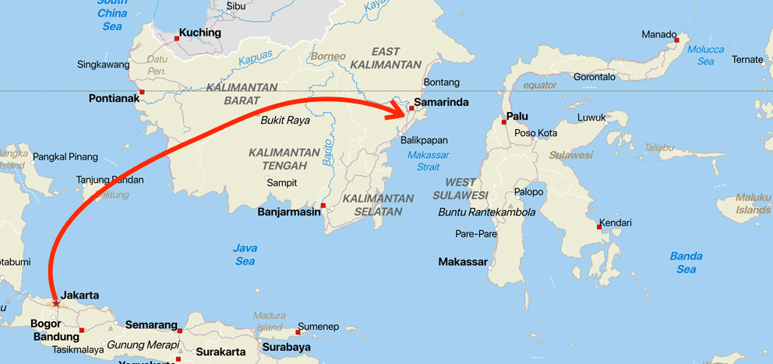
Moving its Capital City
From Jakarta to East Kalimantan Province, on the island of Borneo
Jakarta was built on a marsh located below sea level.
More prone to natural disasters such as earthquakes because the island Java lies on the Pacific Ring of Fire
The area is safer in terms of natural disaster

Slide 4
Method
Image Processing using PIL and Skimage packages
Resize, change color to greyscale and entropy for different elevation
LandscapeWithOcean.py code for simulating ‘erosion’ process of the land feature

