Slide 1
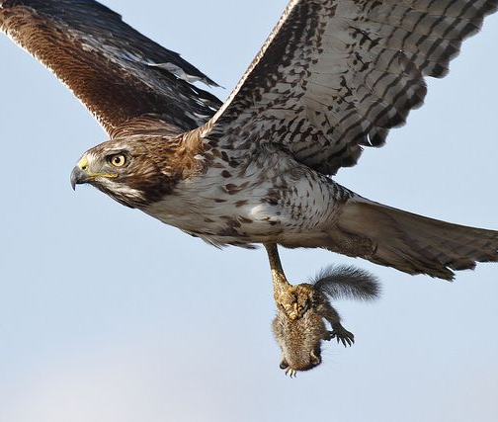
The Animal Hunger Games
By: Sohel Bagai
EPS 109

Slide 2
Topic and Method of Simulation
For my final project, I created a predator-prey simulation where two species of animals (hawks and squirrels) compete. The animals move around attempting to hunt and target prey or avoid predators. The larger animals will survive (or at least have a better chance of survival). In this case, the hawks have a better chance of survival for obvious reasons.
The method of simulation that I used is the random walk method of simulation. One way to conceptualize a random walk is as a process where a marker or token is moved randomly over a space. It is the process by which randomly-moving objects wander away from where they started. In the case of my final project, the animals are moving randomly throughout the environment.

Slide 3
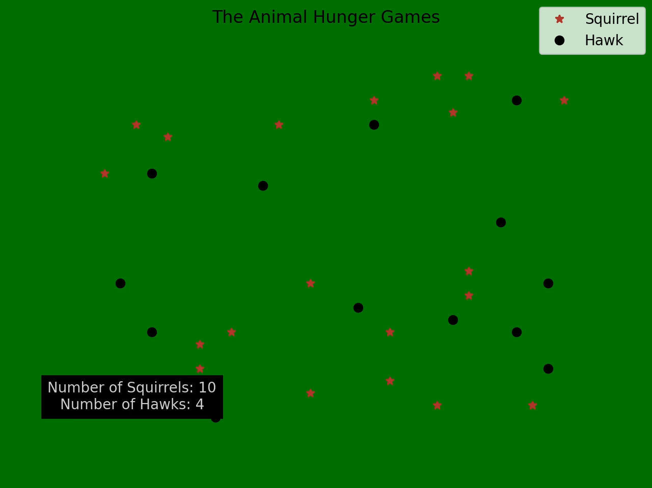
Animation

