Slide 1
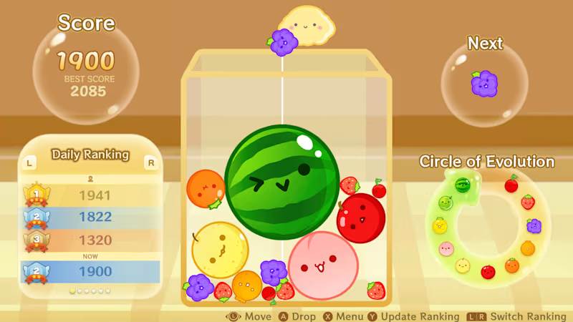
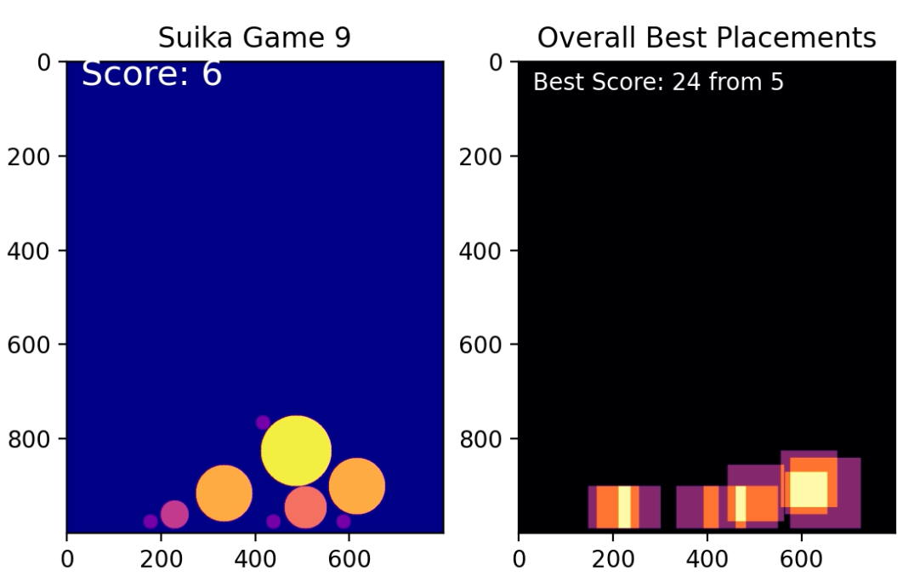
Suika Game: Monte Carlo
Presented by: Eugene Chao, Fall 2023

Slide 2
How it works
Goal: Determine the most optimal initial fruit placement strategy for the game Suika (similar to Tetris)
Monte Carlo: Given random x positions and direction shifts, simulate fruit placements that reveal patterns yielding the highest scores.
Demonstrate the distribution of more placements leading to higher score and reveal the best game # along with its score.
Notes:
Created a simulation model that is used to predict the probability of receiving a high score when the potential for random variables (x position & direction the ball will roll based on impact) is present (not totally RNG for roll but for this simulation it is)
Used purely random x positions on each fruit drop and processed 10,000 simulations.
Created an animation to show the game’s progression as well as an animation that shows the scores piling up based on the positions where the fruits were combined.

Slide 3
Animation

