Slide 1
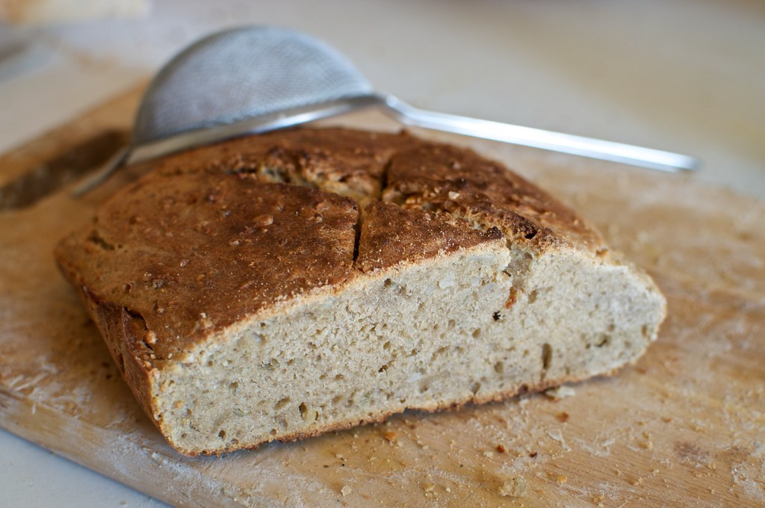
Bread Rising
Zoe Chyatte
"Bread #2" by Damien Pollet is licensed under CC BY-SA 2.0.

Slide 2
Topic and Methods
Background
Simulation Methods
If dough is left alone after the ingredients are combined, it will expand
Expansion due to CO2 bubbles from yeast output or manual kneading
Growth increases at a decreasing rate
Dough becomes curved for efficiency – least surface area for most volume
Randomness (including random walks)
PDE
Sources
Carol, Boynton. “The Chemistry of Baking Bread.” Yale National Initiative, Yale University, https://teachers.yale.edu/curriculum/viewer/initiative_17.04.02_u. Accessed 28 Nov. 2023.
Romano, A., et al. “Description of Leavening of Bread Dough with Mathematical Modelling.” Journal of Food Engineering, vol. 83, no. 2, Nov. 2007, pp. 142–48. ScienceDirect, https://doi.org/10.1016/j.jfoodeng.2007.02.014.
Turbin-Orger, A., et al. “Kinetics of Bubble Growth in Wheat Flour Dough during Proofing Studied by Computed X-Ray Micro-Tomography.” Journal of Cereal Science, vol. 56, no. 3, Nov. 2012, pp. 676–83. ScienceDirect, https://doi.org/10.1016/j.jcs.2012.08.008.

Slide 3
Animation – Bubbles in Bread

