Slide 1
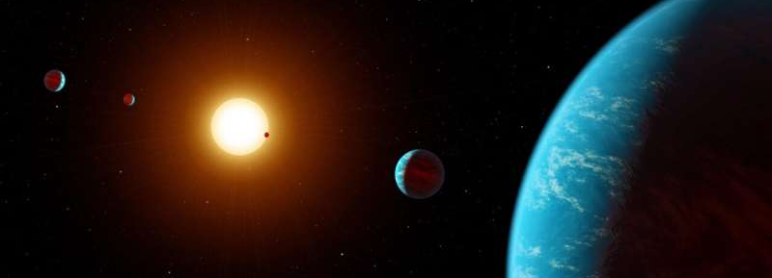
Interactive 3D simulation of exoplanet system HD 23472
Artist’s rendition of a 5 exoplanet system
Hope Diffenderfer

Slide 2
How and why did I do this?
HD 23472:
Methods:
An exoplanet system with 3 “super-Earths” and two “super-Mercuries”
Very rare, only 8 known “super-Mercuries”
Discovered using transit method
Observing light curves of stars to find exoplanets
Wanted to create an interactive simulation to observe the orbital paths of the planets
Gathered data from NASA Exoplanet Archive
Mass, semi-major axes, etc
Calculated aphelion position and velocity
Set initial conditions and wrote a loop to update position and velocity values to generate orbits
Plotted in 3D using Matplotlib
Based on my own previous orbital simulation project from last year
Notes:
Only 8 known super mercuries

Slide 3
Previous project:

Slide 4
Modified previous project:

Slide 5
Final product:

