Slide 1
Fractals in the Sky!
Mallory Helfenbein

Slide 2
Topic: Showing the fractal nature of clouds. Animation displays an image of a “cloud” in the sky and zooms into the cloud structure to show the Julia Set represents a cloud. Then the following animation displays the zooming in of the complex pattern displayed within the cloud.
Methods: Using Julia Set iterations to animate the interior fractal structure of clouds.
z_{n+1} = z_{n}⁴ + 0.05 + 0.9i

Slide 3
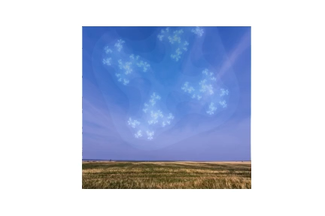

Slide 4
