Slide 1
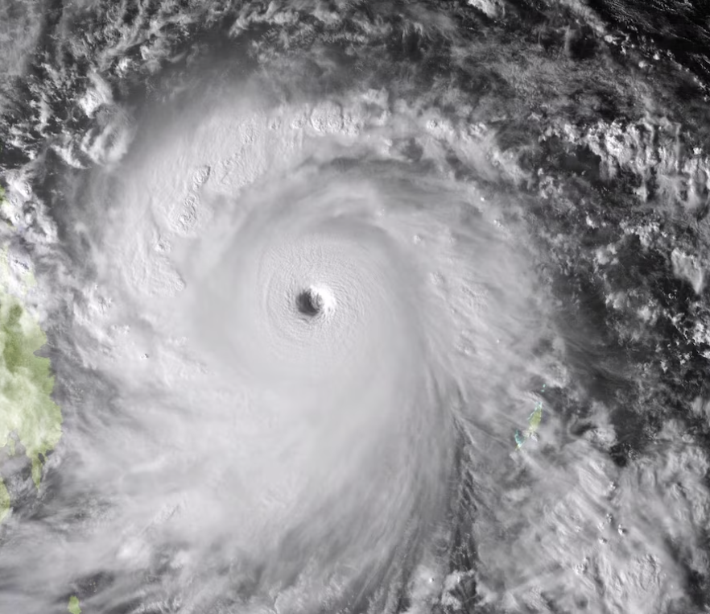
Elementary Dynamical Simulation of Hurricane Winds using Rankine Vortex
By Rohin Juneja

Slide 2
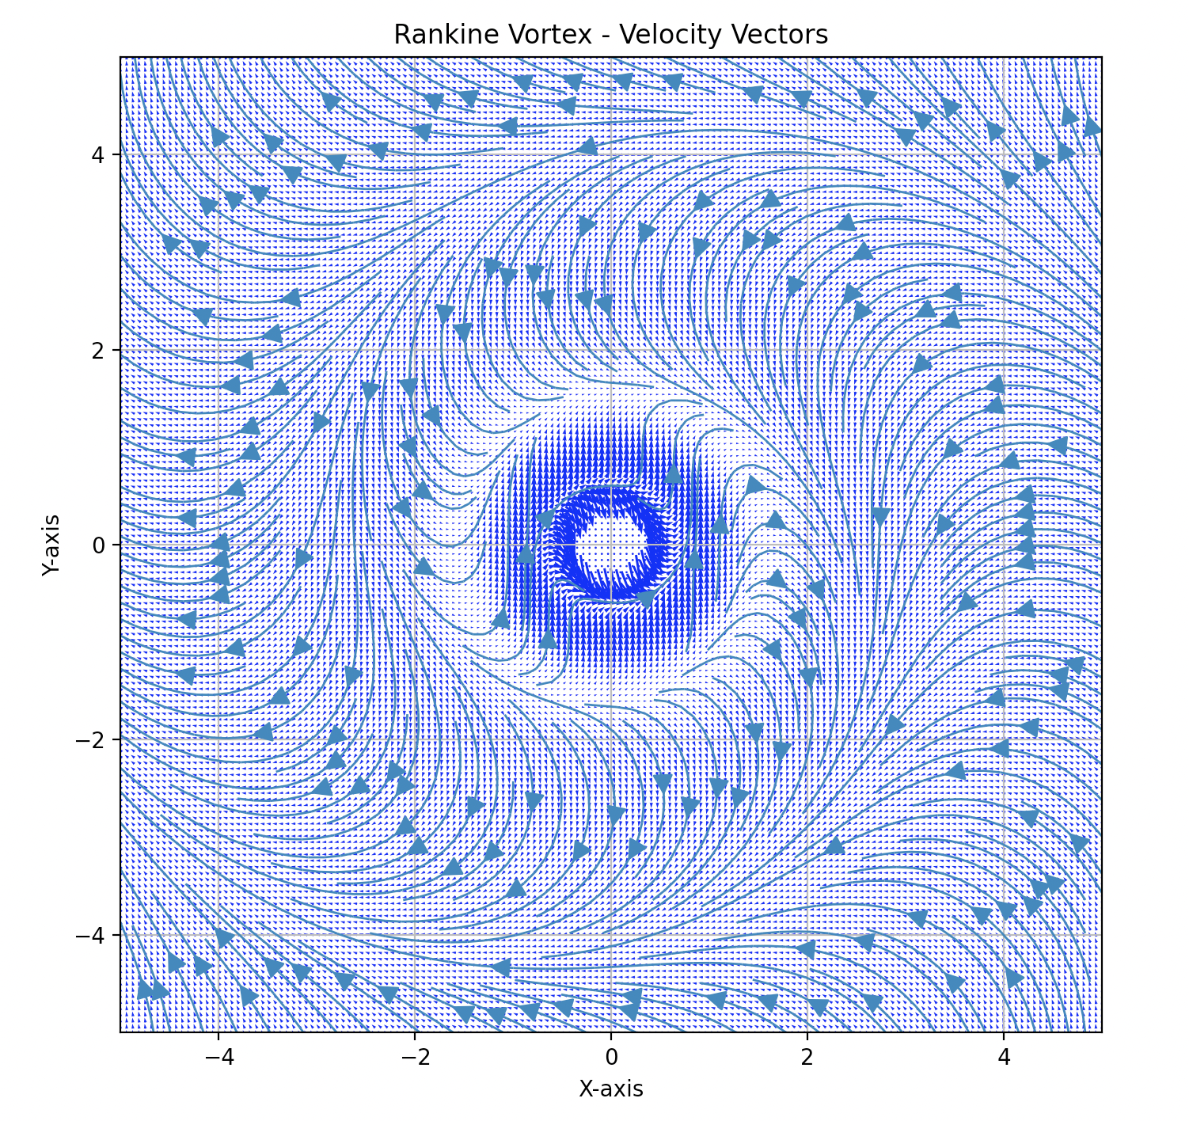
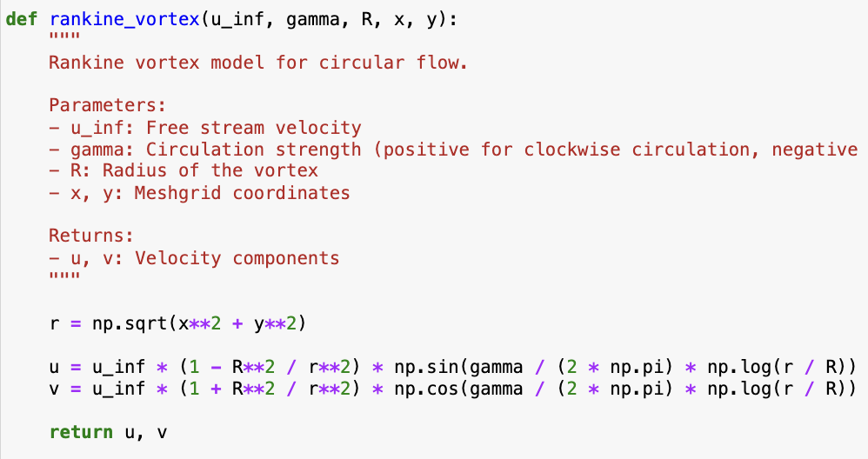
What is a Rankine Vortex?
Simple model of rotational fluid flow is a surprisingly accurate for intense wind vortices
Named for the Scottish engineer William John Rankine, the Rankine vortex is characterized by a central core where the fluid velocity is constant and equal to the vortex's maximum velocity. Outside the core, the velocity decreases radially until it becomes zero at a certain distance from the center.
This Rankine vortex function gives a velocity vector at a given radius r from the center of the vortex. Below, ‘a’ refers to the radius of the vortex-core (see image on bottom-right), ‘r’ is the distance from the center, and Gamma is the circulation strength.
Why is this vortex a good representation of hurricane winds?
“The use of such a simple approach is made possible by the remarkable consistency and relative uniformity of hurricane circulations, and indeed those of all intense vortices.” (Holland et al., 2010)

Slide 3
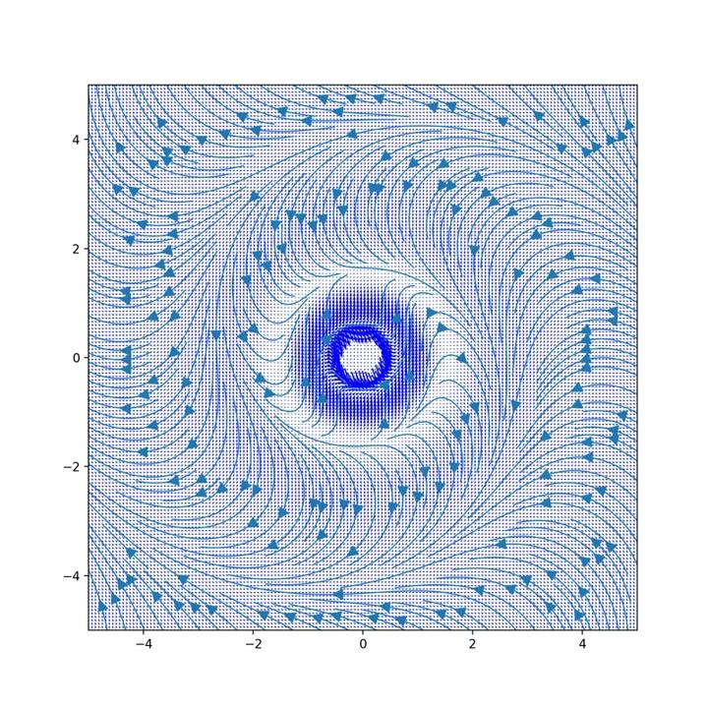
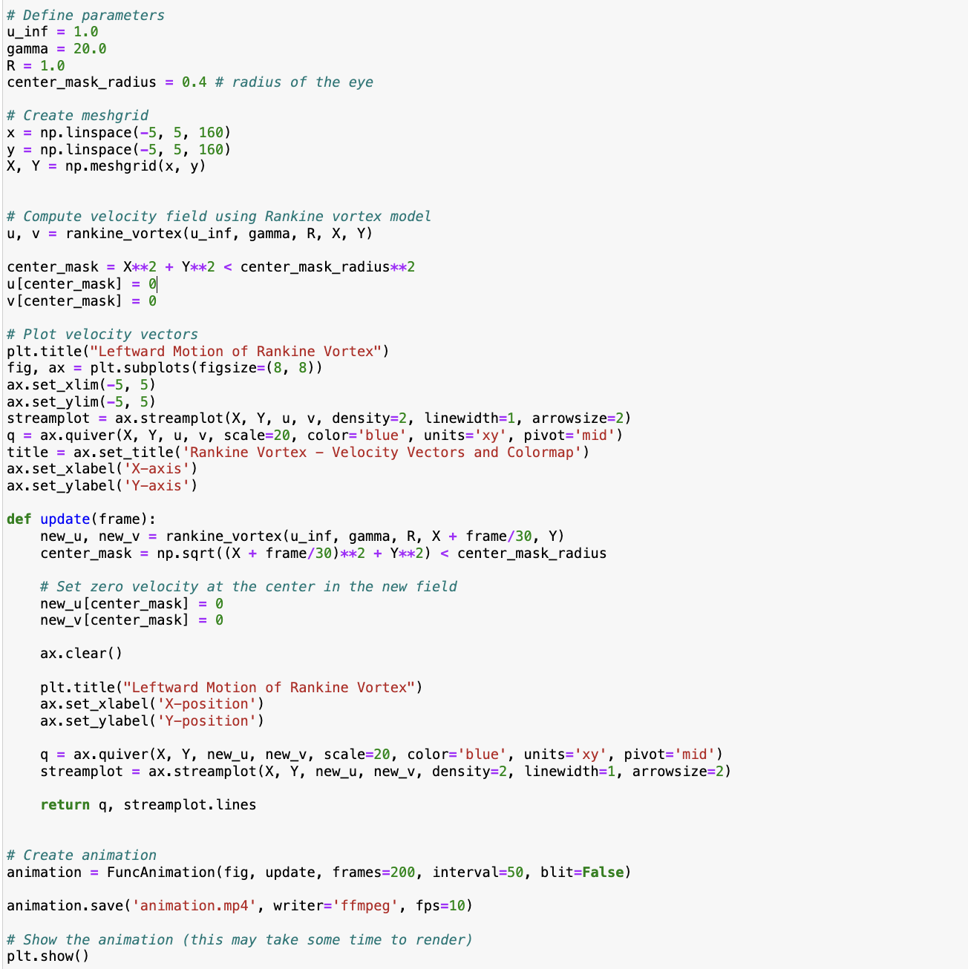
Animation
Selected animation follows direct leftward path. Motion of eye can be modeled via random walks as well

Slide 4
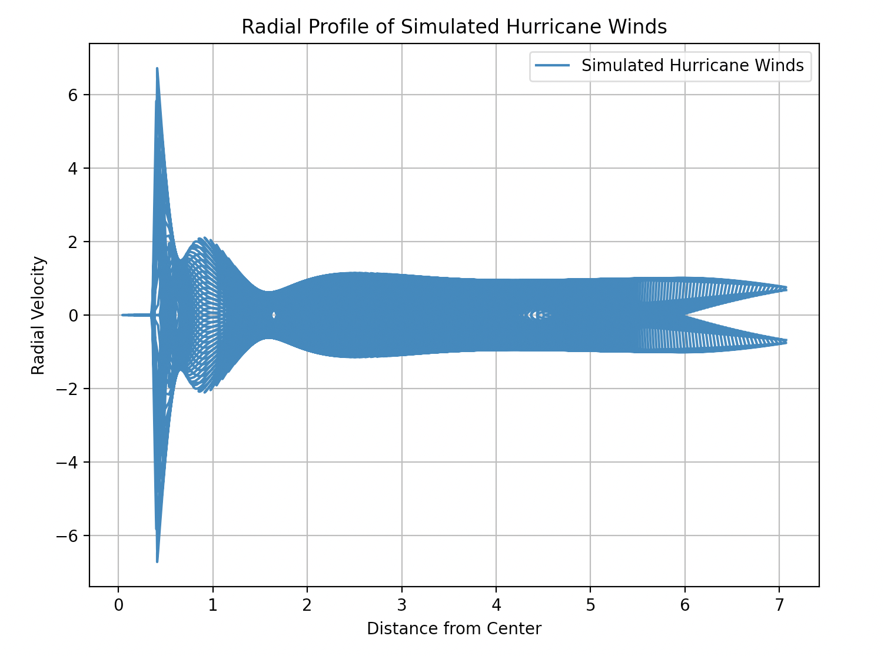
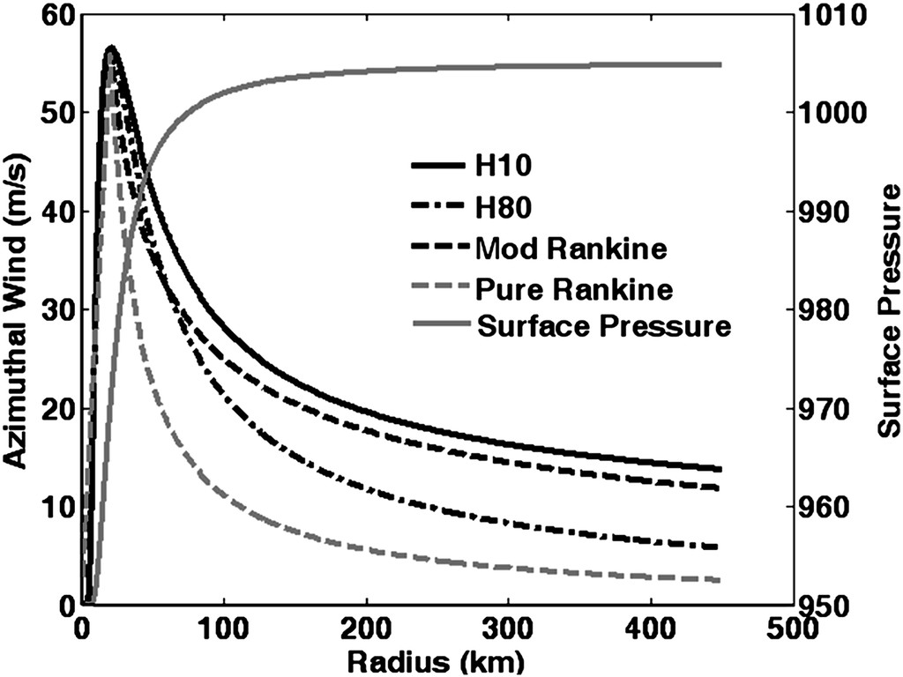
Verification
Ensuring accuracy of generated simulation by comparison to findings in relevant literature
What can explain the difference between these two curves? 1) Parameter selections for circulation strength and 2) my addition of an “eye” at center of vortex
Figure from Holland et al. (2010)

Slide 5
References
Thank you for listening!
Holland, G. J., J. I. Belanger, and A. Fritz, 2010: A Revised Model for Radial Profiles of Hurricane Winds. Mon. Wea. Rev., 138, 4393–4401, https://doi.org/10.1175/2010MWR3317.1.
Dario Giaiotti and Fulvio Stel: The Rankine Vortex Model. Regional Meteorological Observatory, via Oberdan, 16/A I-33040 Visco (UD), ITALY (4 October 2006)
Maciej Dutkiewicz 2019 IOP Conf. Ser.: Models of strong wind acting on buildings and infrastructure. Mater. Sci. Eng. 471 052030

