Slide 1
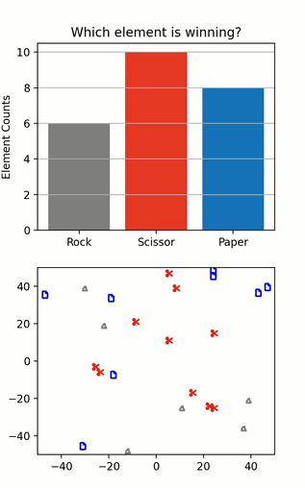
Rock Scissor Paper SPOCK!
ChangWook (CW) Jung

Slide 2
Simulation Description
Method used: Random walks
Description: Simulate a mindless way to kill time using random walks and the age-old rock-paper-scissor game

