Slide 1
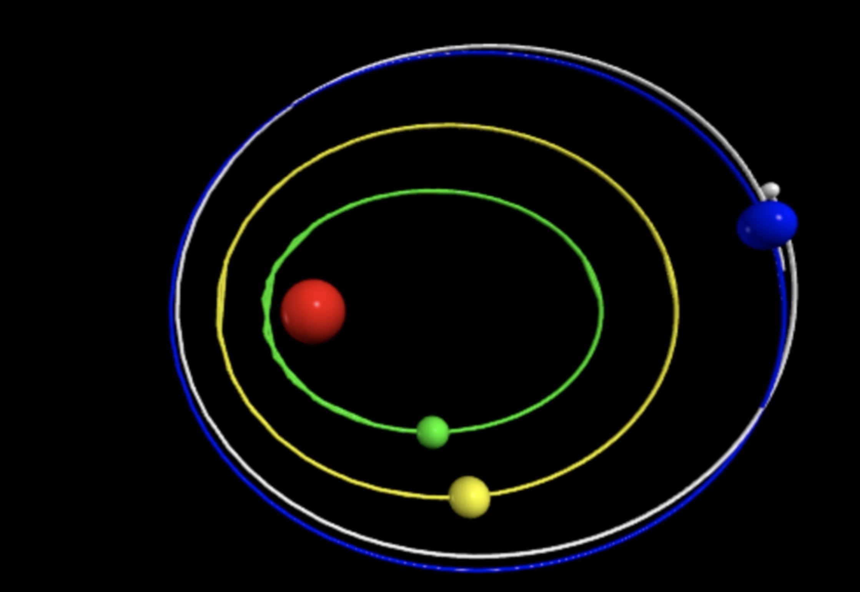
Simulating the Orbit of AN Exo-moon Around Kepler-10d
Derek Kaplan

Slide 2
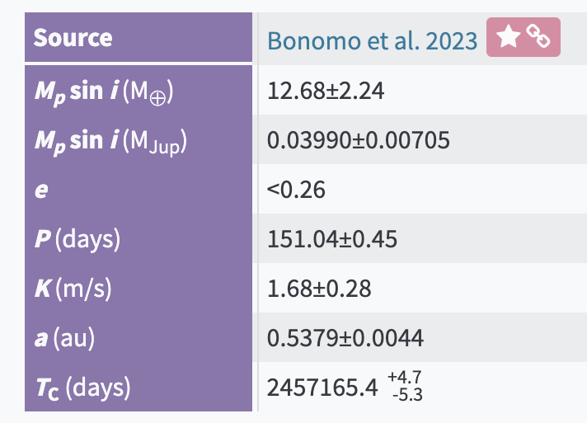
Methods
Helped discover Kepler-10 d in 2018
I used the Nasa Exoplanet Archive for the majority of system characteristics
There is no yet confirmed radius for Kepler-10 d, so I estimated R$∝M^{0.55}$ (Bashi et al. 2017) for lower mass planets
Tinkered with the potential exo-moon’s mass and velocity to see what characteristics the moon could have and where orbits were stable

Slide 3
Normal Orbit
Notes:
Using our Moon’s mass, orbital tilt from planet of 5 degrees (same as the Moon’s) and Kepler-10 system initial conditions

Slide 4
Small Mass Limit ~${7∗10}^{9}$ kg
Notes:
Smallest moon we know of is Deimos at about 10^15 kg

Slide 5
Large mass Limit ~${3∗10}^{26}$kg
Notes:
Largest moon we know of is Ganymede at about 10^23

Slide 6
Small velocity limit ~7.75 km/s
Notes:
Moon orbits at about 1 km/s around the Earth and Earth orbits at about 30 km/s around the Sun

Slide 7
Large Velocity Limit ~54.2 km/s

Slide 8
References
Bashi, D., Helled, R., Zucker, S., & Mordasini, C. (2017). Two empirical regimes of the planetary mass-radius relation. arXiv preprint arXiv:1701.07654.
Nasa Exoplanet Archive
Pisgah Astronomical Research Institute

