Slide 1
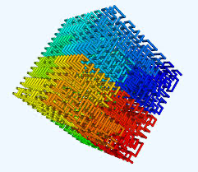
Exploring Hilbert Curves
Melanie McKune

Slide 2
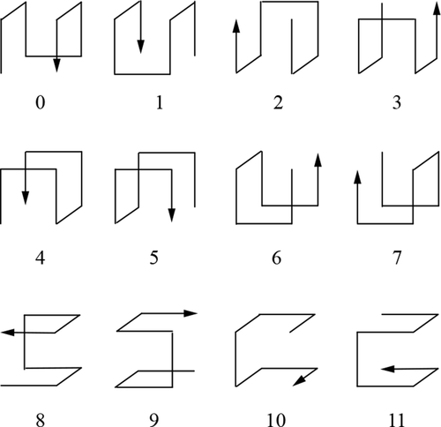
Hilbert Curves
A space-filling curve that passes through every point in a grid exactly once
Created by German mathematician David Hilbert in 1891
Properties
As the order increases, the curve covers more points in the same space
Recursive: larger parts are comprised of small copies of the curve
Locality: points that are close to each other in the curve are close in space
Recursively dividing a square into four smaller squares and connecting them in a specific order
The example to the left are the 12 states of a 3D Hilbert Curve of order 1

Slide 3
2D Hilbert Curve Order 2

Slide 4
2D Hilbert Curve Order 3

Slide 5
2D Hilbert Curve Order 3 with Colors

Slide 6
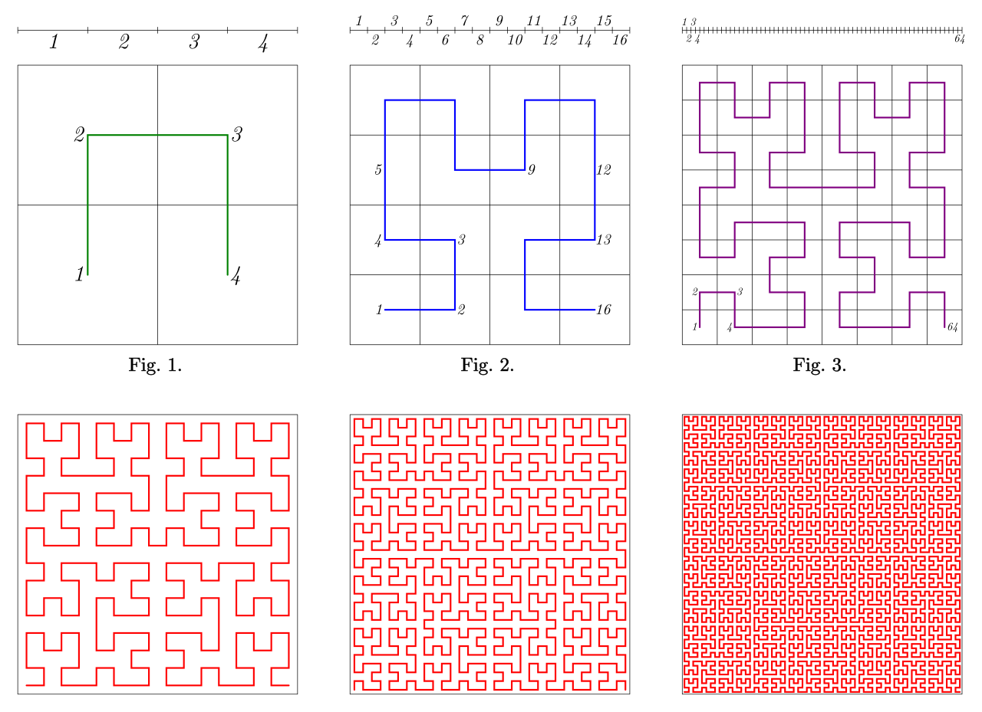
Examples of Plots with Higher Orders
Image from:
http://datagenetics.com/blog/march22013/index.html

Slide 7
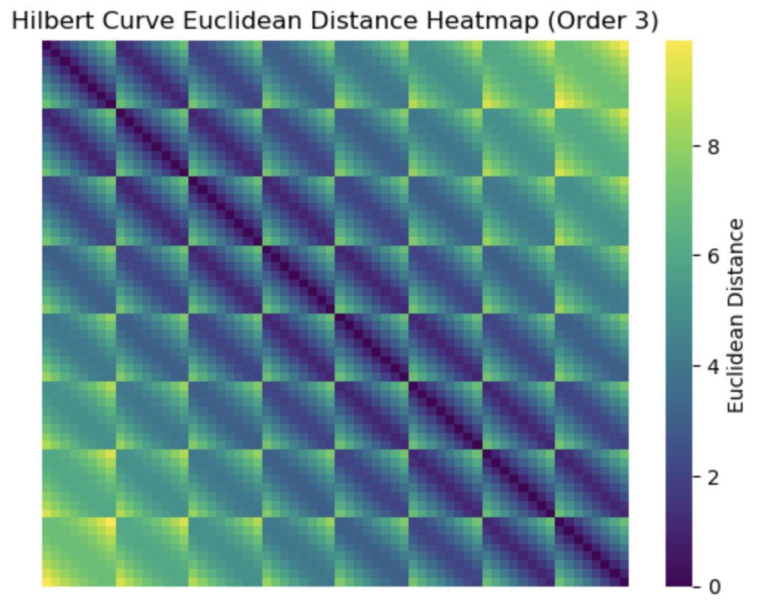
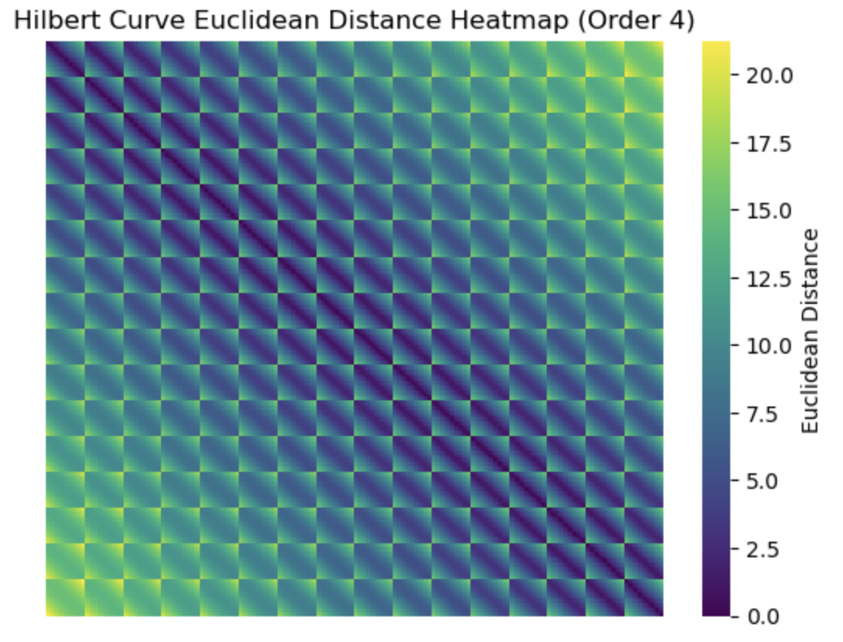
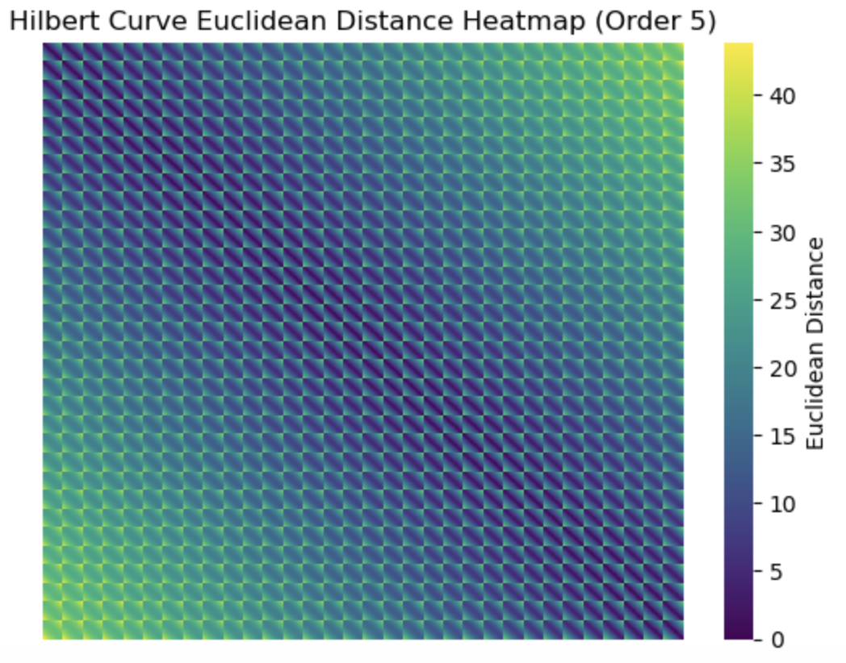
Locality
A property of Hilbert Curve is the ability to fold a one-dimensional axis into a two-dimensional space while preserving the locality of data points
Visualizing the pairwise distance between points in the 2D space as a heatmap

Slide 8
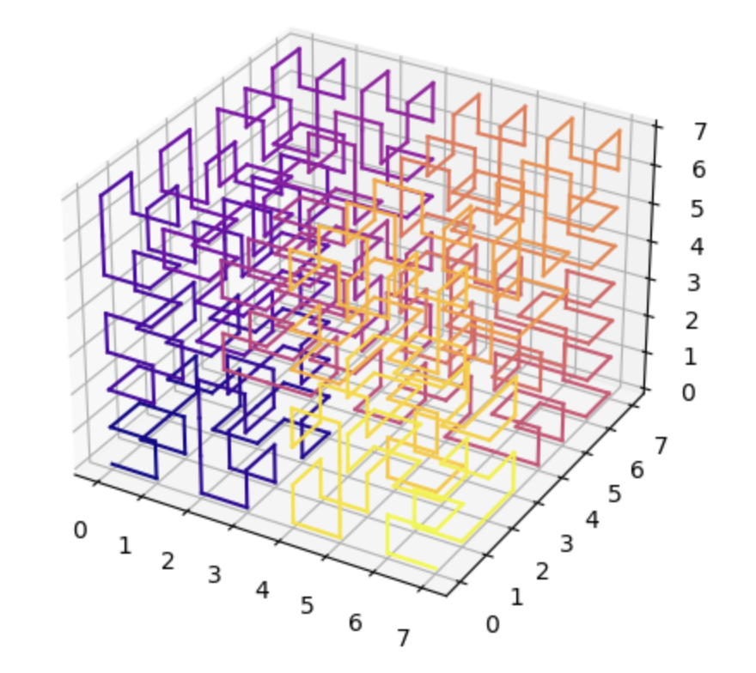
3D Hilbert Curve Animation
I used the python package Hilbert Curve to generate this animation.

