Slide 1
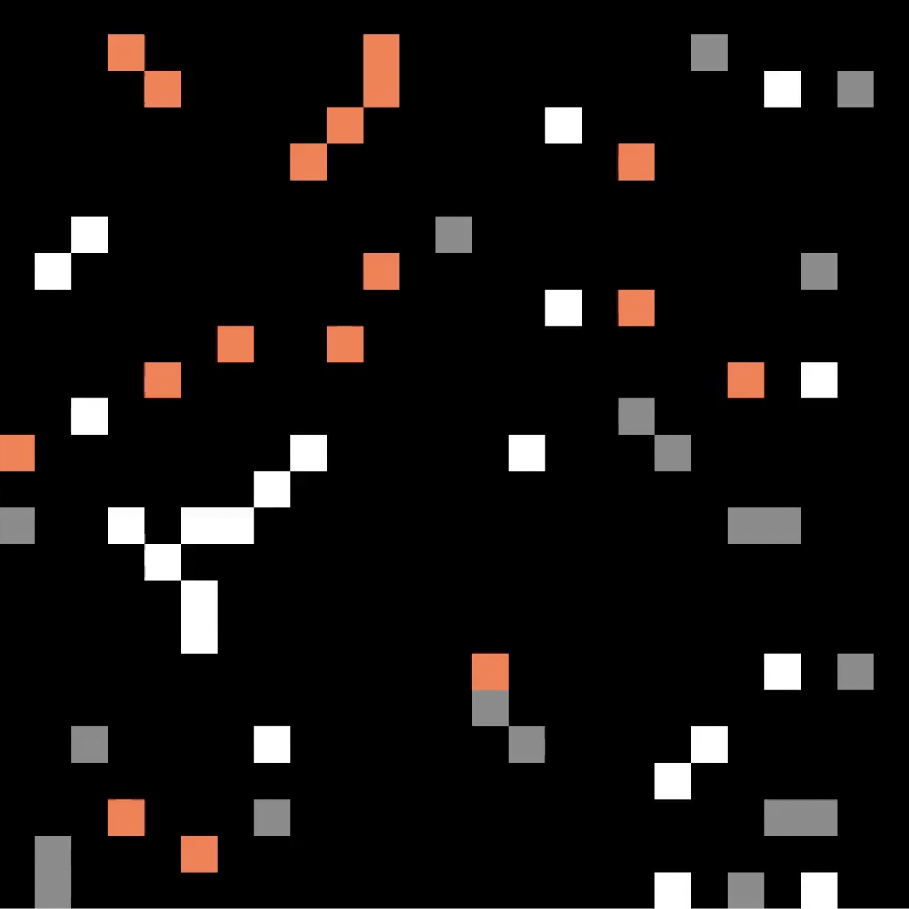
Survival of
The Fittest
Sarah Pedrami

Slide 2
TOPIC + METHODS
Simulate the game “Rock Paper Scissors” using random walks
Randomly place 60 pixels (20 of each object type) in a 25x25 pixel box
During each iteration first randomly move each pixel left, right, up or down
Then check the pixel’s neighbors to determine their object type, update as “captures” occur
Repeat until there is a winner
🪨
📄
✂️

Slide 3
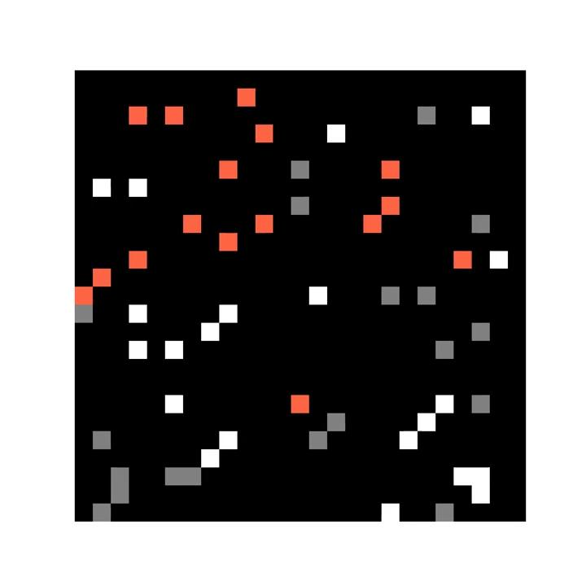
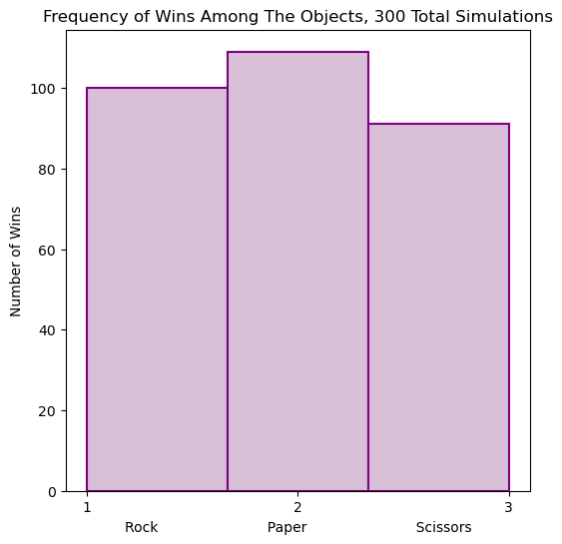
ANIMATION + RESULTS

