Slide 1
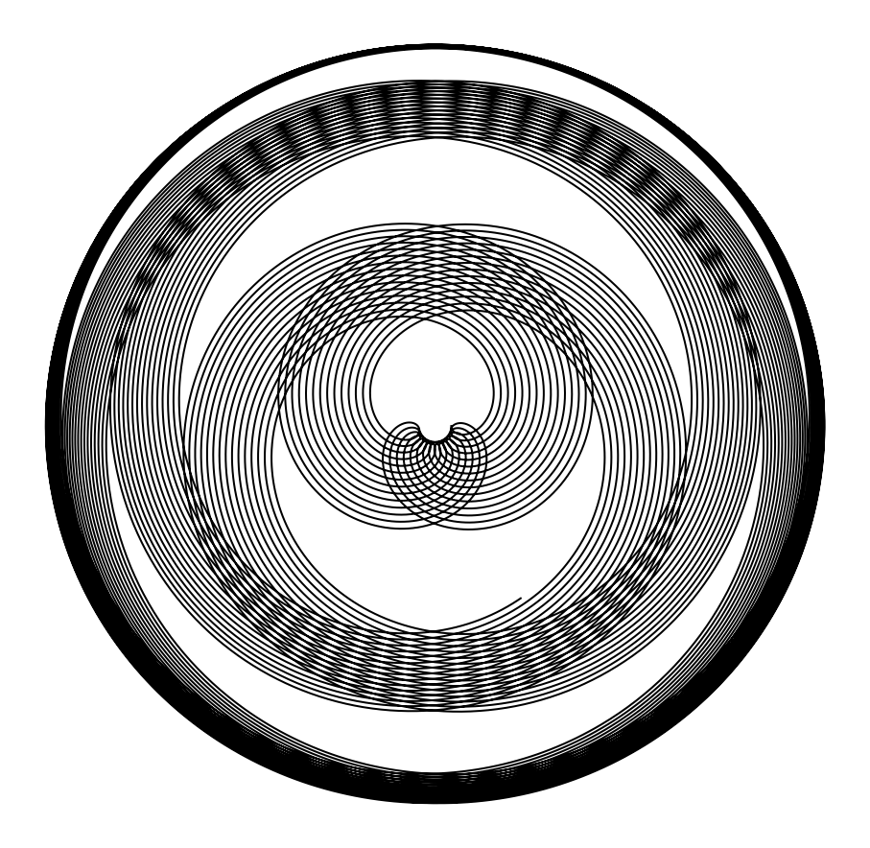
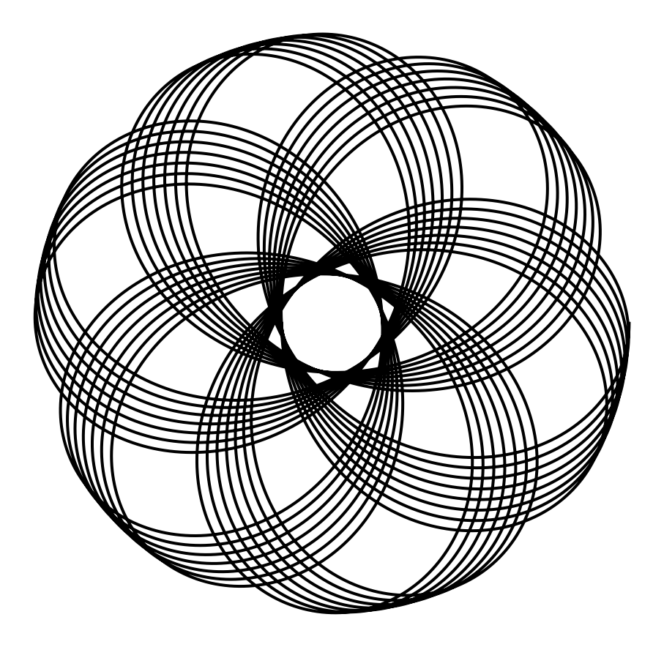
Spirographs with Python
Mia Szerdi

Slide 2
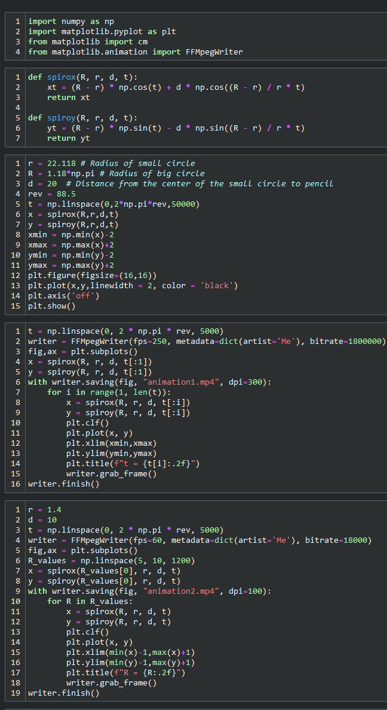
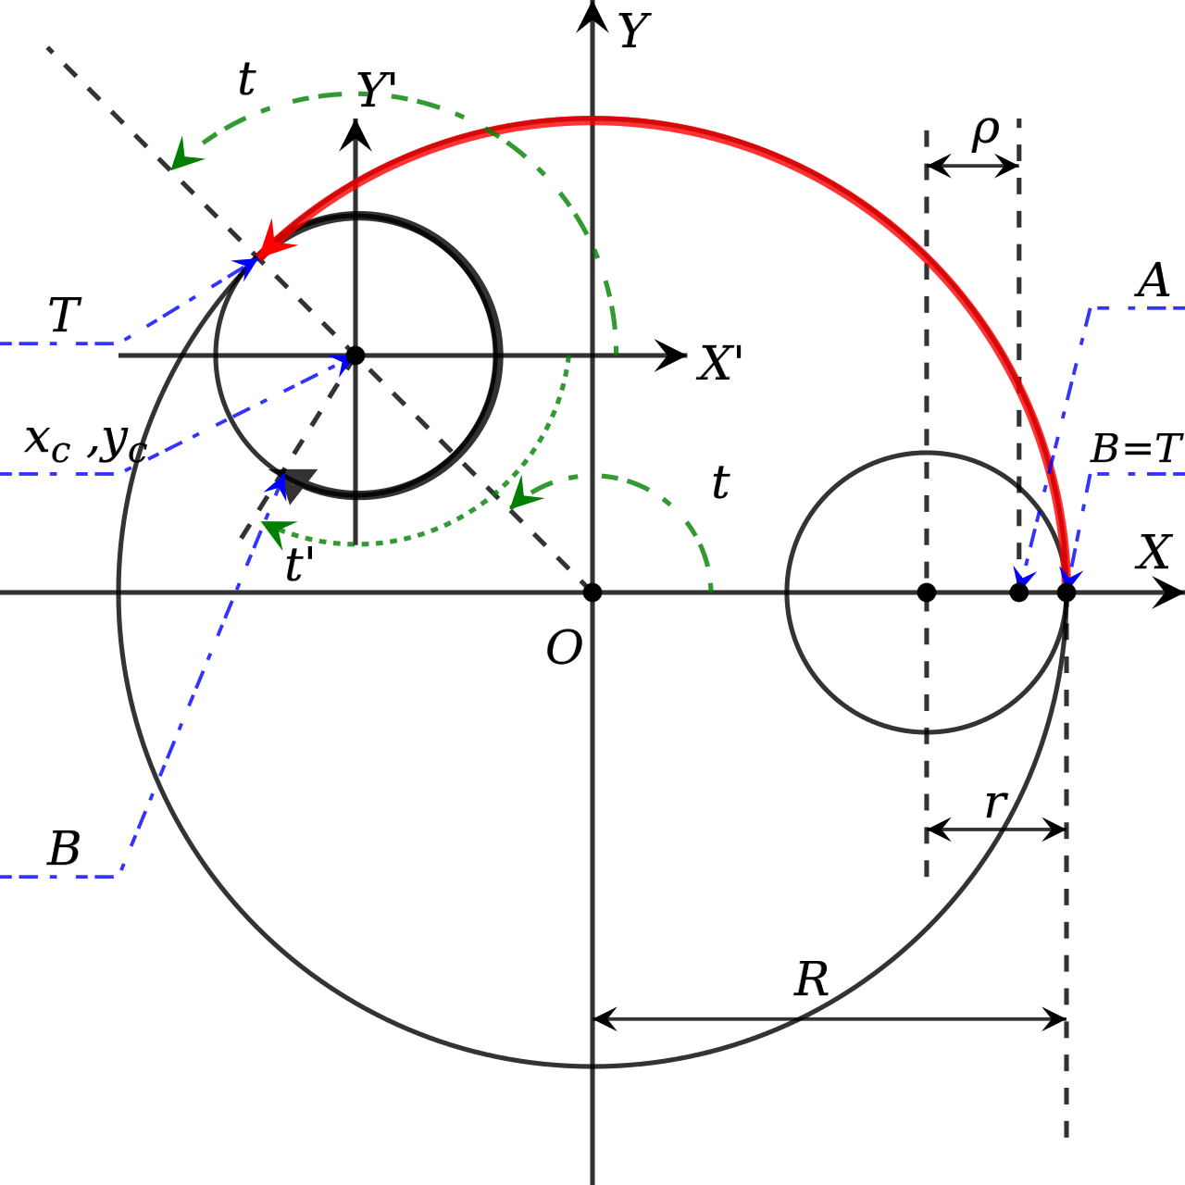
How it works:
Lots of number crunching and plotting.
To animate drawing, set up a loop and iterate through t.
For the rest of the animations, calculate the entire spirograph at once and iterate through a list of initial conditions: r, R, and d.
Diagram for spirograph trajectory equation derivation to the right, code sample further right.
Image courtesy of Wikipedia: https://en.wikipedia.org/wiki/Spirograph#/media/File:Resonance_Cascade.svg

Slide 3
