Slide 1
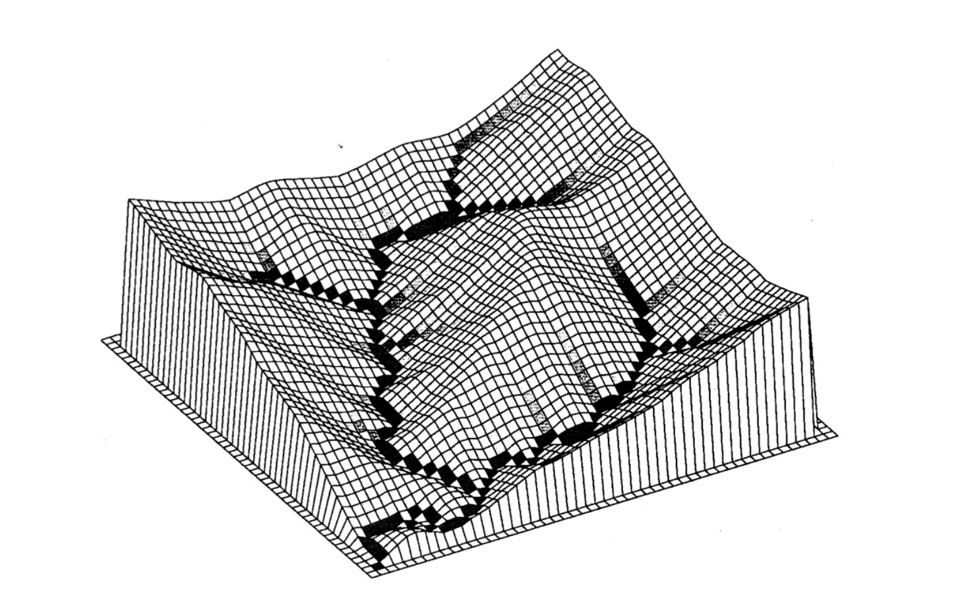
3D Simulation of Topographic of erosion in California
Tang,ZiKang 3039758217
$$\frac{δz}{δt}=\frac{ρ_{rock}}{ρ_{soil}}U − \overset{⃑}{∇ }∗ \overset{⃑}{q_{s}} \frac{δz}{δt}=D∇^{2}z −K\left(A^{m}{\left|∇z\right|}^{n}−θ_{c}\right)+E$$

Slide 2
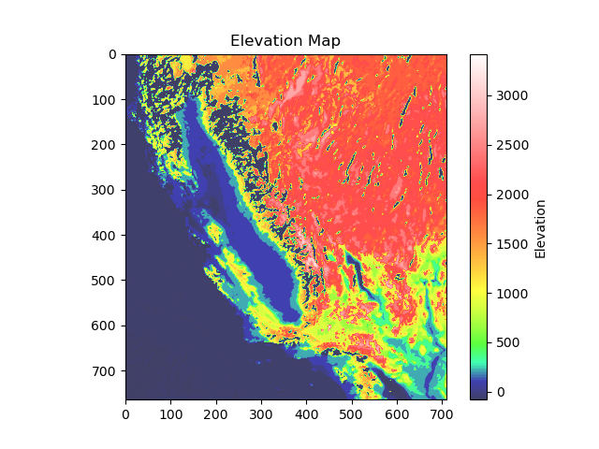
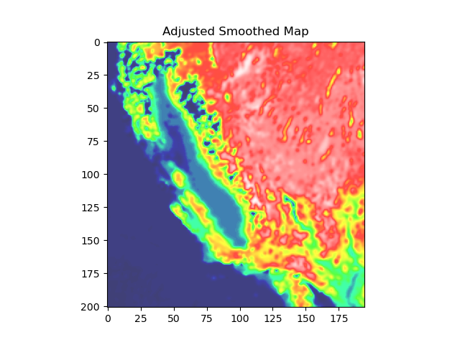
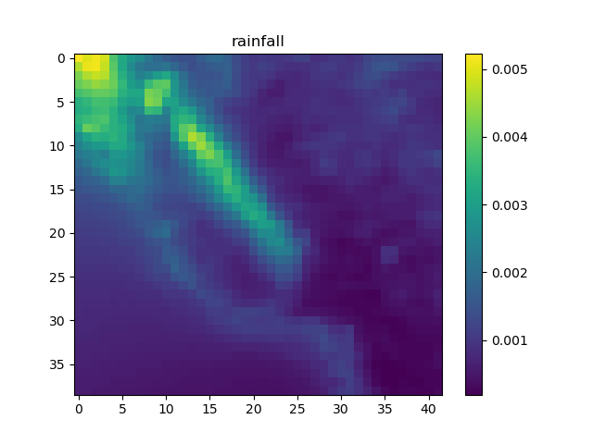
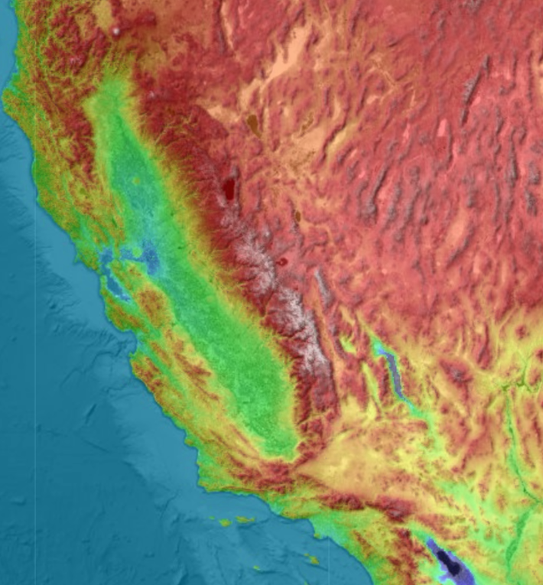
Step1 Get the landscape of California (topographic map) from topographic-map.com
Step2 Convert the .png image to a numpy array according the given colorbar.
Step3 Resampling: Use methods like bicubic interpolation to adjust the original array from 761×730 to 200×200. Smoothing: apply a low-pass filter (Gaussian filter), to reduce the high-frequency details
Step4 Get the rainfall data from
ERA5 monthly averaged data on single levels from 1940 to present(DOI: 10.24381/cds.f17050d7)
Then to calculate the monthly average of precipitation, we assume that precipitation is proportional to erodibility coefficient, to decide the value of K.
The mean rainfall is 0.00118 kg/m^2 /month
Step5 Use ODE and iteration to calculate the topographic erosion in California

