Slide 1
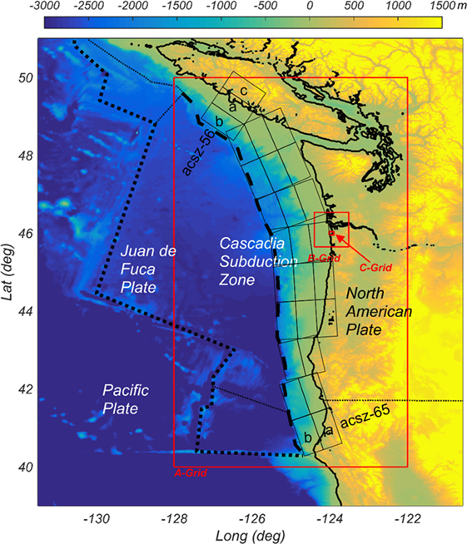
Simulation of Earthquakes Near the Cascadian Subduction Zone
Marcella Welter

Slide 2
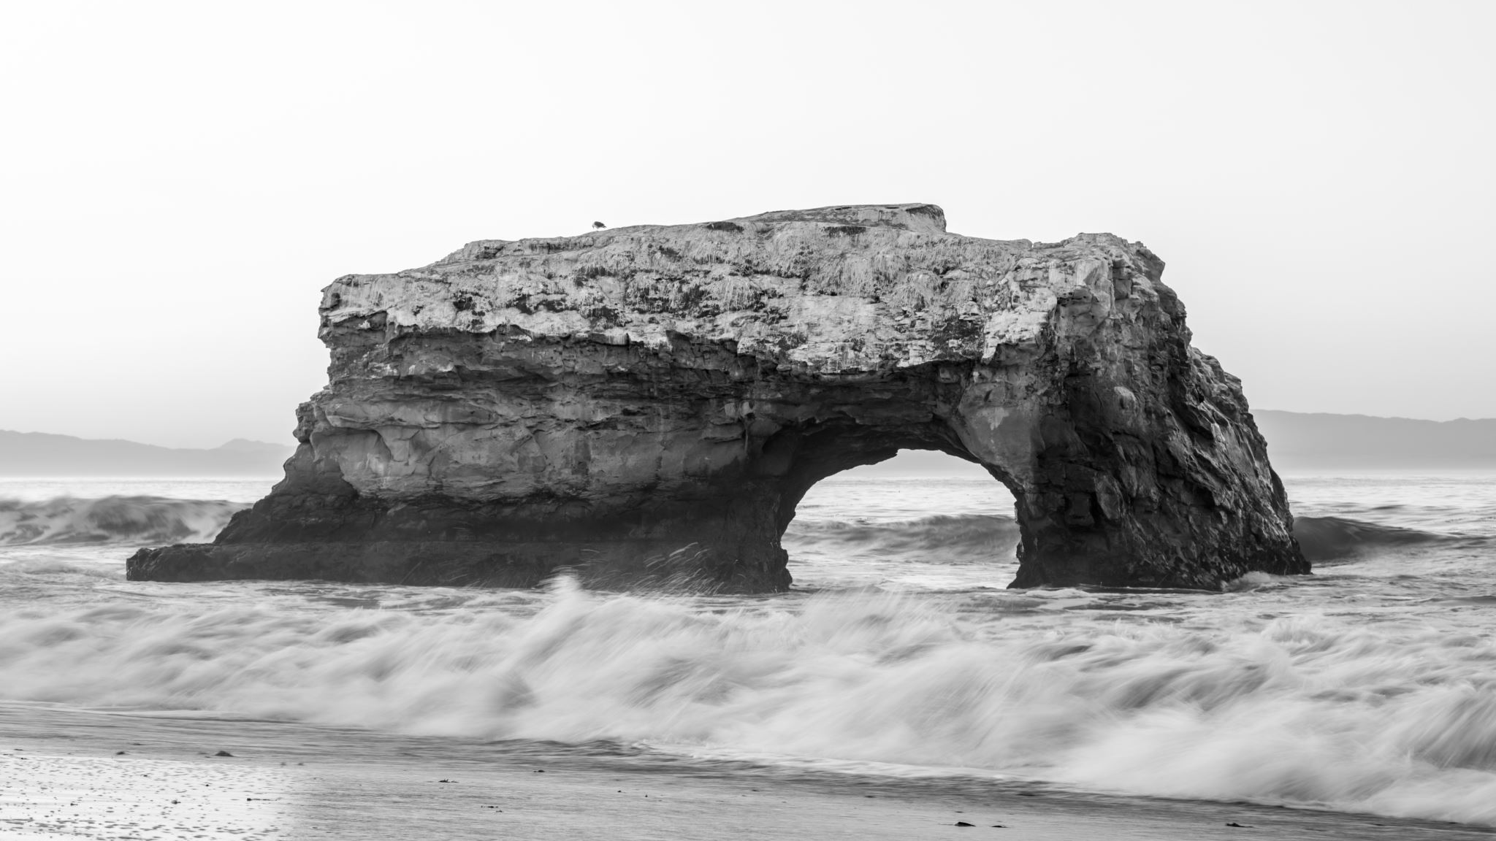
Cascadian Subduction Zone
A convergent plate boundary with the Juan de Fuca plate subducting under the North American plate, located off the Oregon coast. A hotspot for deep earthquakes and has potential to have 9.0+ earthquake.
Methods:
Downloaded catalog of past earthquakes (1970 – 2023), including coordinates, time, and magnitude
Plotted earthquakes for each year in separate frames within subduction zone (used Google Maps to find approximate coordinates, created functions to get catalog for each year, and create each frame)
Used ffmpeg to collect all the frames and create animation

Slide 3
Final Animation

